Slide 1
STK-4051/9051 Computational Statistics Spring 2024
IRLS and ADMM
Instructor: Odd Kolbjørnsen, oddkol@math.uio.no

Slide 2

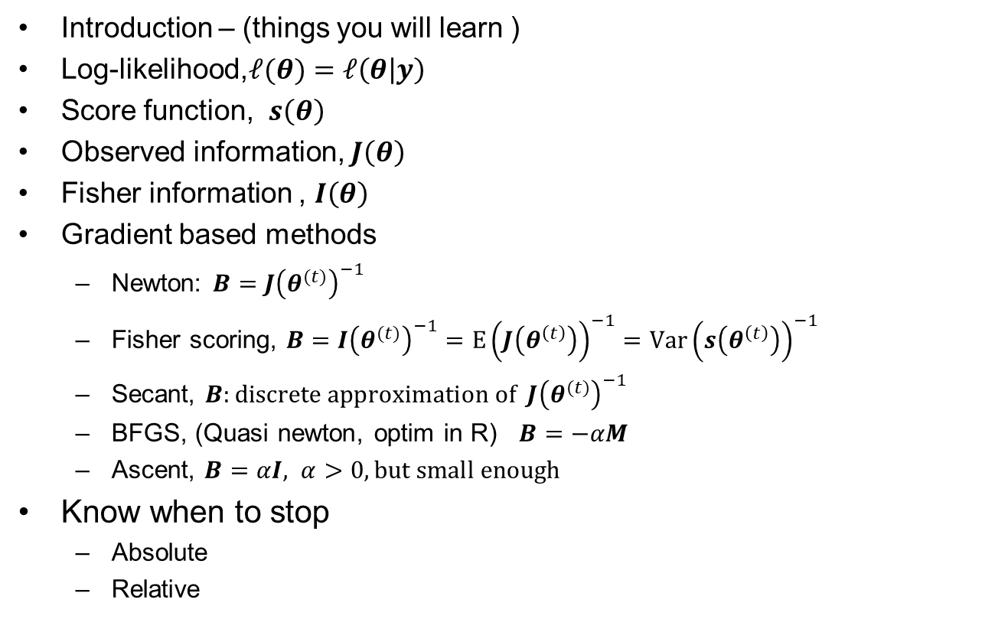
Last time
Introduction – (things you will learn )
Log-likelihood,$ℓ(θ)=ℓ\left(θ | y\right)$
Score function, $s\left(θ\right)$
Observed information, $J\left(θ\right)$
Fisher information , $I\left(θ\right)$
Gradient based methods
  Newton: $B={J\left(θ^{(t)}\right)}^{−1}$
  Fisher scoring, $B={I\left(θ^{(t)}\right)}^{−1}=E{\left(J\left(θ^{\left(t\right)}\right)\right)}^{−1}=Var{\left(s\left(θ^{\left(t\right)}\right)\right)}^{−1}$
  Secant, $B:{discrete approximation of J\left(θ^{(t)}\right)}^{−1}$
  BFGS, (Quasi newton, optim in R) $B=−αM$
  Ascent, $B=αI, α>0, but small enough$
Know when to stop
  Absolute
  Relative
$$θ^{(t+1)}=θ^{(t)}+Bs\left(θ^{(t)}\right)$$

Slide 3
Last time cont.
Gauss – Newton, linearize around theta, update using linear regression
Gauss Seidel: Iterate one coordinate at the time
Other alternatives
  Fixed point iterations (can also be gradient based) contraction
  Nelder – Mead (optim in R)
  Bi-section (exercise)

Slide 4


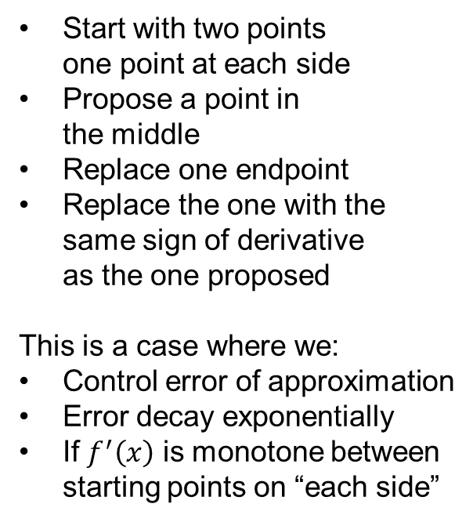
Bisection
Minimum of $f(x)$
Start with two points
one point at each side
Propose a point in
the middle
Replace one endpoint
Replace the one with the
same sign of derivative
as the one proposed
This is a case where we:
Control error of approximation
Error decay exponentially
If $f^{′}\left(x\right)$ is monotone between
starting points on “each side”
Root of $f^{′}\left(x\right)=0$

Slide 5
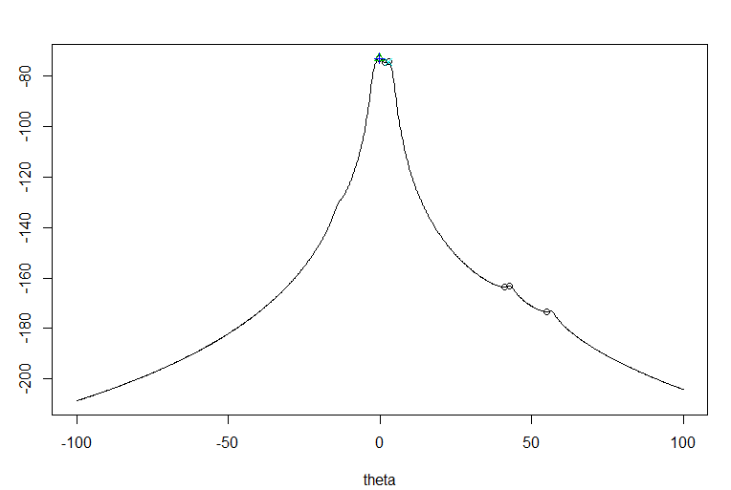
Question after lecture
About convergence of gradient methods.
Does the methods converge to a global or local extrema?
Answer: The method converges to a local extrema, remember exercise 2.1
For some problems,
there is only one local extrema

Slide 6
Discussion
Why is Newton’s method particularly suited for optimization of log likelihoods?
Why do you think the estimator obtained by one iteration of Newton's method is asymptotically just as good as the ML?
Hint: What is the asymptotic result for ML?

Slide 7

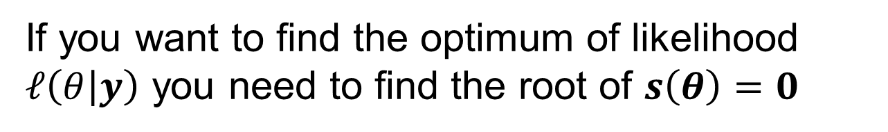

Question?
What is the connection between:
finding the optimum of a function
finding the root of a set of equations
If you want to find the optimum of likelihood $ℓ\left(θ | y\right)$ you need to find the root of $s\left(θ\right)=0$
$$f(θ)$$
$$∇f\left(θ\right)=0$$

Slide 8
Today
Iteratively reweighted least square
ADMM
ADMM for LASSO
Discrete optimization
  Decision theory
  Local methods
  Simulated anealing

Slide 9

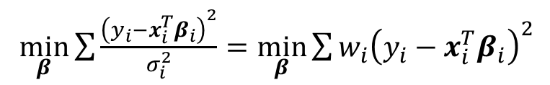

Weighted least square
Assume you have data with unknown mean and known variable variance and want to estimate mean
$\min_{β}\sum{\frac{{\left(y_{i}−{x_{i}^{T}β}_{i}\right)}^{2}}{σ_{i}^{2}}}=\min_{β}\sum{{w_{i}\left(y_{i}−{x_{i}^{T}β}_{i}\right)}^{2}}$
$W=diag (w)$
$${\hat{β}}_{WLS}={\left(X^{T}WX\right)}^{−1}X^{T}Wy$$

Slide 10
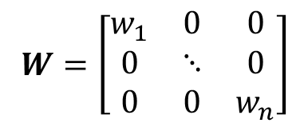
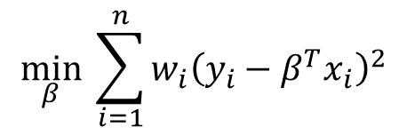
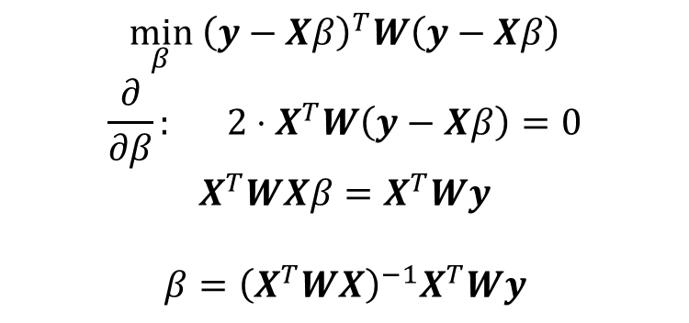
Weighted least square
$$\min_{β} \sum_{i=1}^{n}{{w_{i}\left(y_{i}−β^{T}x_{i}\right)}^{2}}$$
$W=\left[\begin{matrix}w_{1} & 0 & 0 \\ 0 & ⋱ & 0 \\ 0 & 0 & w_{n}\end{matrix}\right]$
$$\min_{β} {\left(y−Xβ\right)}^{T}W\left(y−Xβ\right)$$
$$\frac{∂}{∂β}: 2⋅X^{T}W\left(y−Xβ\right)=0$$
$$X^{T}WXβ=X^{T}Wy$$
$$β={\left(X^{T}WX\right)}^{−1}X^{T}Wy$$

Slide 11
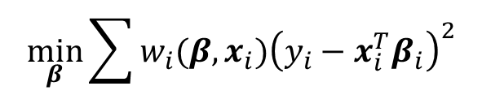
Iteratively reweighted least square
Assume you have data with unknown mean and known variable variance and want to estimate mean
Now: what if variance is unknown and a function of the parameter ?
Then: update the weights with previous estimate of parameter.
Useful trick, can be used for GLM generalized linear models
$\min_{β}\sum{\frac{{\left(y_{i}−{x_{i}^{T}β}_{i}\right)}^{2}}{σ_{i}^{2}}}=\min_{β}\sum{{w_{i}\left(y_{i}−{x_{i}^{T}β}_{i}\right)}^{2}}$
$W=diag (w)$
$${\hat{β}}_{WLS}={\left(X^{T}WX\right)}^{−1}X^{T}Wy$$
$$\min_{β}\sum{{w_{i}(β,x_{i})\left(y_{i}−{x_{i}^{T}β}_{i}\right)}^{2}}$$

Slide 12
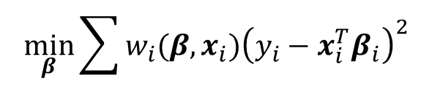
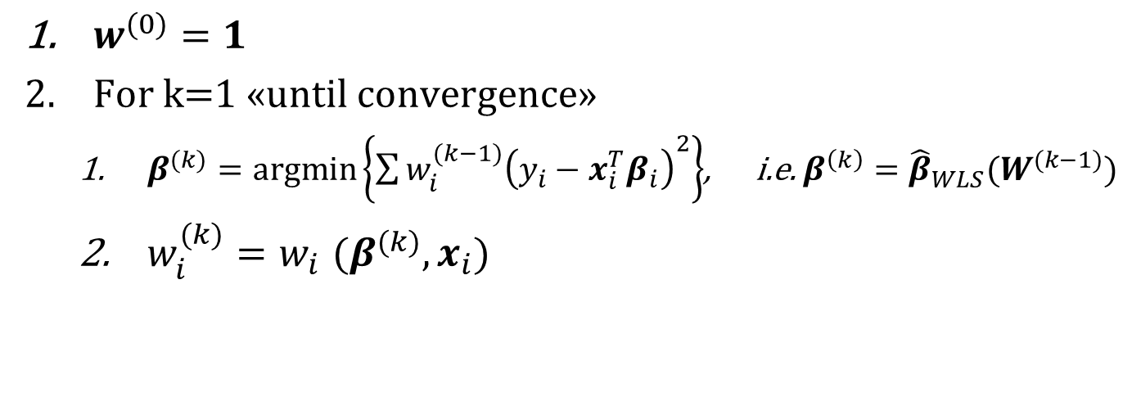
Iteratively reweighted least square (“linear case”)
$$\min_{β}\sum{{w_{i}(β,x_{i})\left(y_{i}−{x_{i}^{T}β}_{i}\right)}^{2}}$$
$w^{(0)}=1$
For k=1 «until convergence»
  $β^{(k)}=argmin\left\{\sum{{w_{i}^{(k−1)}\left(y_{i}−{x_{i}^{T}β}_{i}\right)}^{2}}\right\}$, i.e. ${β^{\left(k\right)}=\hat{β}}_{WLS}(W^{(k−1)})$
  $w_{i}^{(k)}{=w}_{i}(β^{(k)},x_{i})$

Slide 13
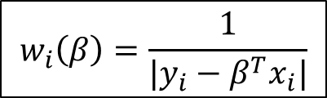
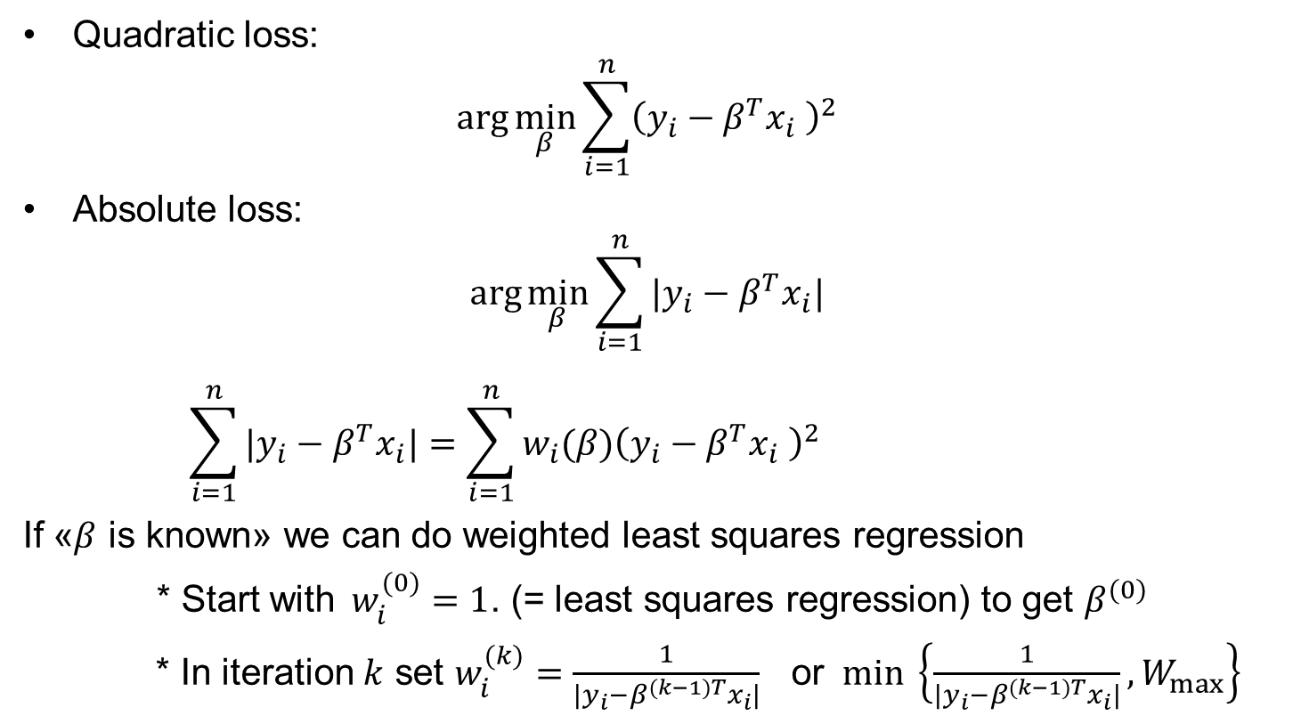
Example: L1-regression robustness to outliers
Quadratic loss:
$$\arg{\min_{β}{\sum_{i=1}^{n}{{\left(y_{i}−β^{T}x_{i} \right)}^{2}} }}$$
Absolute loss:
$$\arg{\min_{β}{\sum_{i=1}^{n}{|y_{i}−β^{T}x_{i}|} }}$$
$$\sum_{i=1}^{n}{|y_{i}−β^{T}x_{i}|}=\sum_{i=1}^{n}{{w_{i}(β)\left(y_{i}−β^{T}x_{i} \right)}^{2}}$$
If «$β$ is known» we can do weighted least squares regression
* Start with$w_{i}^{(0)}=1$. (= least squares regression) to get $β^{(0)}$
* In iteration $k$ set $w_{i}^{(k)}=$ $\frac{1}{|y_{i}−β^{(k−1)T}x_{i}|}$ or $min \left\{\frac{1}{|y_{i}−β^{(k−1)T}x_{i}|}, W_{max}\right\}$
$$w_{i}\left(β\right)=\frac{1}{|y_{i}−β^{T}x_{i}|}$$

Slide 14
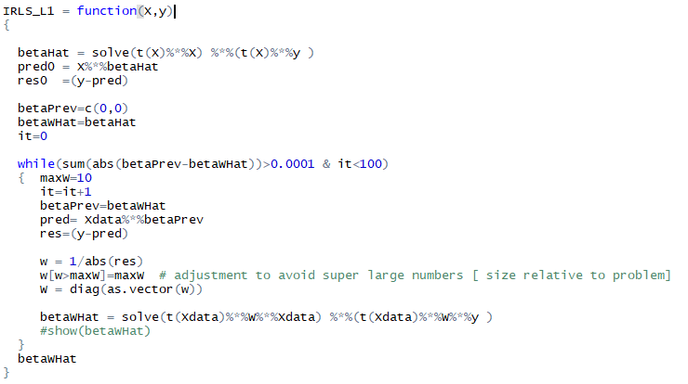
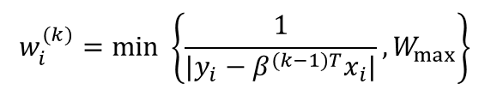

IRLS.R
$$w_{i}^{(k)}=min \left\{\frac{1}{|y_{i}−β^{(k−1)T}x_{i}|}, W_{max}\right\}$$
$$β={\left(X^{T}WX\right)}^{−1}X^{T}Wy$$

Slide 15
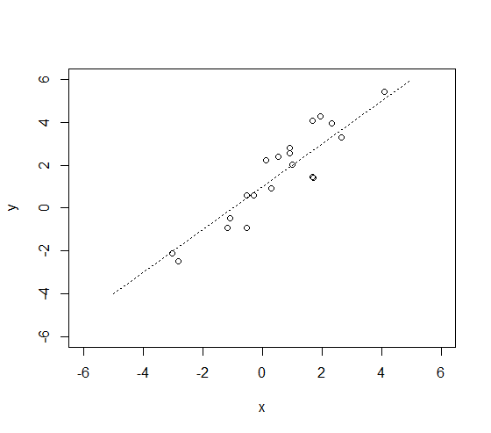
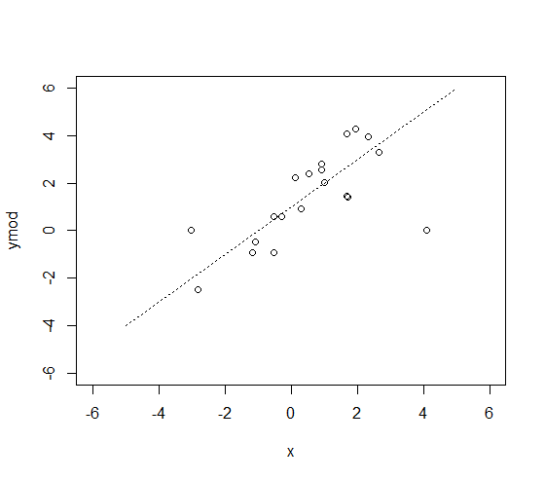
Example n=20
Case 1
Case 2

Slide 16
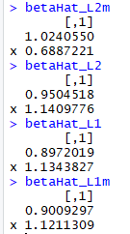
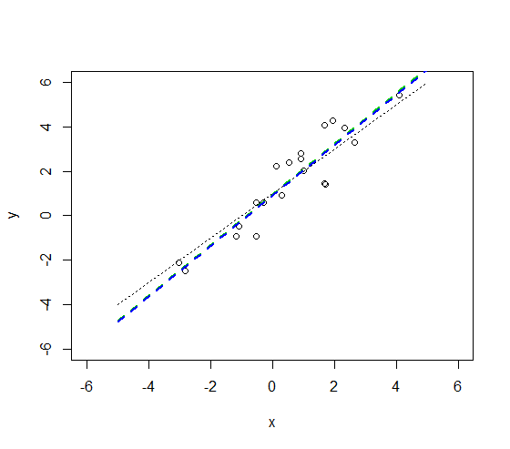
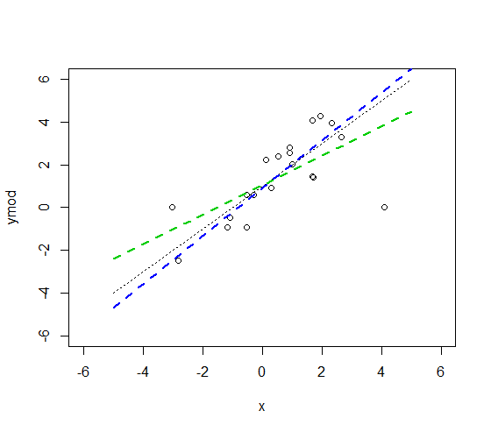
Example n=20
Quadratic loss
Absolute loss
Case 1
Case 2
Results almost identical
Quadratic loss is
sensitive to outliers

Slide 17

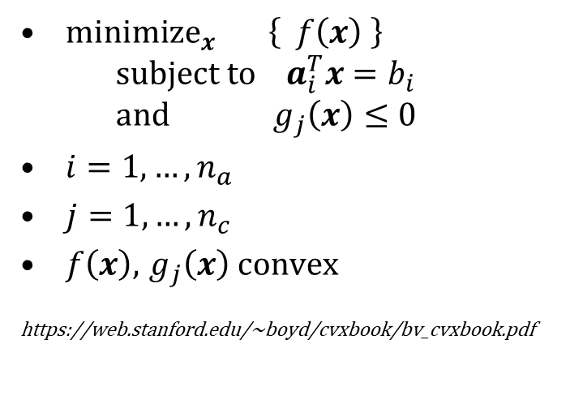


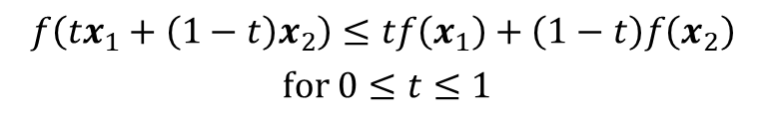
Convex optimization
${minimize}_{x} \left\{ f\left(x\right) \right\}$
$subject to a_{i}^{T}x=b_{i}$
$and g_{j}\left(x\right)≤0$
$i=1,…,n_{a}$
$j=1,…,n_{c}$
$f\left(x\right)$, $g_{j}\left(x\right)$ convex
https://web.stanford.edu/~boyd/cvxbook/bv_cvxbook.pdf
A field on its own,…
Covers many important problems
  Least squares
  Linear programming
  Convex quadratic minimization
  with linear or convex quadratic constraints
  Conic optimization
  Second order cone programming
  …
Many algorithms open source
  Bundle methods
  Subgradient projection methods (Polyak),
  Interior-point methods
  Cutting-plane methods
  Ellipsoid method
  Subgradient method
  Dual subgradients
  …
Convex function:
$$f\left(x\right)$$
$$\left(x_{1},f(x_{1})\right)$$
$$\left(x_{2},f(x_{2})\right)$$
$$f\left({tx}_{1}+\left(1−t\right)x_{2}\right)≤tf\left(x_{1}\right)+\left(1−t\right)f\left(x_{2}\right)$$
$$for 0≤t≤1$$
Interpolation always above function

Slide 18
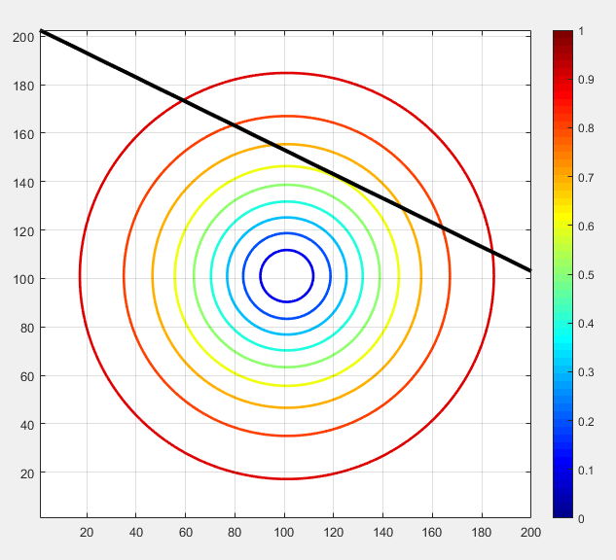
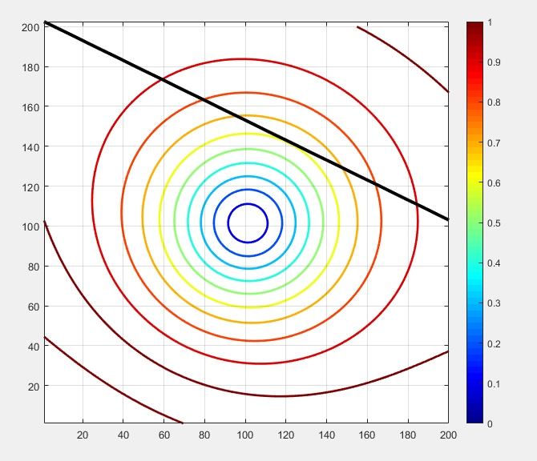
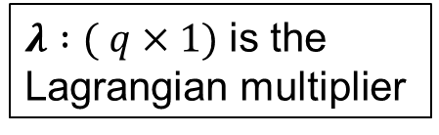
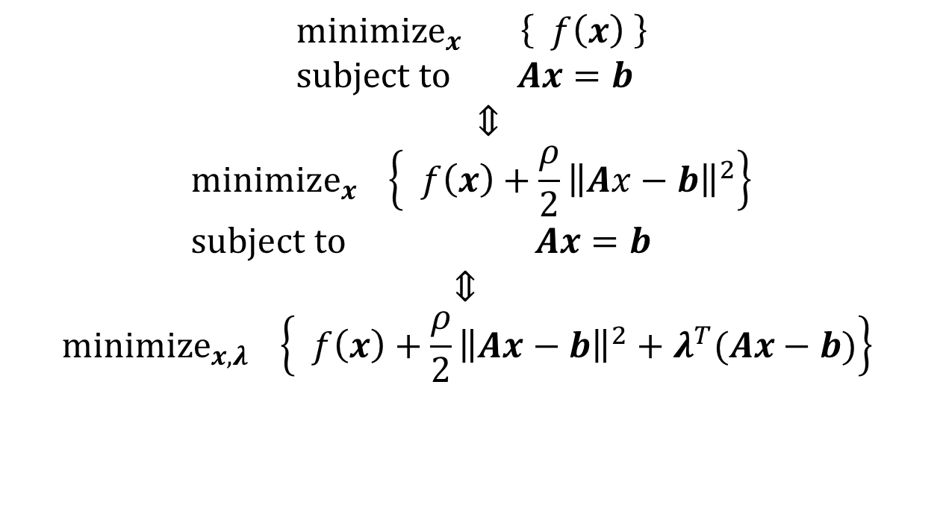
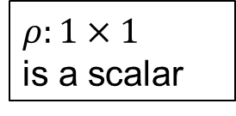
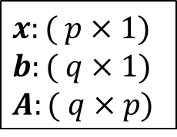
Minimization under an equality constraint and the augmented Lagrangian multiplier
Just a small taste of convex optimization
$x:( p×1)$
$b:( q×1)$
$A:( q×p)$
$${minimize}_{x} \left\{ f\left(x\right) \right\} \\ subject to Ax=b$$
$$⇕ \\ {minimize}_{x} \left\{ f\left(x\right)+\frac{ρ}{2}{\left\|Ax−b\right\|}^{2}\right\} \\ subject to Ax=b$$
$$⇕ \\ {minimize}_{x,λ} \left\{ f\left(x\right)+\frac{ρ}{2}{\left\|Ax−b\right\|}^{2}+λ^{T}(Ax−b)\right\}$$
$ρ:1×1$
is a scalar
$λ :( q×1)$ is the Lagrangian multiplier
Geometric interpretation:
Minimum occurs
when the contour
line is tangent to
constraint

Slide 19

$$minimize \left\{ f\left(x\right) \right\} \\ subject to Ax=b$$

Slide 20
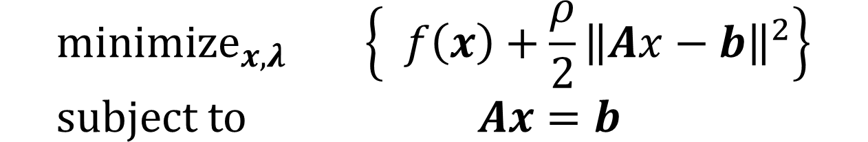
$${minimize}_{x,λ} \left\{ f\left(x\right)+\frac{ρ}{2}{\left\|Ax−b\right\|}^{2}\right\} \\ subject to Ax=b$$
Does not change along the black line

Slide 21
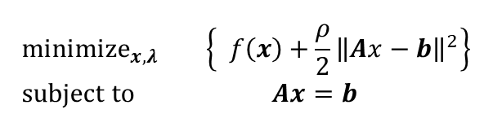
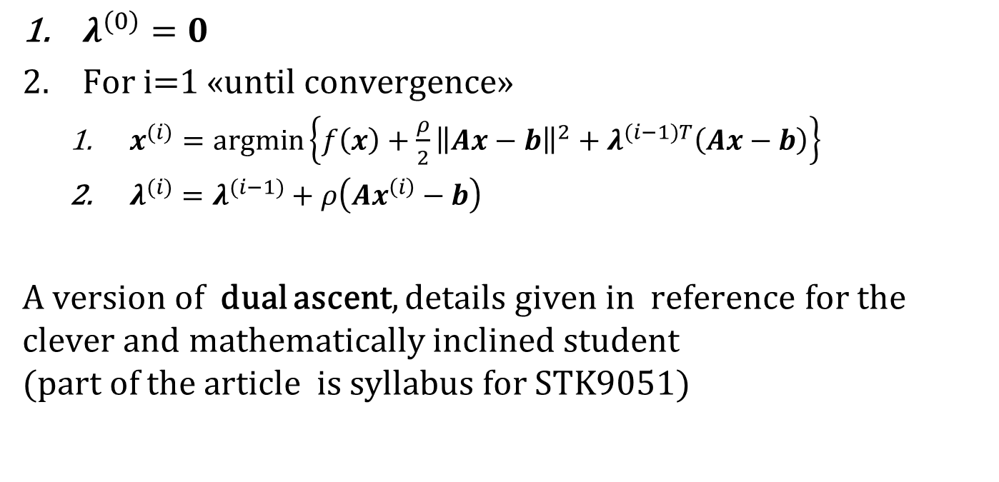
Algorithm for solution:
Method of multipliers
$${minimize}_{x,λ} \left\{ f\left(x\right)+\frac{ρ}{2}{\left\|Ax−b\right\|}^{2}\right\} \\ subject to Ax=b$$
$λ^{(0)}=0$
For i=1 «until convergence»
  $x^{(i)}=argmin\left\{f\left(x\right)+\frac{ρ}{2}{\left\|Ax−b\right\|}^{2}+λ^{(i−1)T}\left(Ax−b\right)\right\}$
  $λ^{(i)}=λ^{(i−1)}+ρ\left(Ax^{\left(i\right)}−b\right)$
A version of dual ascent, details given in reference for the clever and mathematically inclined student
(part of the article is syllabus for STK9051)

Slide 22
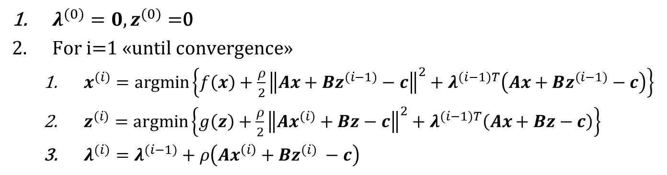
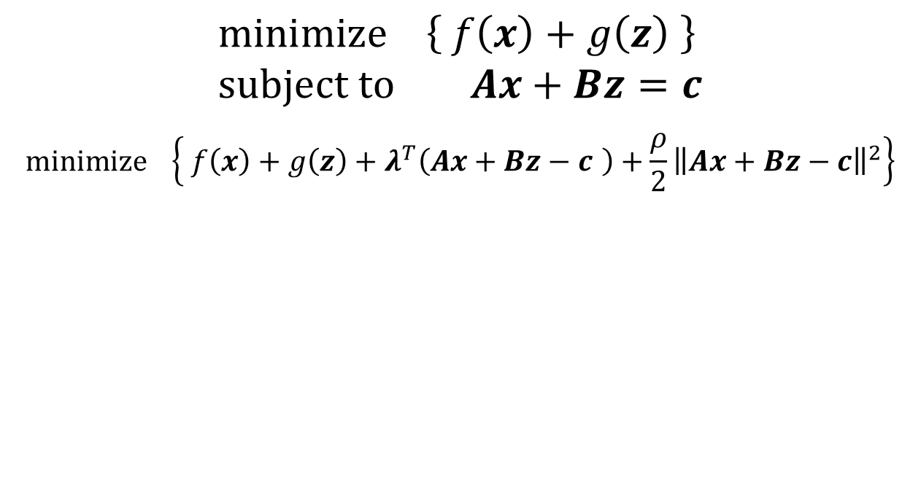

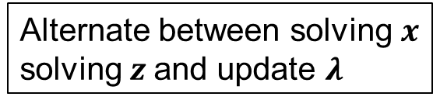
ADMM Alternating Direction Method of Multipliers
$$minimize \left\{ f\left(x\right)+g\left(z\right) \right\} \\ subject to Ax+Bz=c$$
$$minimize \left\{ f\left(x\right)+g\left(z\right)+λ^{T}\left(Ax+Bz−c \right)+\frac{ρ}{2}{\left\|Ax+Bz−c\right\|}^{2}\right\}$$
$λ^{(0)}=0, z^{(0)}=$0
For i=1 «until convergence»
  $x^{(i)}=argmin\left\{f\left(x\right)+\frac{ρ}{2}{\left\|Ax+Bz^{(i−1)}−c\right\|}^{2}+λ^{(i−1)T}\left(Ax+Bz^{(i−1)}−c\right)\right\}$
  $z^{(i)}=argmin\left\{g\left(z\right)+\frac{ρ}{2}{\left\|Ax^{(i)}+Bz−c\right\|}^{2}+λ^{(i−1)T}\left(Ax+Bz−c\right)\right\}$
  $λ^{(i)}=λ^{(i−1)}+ρ\left(Ax^{\left(i\right)}+Bz^{(i)} −c\right)$
Alternate between solving $x$ solving $z$and update $λ$
We do not need to deal with $f\left(x\right)$ and $g\left(z\right)$ simultaneously!

Slide 23
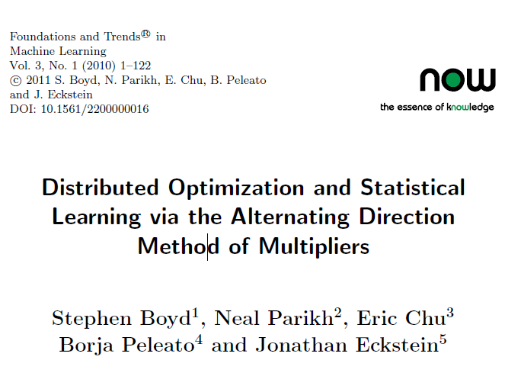
Reference
Proven convergence under general assumptions
Ideal for splitting problem into smaller «solvable» problems
Syllabus ADMM
  No proofs
  Operational use
  Questions about related stuff
Available online
https://web.stanford.edu/~boyd/papers/admm_distr_stats.html

Slide 24
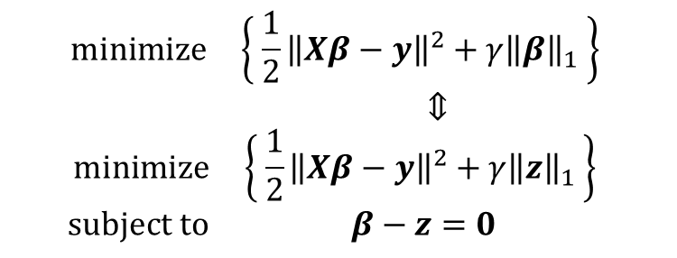
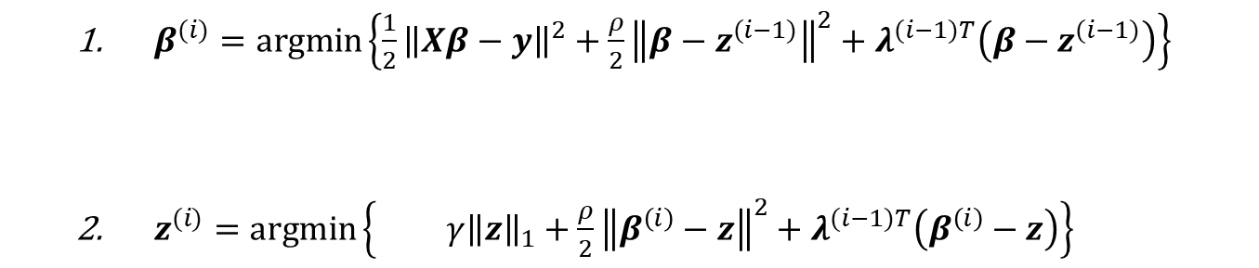
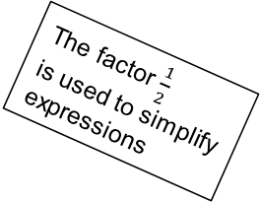
Solving lasso using ADMM
The factor $\frac{1}{2}$
is used to simplify expressions
$$minimize \left\{ {\frac{1}{2}\left\|Xβ−y\right\|}^{2}+γ{\left\|β\right\|}_{1} \right\}$$
$⇕$
$$minimize \left\{ {\frac{1}{2}\left\|Xβ−y\right\|}^{2}+γ{\left\|z\right\|}_{1} \right\}$$
$$subject to β−z=0$$
Lasso:
In ADMM
  $β^{(i)}=argmin\left\{{\frac{1}{2}\left\|Xβ−y\right\|}^{2}+\frac{ρ}{2}{\left\|β−z^{(i−1)}\right\|}^{2}+λ^{(i−1)T}\left(β−z^{(i−1)}\right)\right\}$
  $z^{(i)}=argmin\left\{ γ{\left\|z\right\|}_{1}+\frac{ρ}{2}{\left\|β^{\left(i\right)}−z\right\|}^{2}+λ^{(i−1)T}\left(β^{\left(i\right)}−z\right)\right\}$
First problem has only quadratic and linear terms, thus it is solved by linear equations
Second problem is non linear but can be solved for each component separately

Slide 25

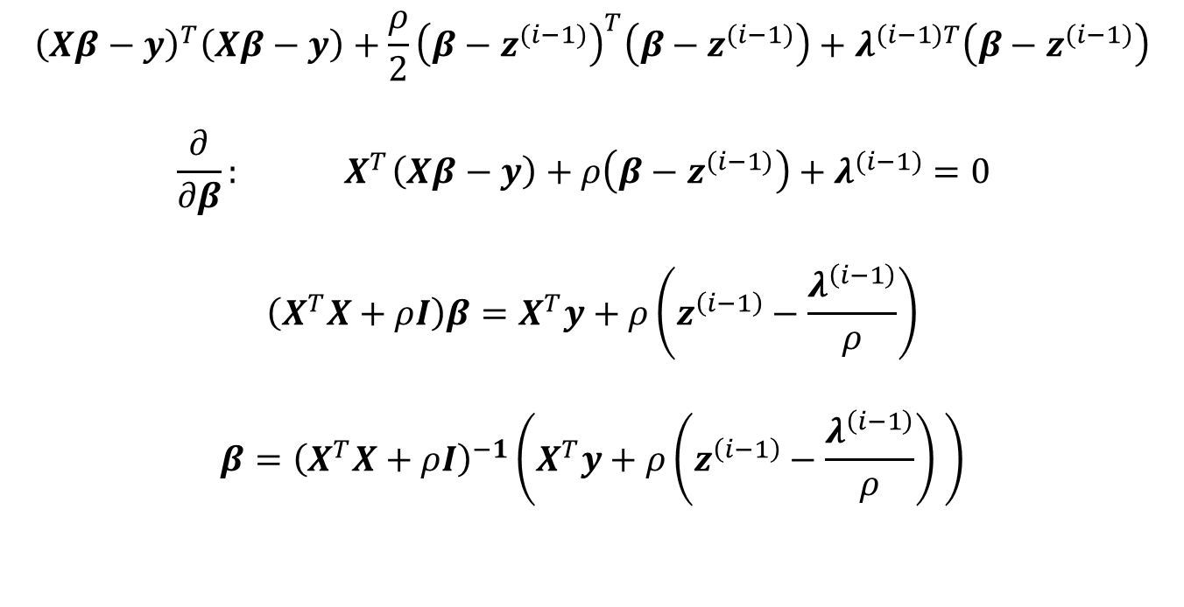
First problem
$${argmin}_{β}\left\{{\frac{1}{2}\left\|Xβ−y\right\|}^{2}+\frac{ρ}{2}{\left\|β−z^{(i−1)}\right\|}^{2}+λ^{(i−1)T}\left(β−z^{(i−1)}\right)\right\}$$
$${\left(Xβ−y\right)}^{T}\left(Xβ−y\right)+\frac{ρ}{2}{\left(β−z^{(i−1)}\right)}^{T}\left(β−z^{(i−1)}\right)+λ^{(i−1)T}\left(β−z^{(i−1)}\right)$$
$$\frac{∂}{∂β}: { X}^{T}\left(Xβ−y\right)+ρ\left(β−z^{(i−1)}\right)+λ^{(i−1)}=0$$
$$\left(X^{T}X+ρI\right)β=X^{T}y+ρ\left(z^{\left(i−1\right)}−\frac{λ^{\left(i−1\right)}}{ρ}\right)$$
$${β=\left(X^{T}X+ρI\right)}^{−1}\left(X^{T}y+ρ\left(z^{\left(i−1\right)}−\frac{λ^{\left(i−1\right)}}{ρ}\right) \right)$$

Slide 26
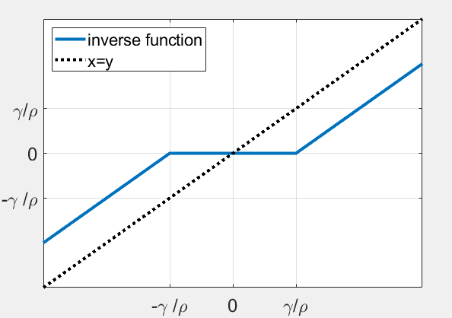
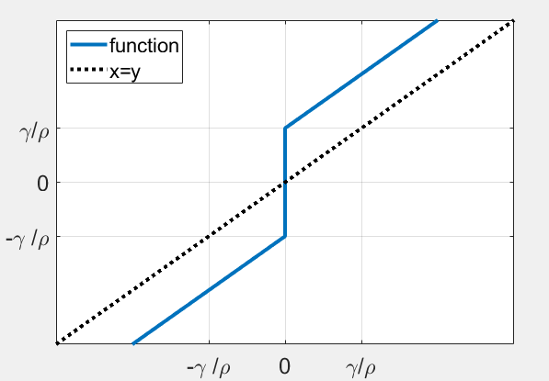
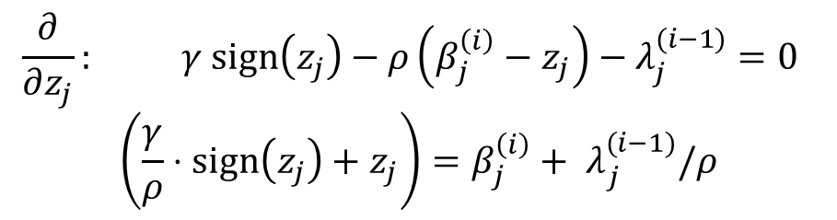

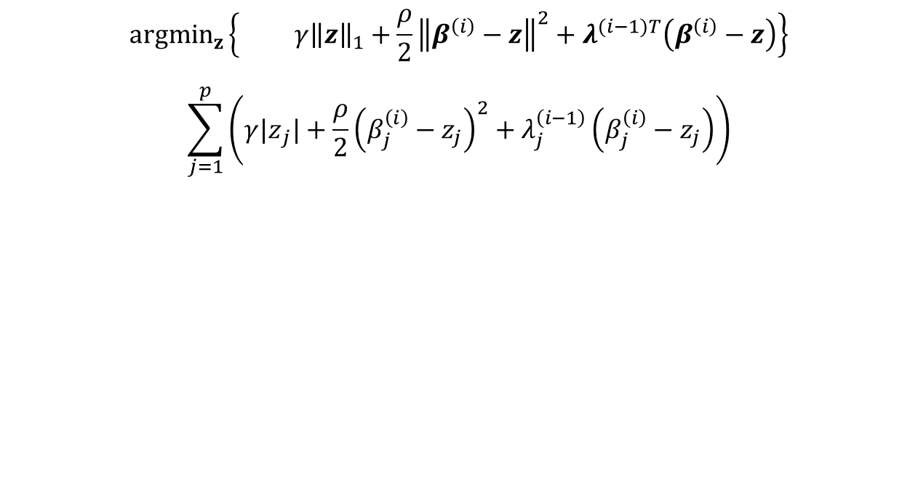


Second problem
$${argmin}_{z}\left\{ γ{\left\|z\right\|}_{1}+\frac{ρ}{2}{\left\|β^{\left(i\right)}−z\right\|}^{2}+λ^{(i−1)T}\left(β^{\left(i\right)}−z\right)\right\}$$
$$\sum_{j=1}^{p}{\left(γ{|z}_{j}|+\frac{ρ}{2}{\left(β_{j}^{\left(i\right)}−z_{j}\right)}^{2}+λ_{j}^{\left(i−1\right)}\left(β_{j}^{\left(i\right)}−z_{j}\right)\right)}$$
$$\frac{∂}{∂z_{j}}: γ sign\left(z_{j}\right)−ρ\left(β_{j}^{\left(i\right)}−z_{j}\right)−λ_{j}^{(i−1)}=0$$
$$\left(\frac{γ}{ρ}⋅sign\left(z_{j}\right)+z_{j}\right)={β_{j}^{\left(i\right)}+ λ}_{j}^{(i−1)}/ρ$$
Solve for each component independently
$${{u_{j}^{(i)}=β}_{j}^{\left(i\right)}+ λ}_{j}^{(i−1)}/ρ$$
$$z_{j}^{(i)}=S(u_{j}^{(i)};γ/ρ)$$
$$u_{j}^{(i)}$$
Inverse function
$$S\left(u;γ/ρ\right)=sign\left(u\right)⋅\max{(\left|u\right|−γ/ρ,0)}$$

Slide 27
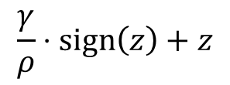

Inverting a function in powerpoint
Rotate
Mirror
$$\frac{γ}{ρ}⋅sign\left(z\right)+z$$
$$sign\left(u\right)⋅\max{(\left|u\right|−γ/ρ,0)}$$

Slide 28
