Slide 1
STK-4051/9051 Computational Statistics Spring 2023
Instructor: Odd Kolbjørnsen, oddkol@math.uio.no

Slide 2
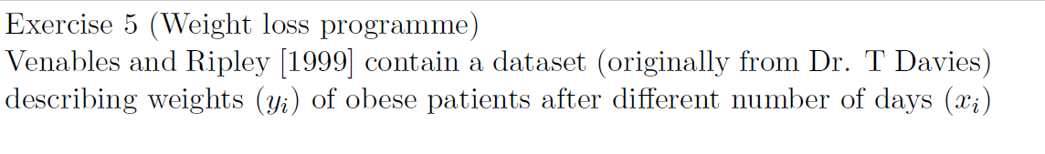
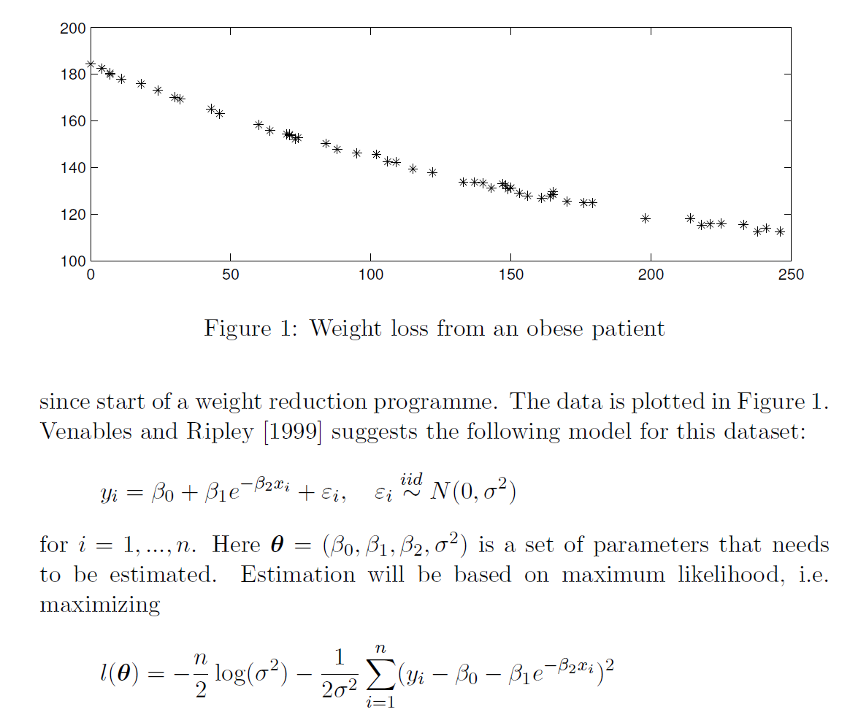

Slide 3
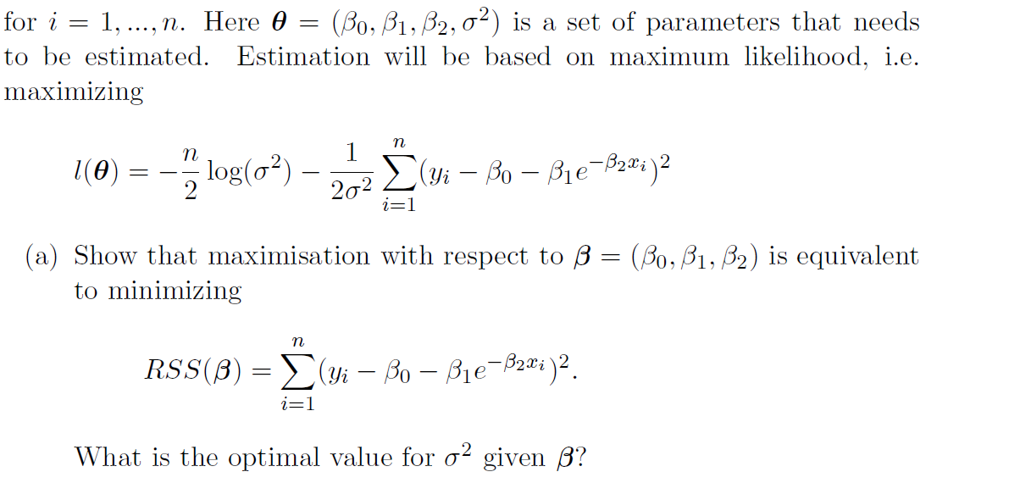
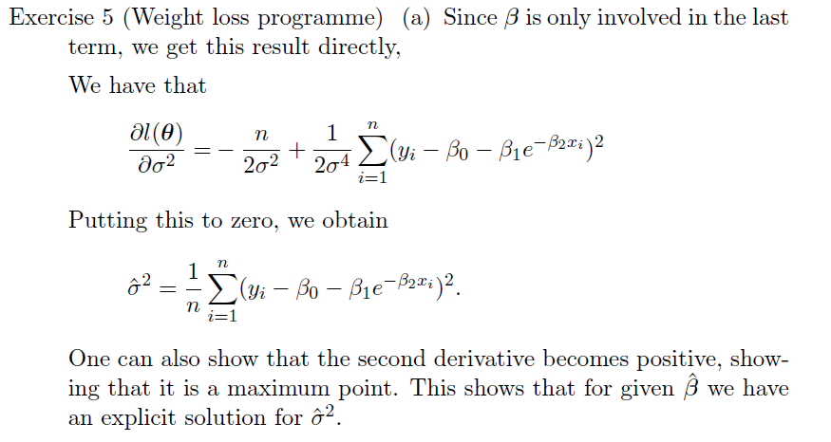
When you are asked to show something use:
Arguments
Computations
If you are not able to do so you might get points if you can provide insight to the problem

Slide 5
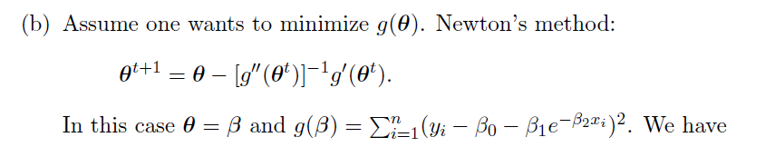
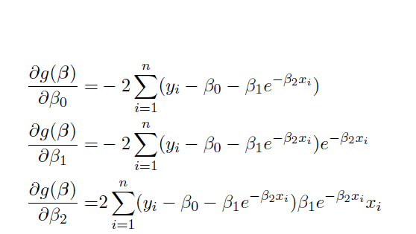

Slide 6
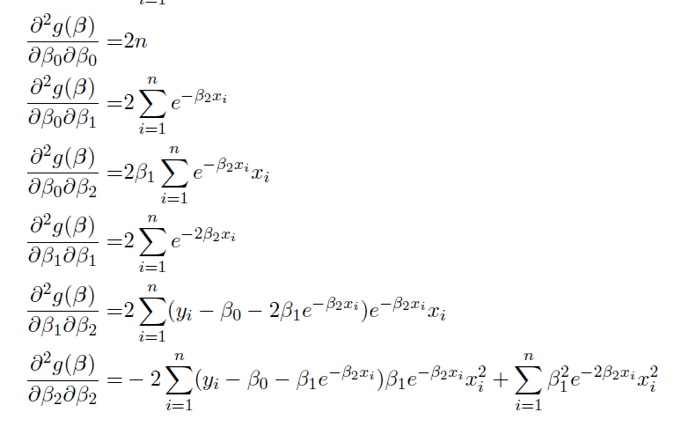

Slide 8
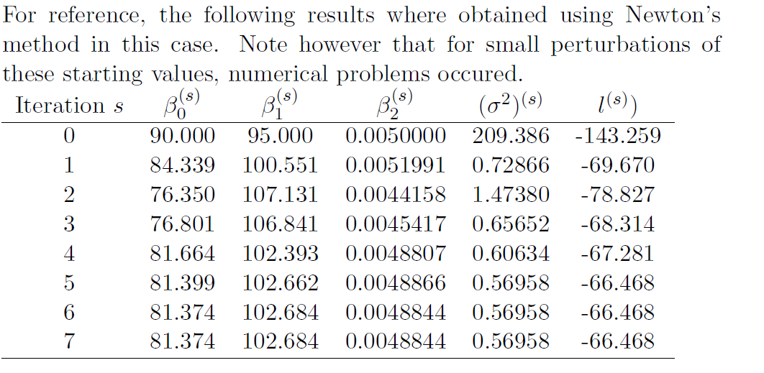
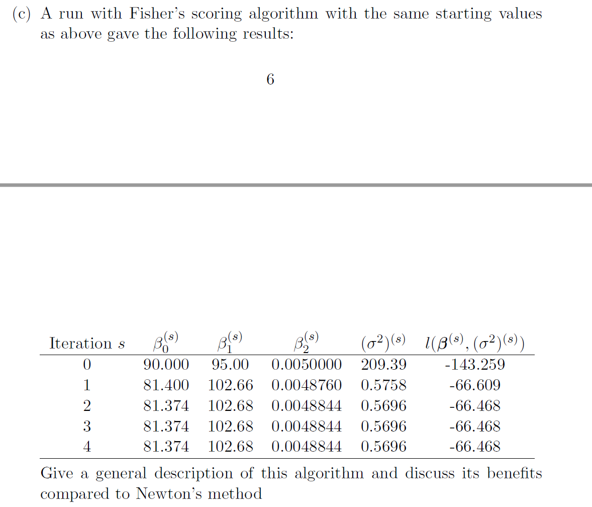
For the Fisher scoring algorithm, we replace the matrix of second
derivatives with their expectation. This guarantees that the matrix becomes positive (semi-)definite
Since this is the variance of the
scoring function.
Which in turn stabilize the solution.

Slide 9
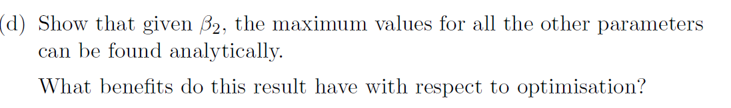
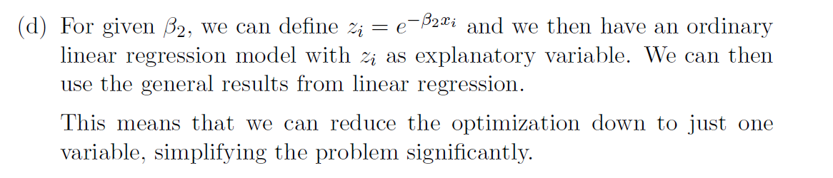

Slide 10
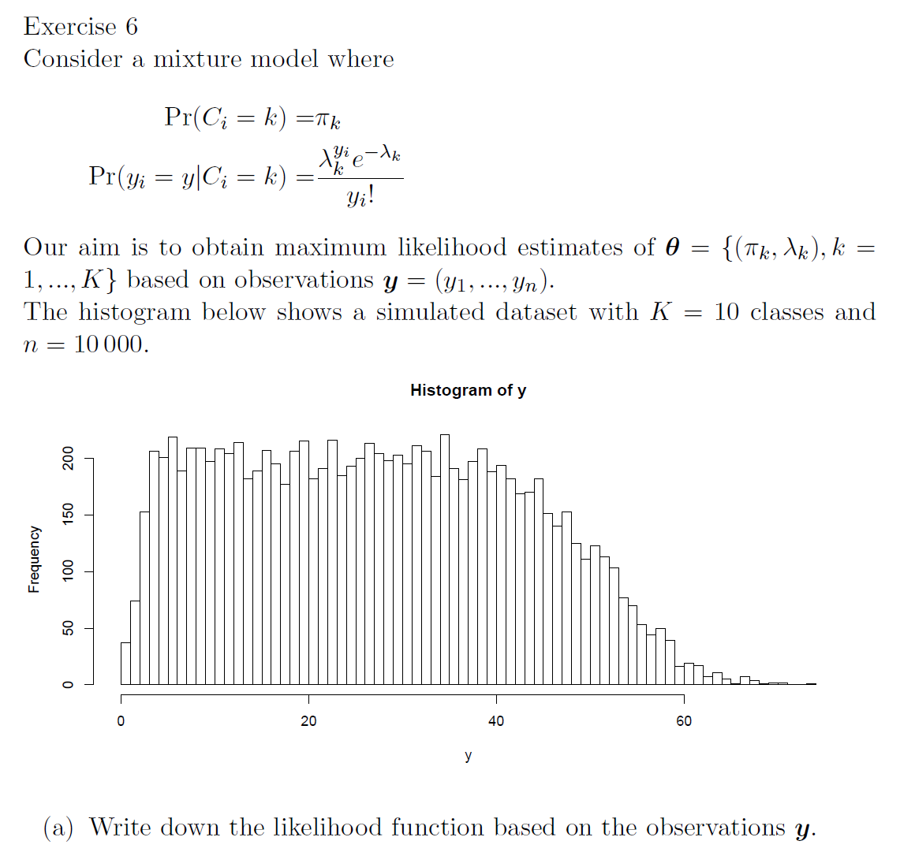
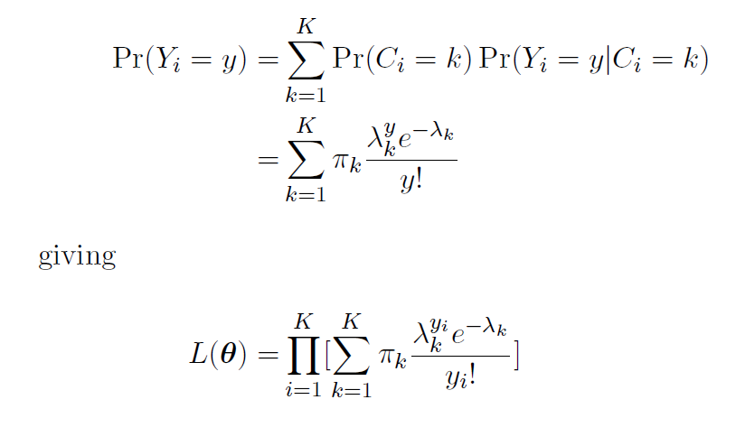

Slide 11
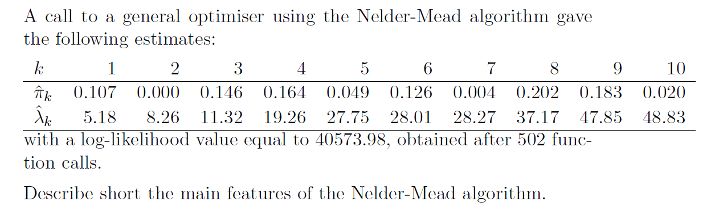
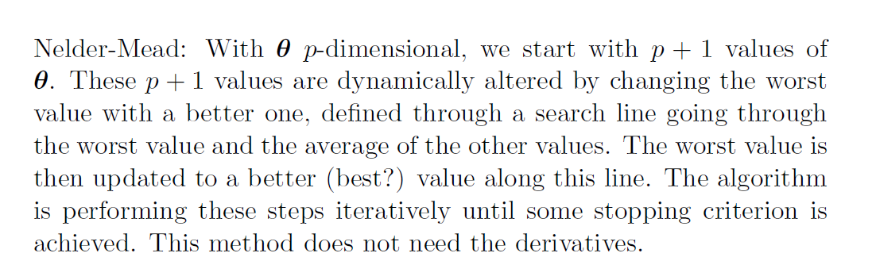

Slide 12
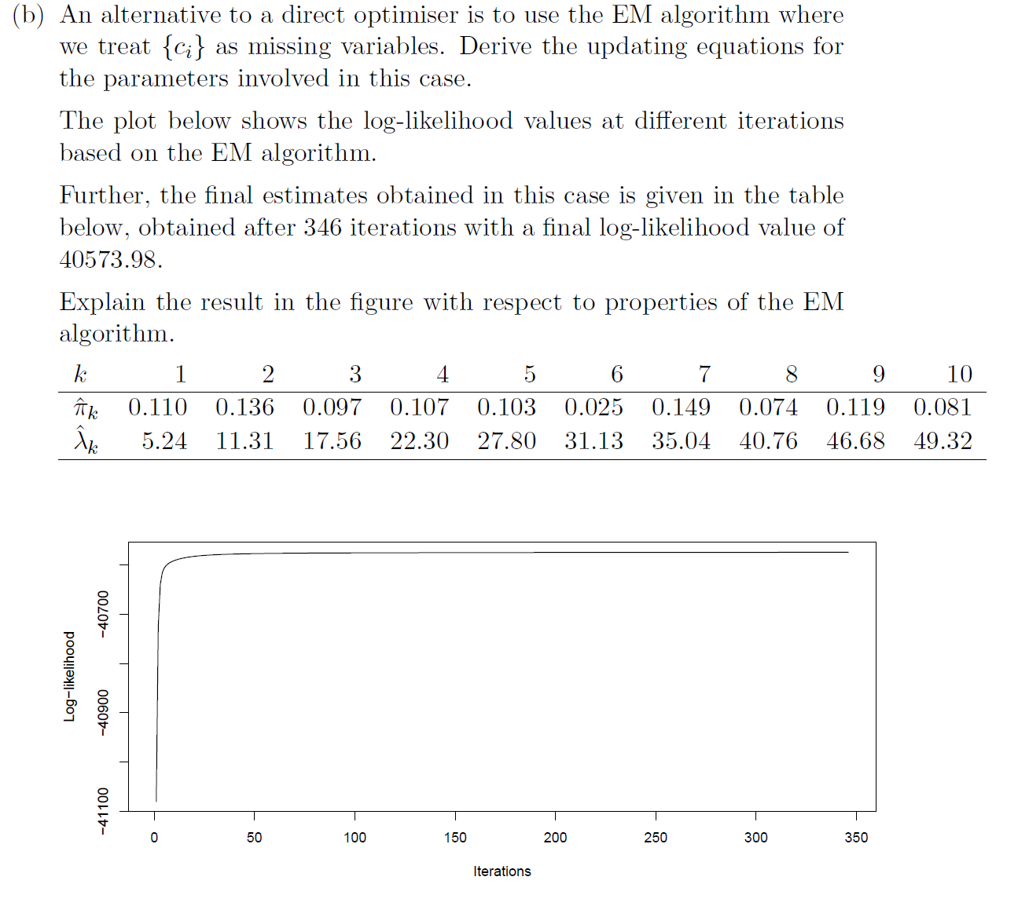

Slide 13
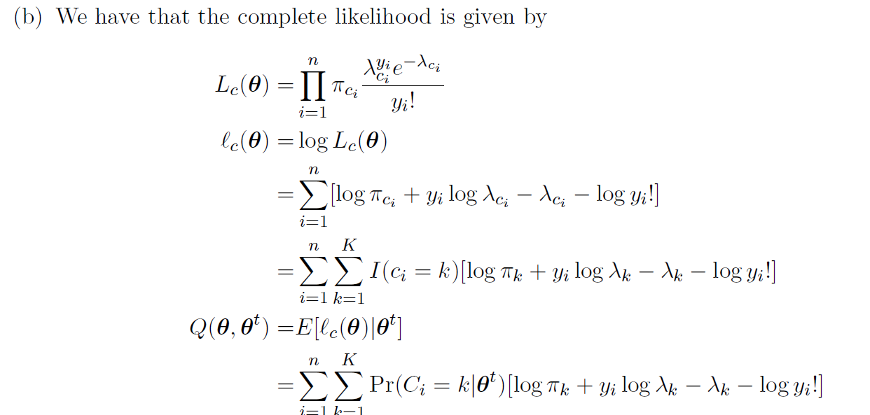
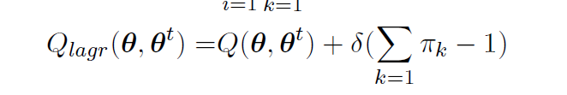

Slide 14
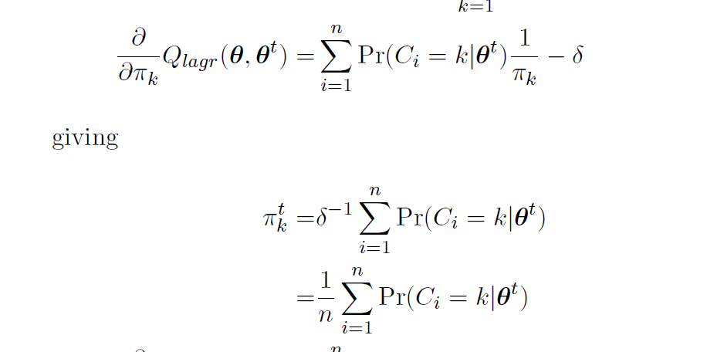

Slide 15
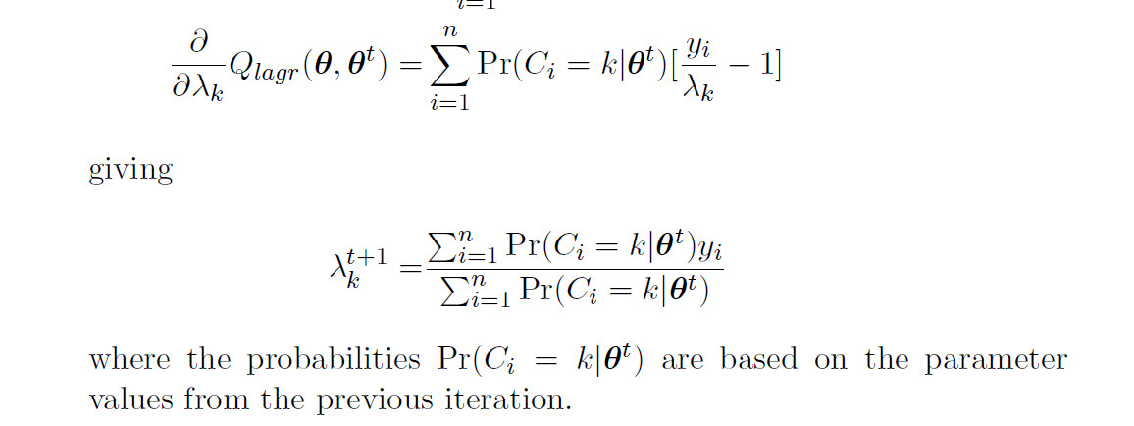

Slide 16
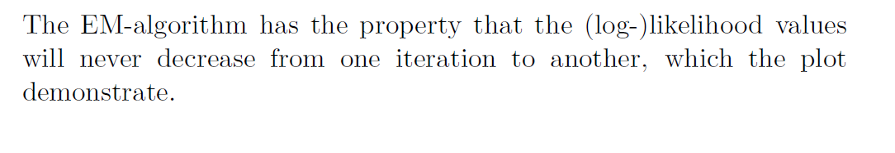

Slide 17
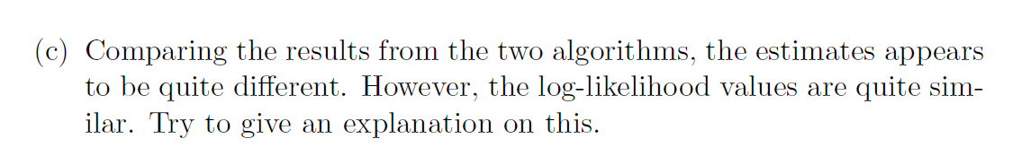
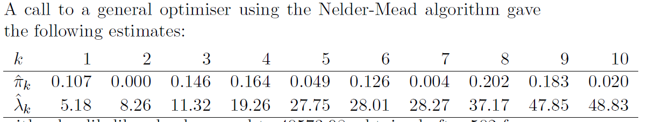
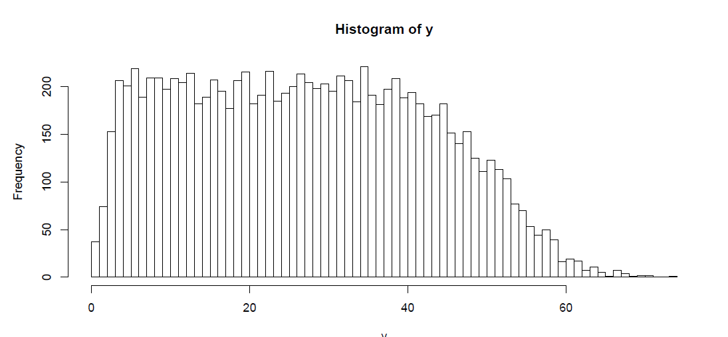
log-likelihood
40573.98,
log-likelihood 40573.98.
A problem in this case is that the
different classes are difficult to
distinguish from the data, making
several configurations of mixtures
of Poisson data possible.

Slide 18
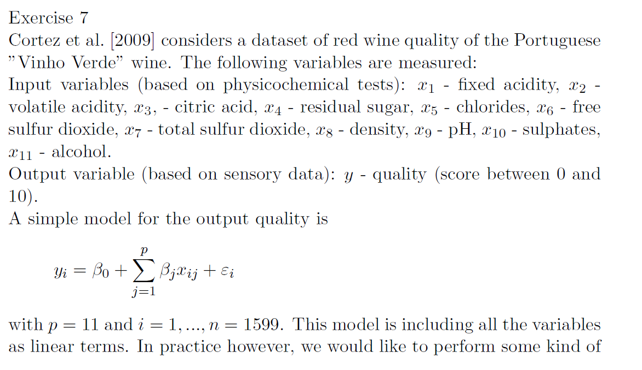
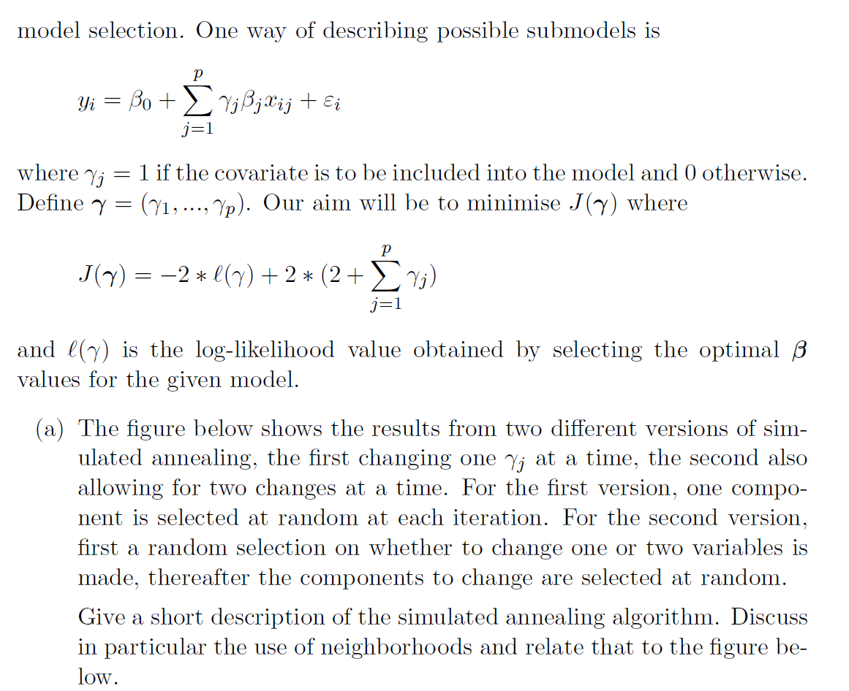

Slide 19
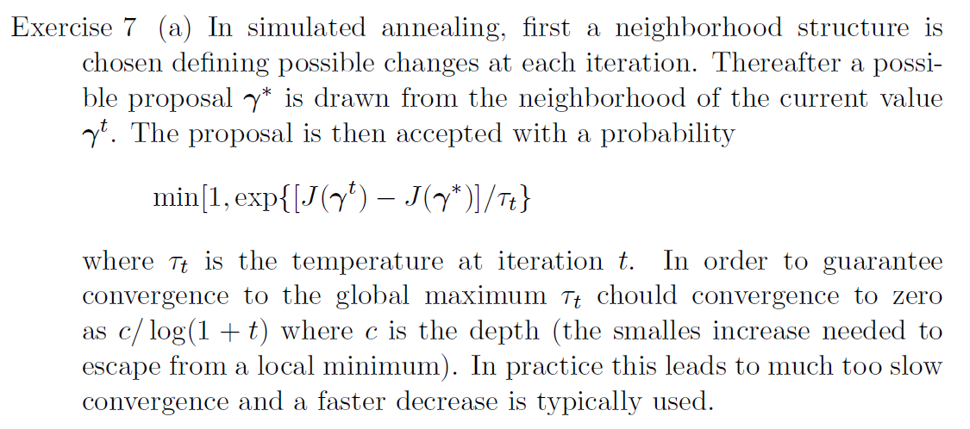

Slide 20
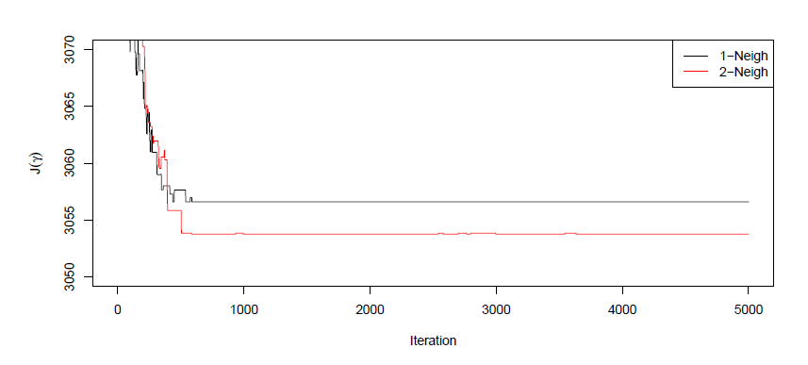
In the figure a too fast cooling schedule has been used, the 1-Neigh is stuck before the
2-Neigh since this has less flexebility

Slide 21
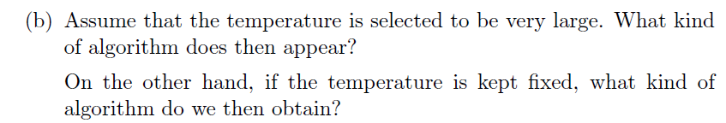
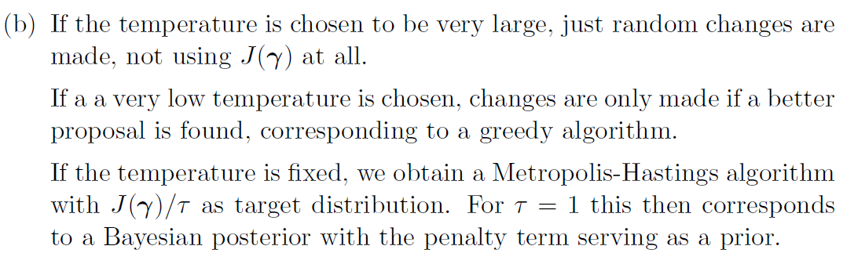

Slide 22
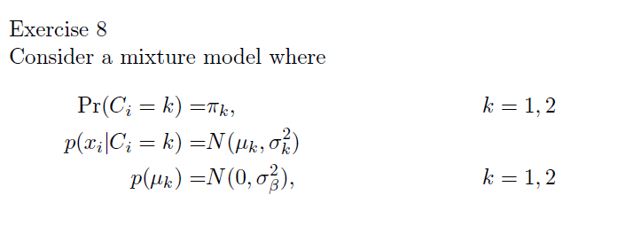

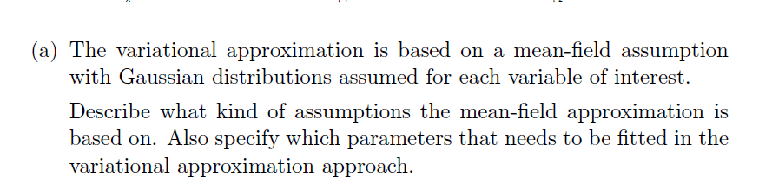

Slide 23
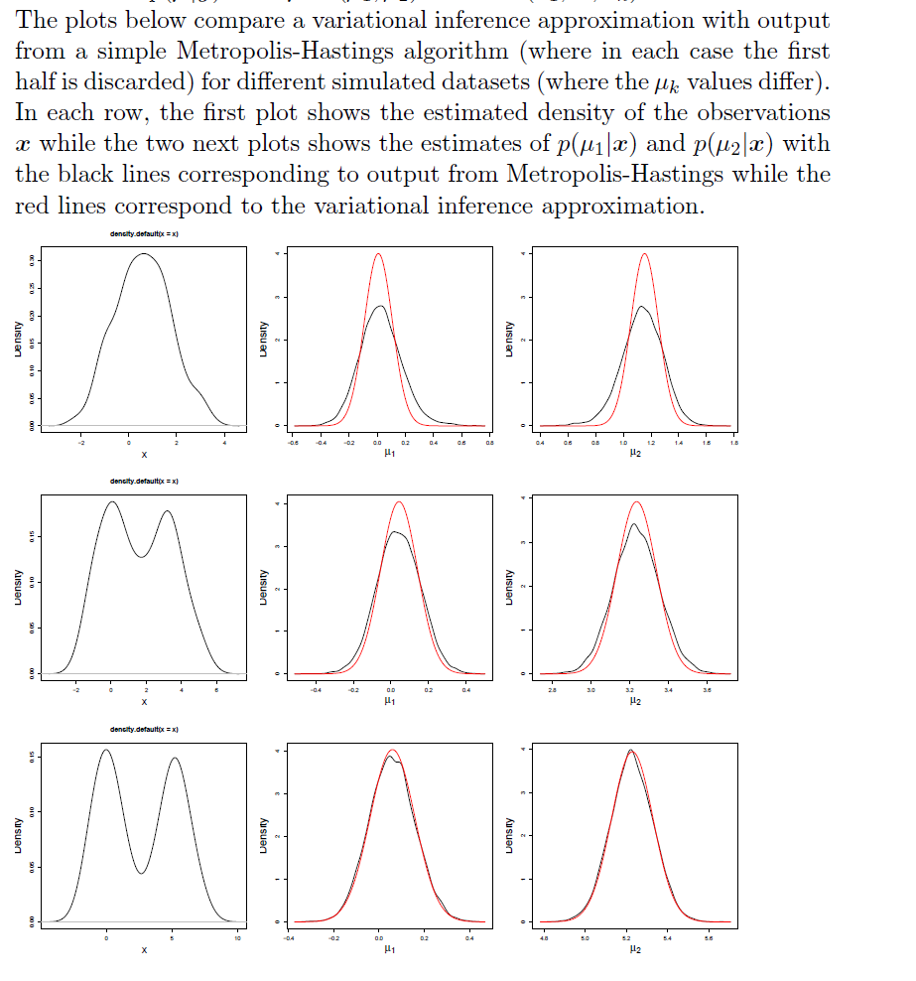
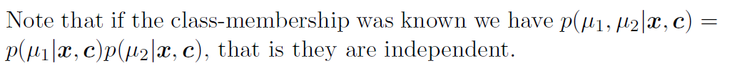
Discuss the results seen in the Figure and relate this to the assumptions
made for the variational approximation.
For the last row, the two classes are quite separated, making it relatively easy to identify which xi's that belong to the two classes.
In that case, the mean Field approximation will become quite good. As there becomes more ucnertainty to which classes that the xi's belong
to, the mean FIeld approximation becomes worse due to that there will
be more dependence between μ1 and μ2.
Case 1
Case 2
Case 3

