Slide 1
STK-4051/9051 Computational Statistics Spring 2024
Comments to exercise 9
Instructor: Odd Kolbjørnsen, oddkol@math.uio.no

Slide 2
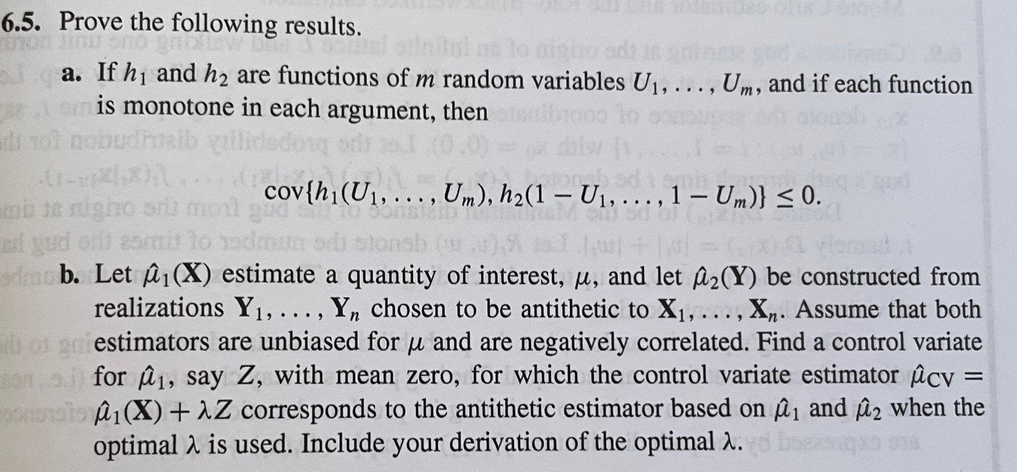
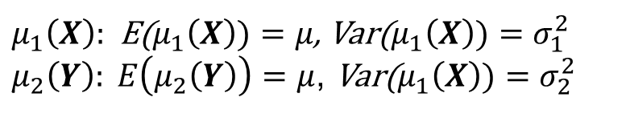

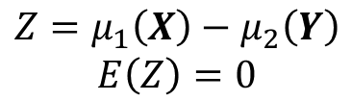
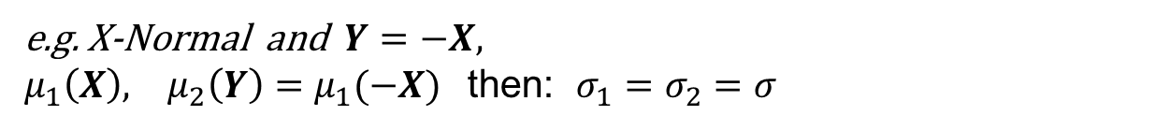
$μ_{1}\left(X\right):$E($μ_{1}\left(X\right))=μ$, Var($μ_{1}\left(X\right))=σ_{1}^{2}$
$μ_{2}\left(Y\right): E\left(μ_{2}\left(Y\right)\right)=μ$, Var($μ_{1}\left(X\right))=σ_{2}^{2}$
$$Cov\left(μ_{1},μ_{2}\right)=σ_{1}σ_{2}ρ$$
$$Z=μ_{1}\left(X\right)−μ_{2}\left(Y\right)$$
$$E\left(Z\right)=0$$
e.g. X-Normal and $Y=−X,$
$μ_{1}\left(X\right), μ_{2}\left(Y\right)=μ_{1}(−X)$then: $σ_{1}=σ_{2}=σ$

Slide 3
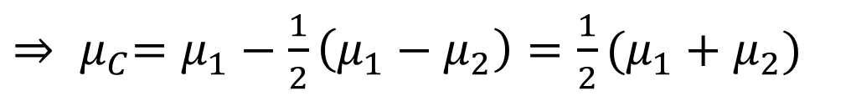
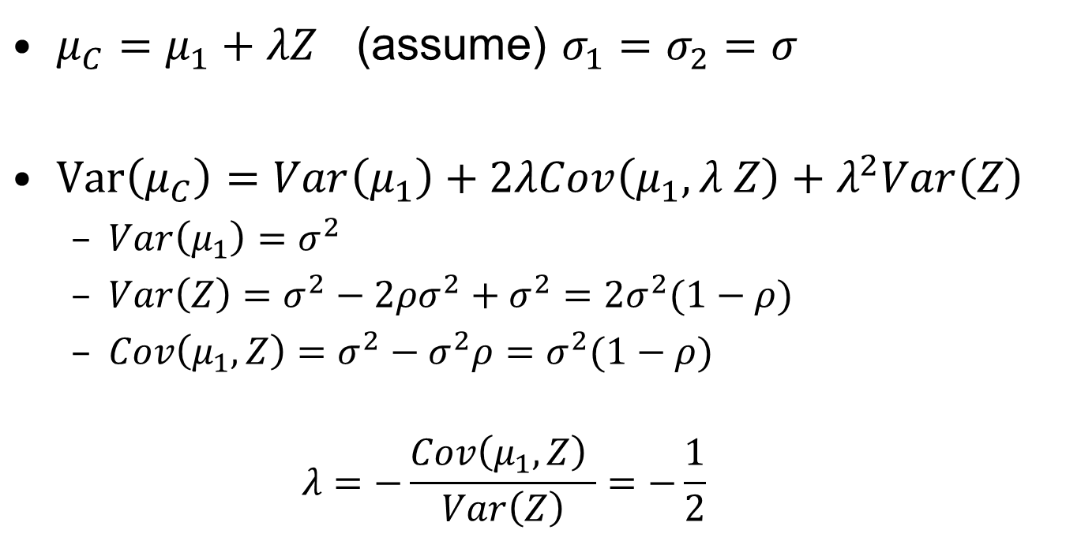
$μ_{C}=μ_{1}+λZ$ (assume) $σ_{1}=σ_{2}=σ$
$Var\left(μ_{C}\right)=Var\left(μ_{1}\right)+2λCov\left(μ_{1},λ Z\right)+λ^{2}Var\left(Z\right)$
  $Var\left(μ_{1}\right)=σ^{2}$
  $Var\left(Z\right)=σ^{2}−2ρσ^{2}+σ^{2}={2σ}^{2}(1−ρ)$
  $Cov\left(μ_{1},Z\right)=σ^{2}−σ^{2}ρ=σ^{2}(1−ρ)$
  $$λ=−\frac{Cov\left(μ_{1},Z\right) }{Var\left(Z\right)}=−\frac{1}{2}$$
${⇒ μ}_{C}=μ_{1}−\frac{1}{2}\left(μ_{1}−μ_{2}\right)=\frac{1}{2}(μ_{1}+μ_{2})$

Slide 4
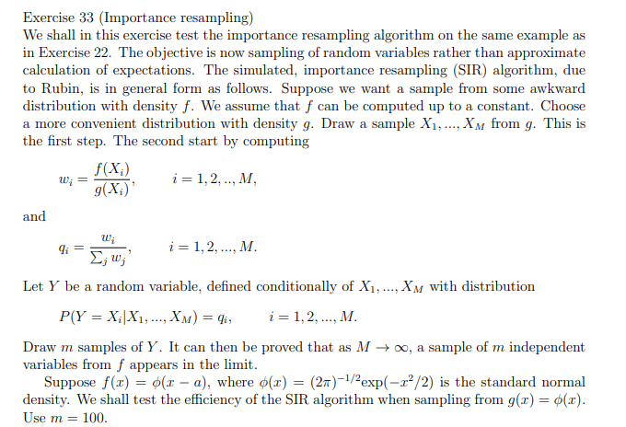
M = total number of samples from g
m = number of resampled

Slide 5
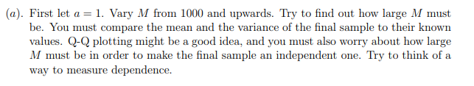


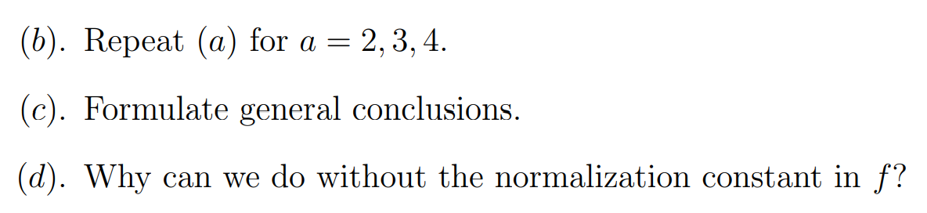

Slide 6
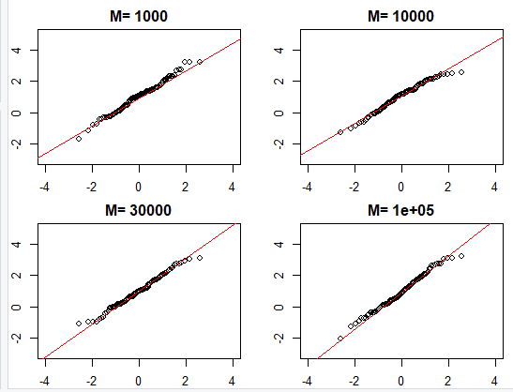
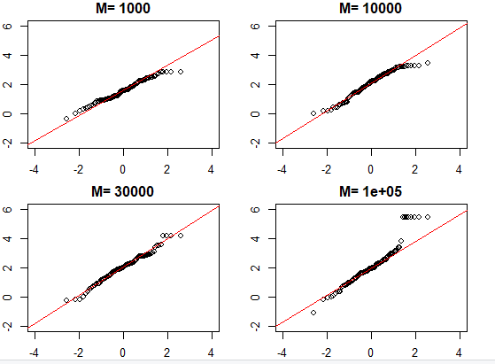
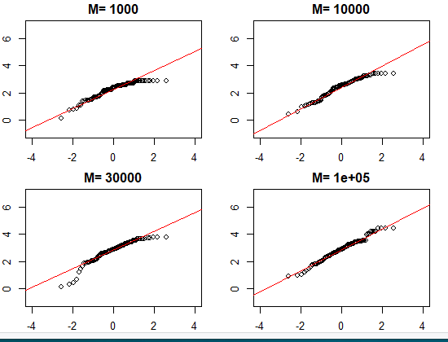
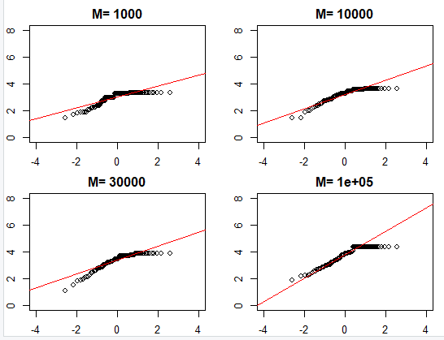
Ex 33 importance sampling
a=1
a=2
a=3
a=4
c) As a increase (1 to 4):
The effective number of samples goes down
The qq plot does not match the line
The mean is too low
The std is too low
d)
The weigths are normalized prior to re-sampling

Slide 7


Dependency
How would you know that the samples are not directly from f?
  Repeated values
Number of repeats in a sample of size m: multinomial
Number of repeats of sample k (among m samples): binomial
$p\left(n_{1}, …,n_{M}\right)=\frac{m!}{n_{1}!⋯n_{M}!}q_{1}^{n_{1}}⋯q_{M}^{n_{M}}$
$p\left(n_{k} \right)=\frac{m!}{n_{k}!\left(m−n_{k}\right)!}q_{k}^{n_{k}}{\left(1−q_{k}\right)}^{m−n_{k}}$

Slide 8
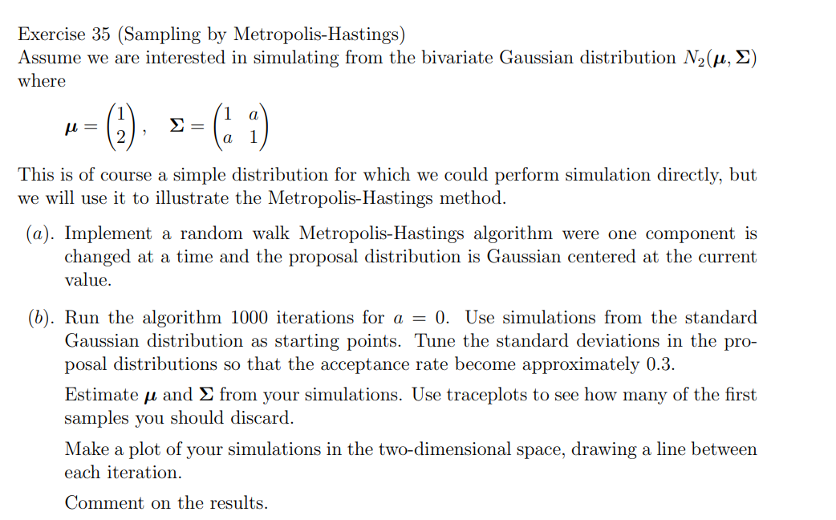

Slide 9
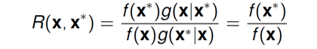
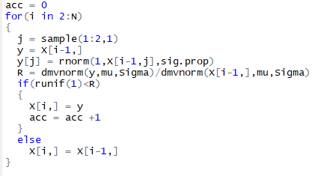
Ex 35
Random Walk
Use library mvtnorm
B) We need more than 1000
samples to get good estimates,
but we are in the ball park
C) We are not even close
with the 1000 samples.
We are trapped in the valley.

Slide 10
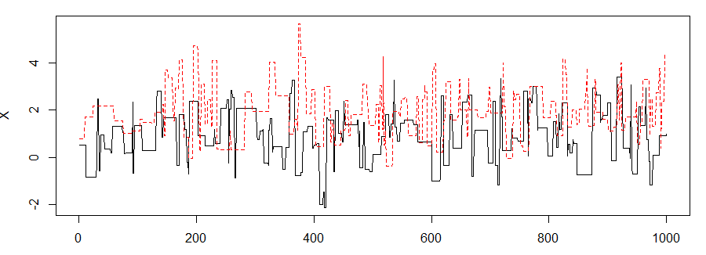
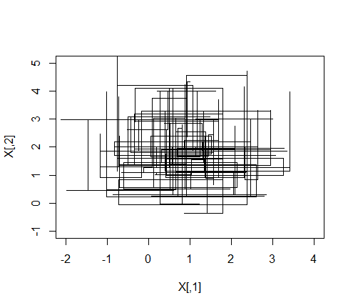
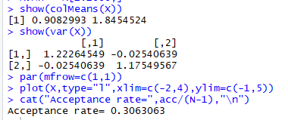
Correlation = 0 in target distribution

Slide 11
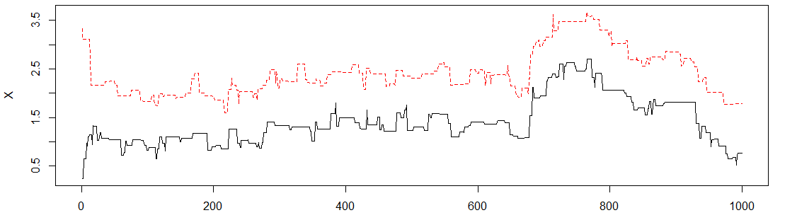
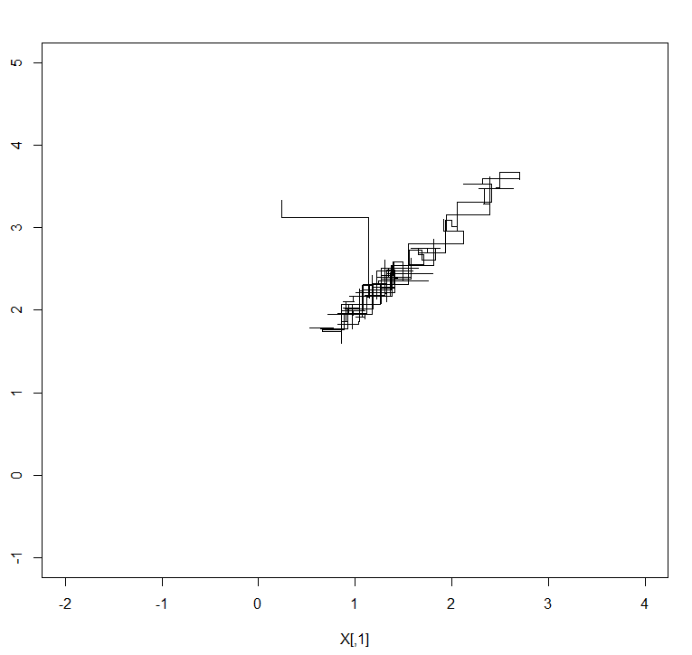
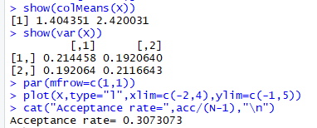
Correlation = 0.99 in target distribution

Slide 12
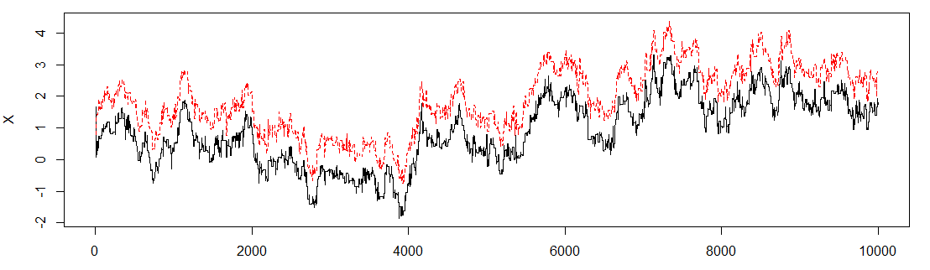
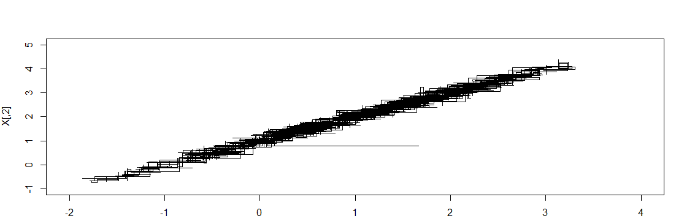
Correlation = 0.99 in target distribution

Slide 13
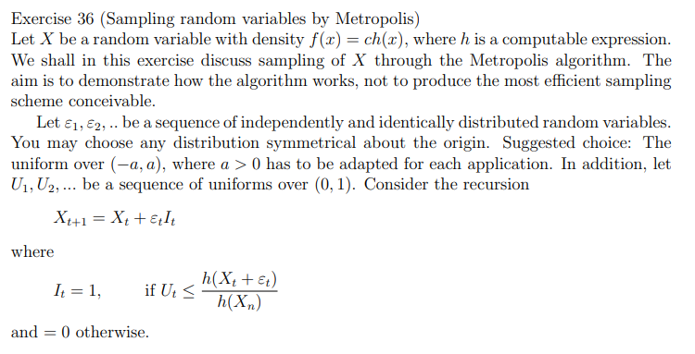


Slide 14
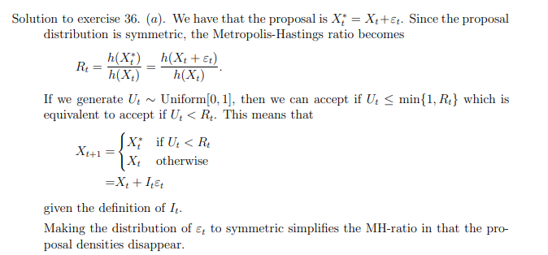

Slide 15
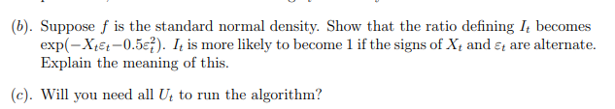
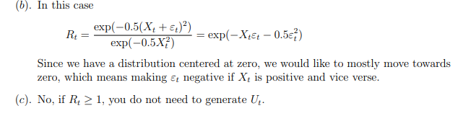

Slide 16
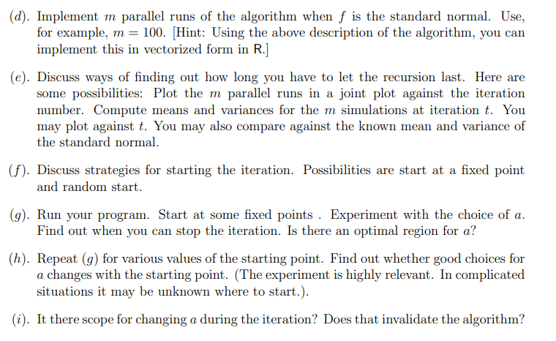
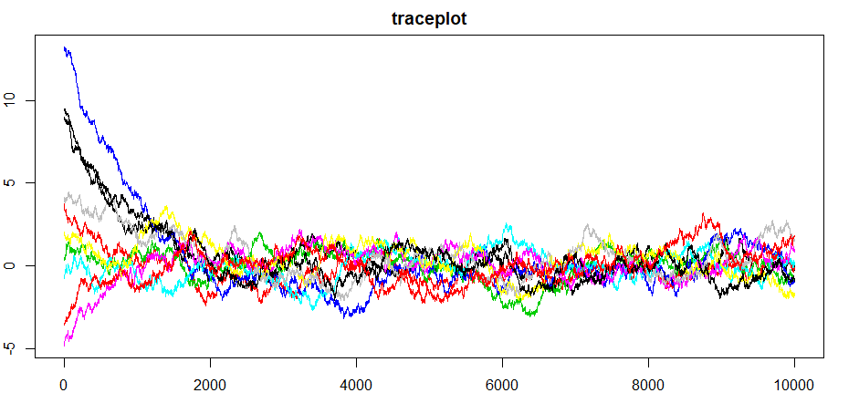
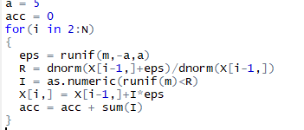
Just do it…

Slide 17
f) use multiple start points, (extreme values or random)
g,h) Do it
Changing a you do not have detailed balance, since the reverse probability is different This must be accounted for

