Slide 1
STK-4051/9051 Computational Statistics Spring 2024
Ex3
Instructor: Odd Kolbjørnsen, oddkol@math.uio.no

Slide 2
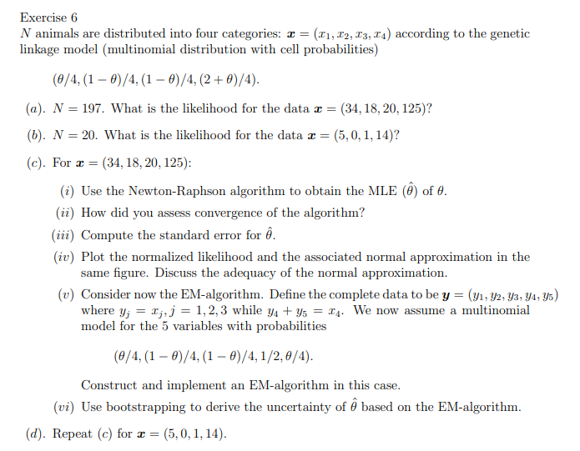
Genetic linkage is the tendency of DNA sequences that are close together on a chromosome to be inherited together

Slide 3
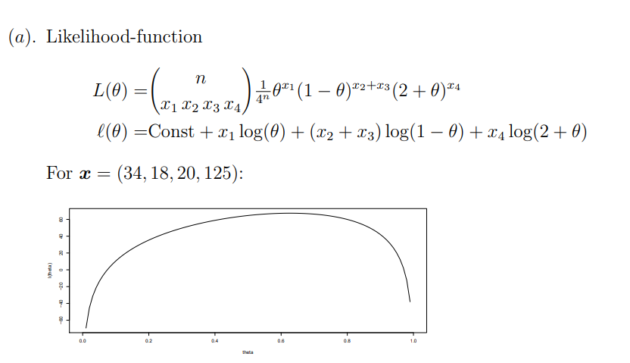
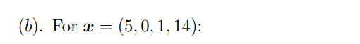
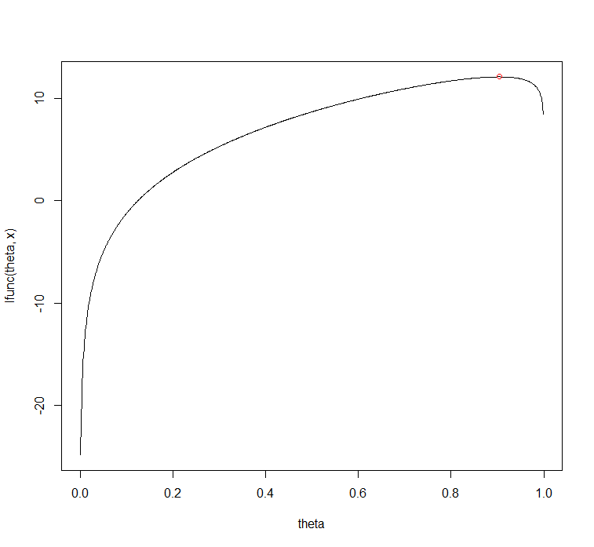
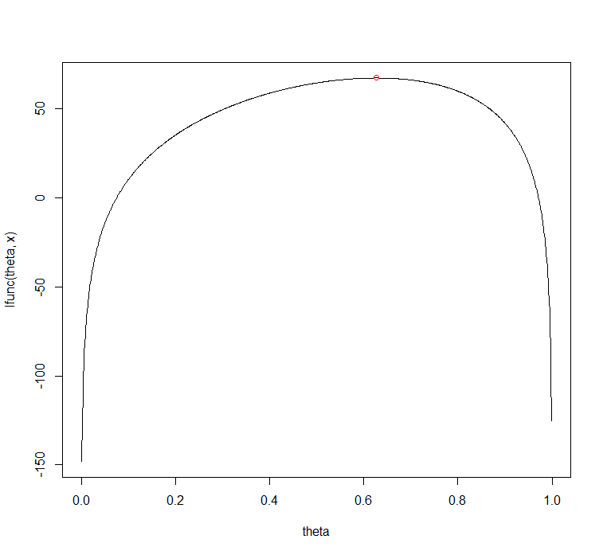

Slide 4
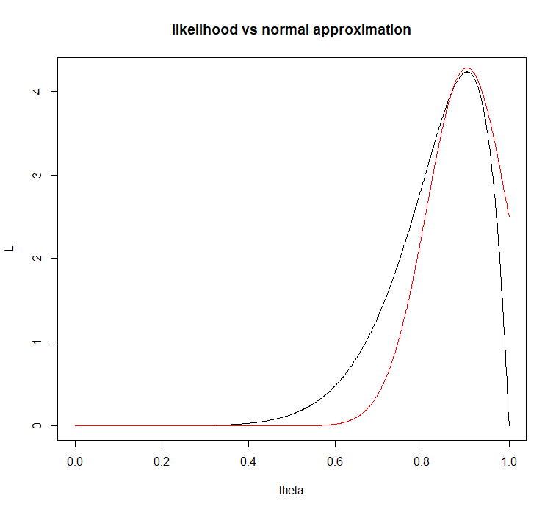
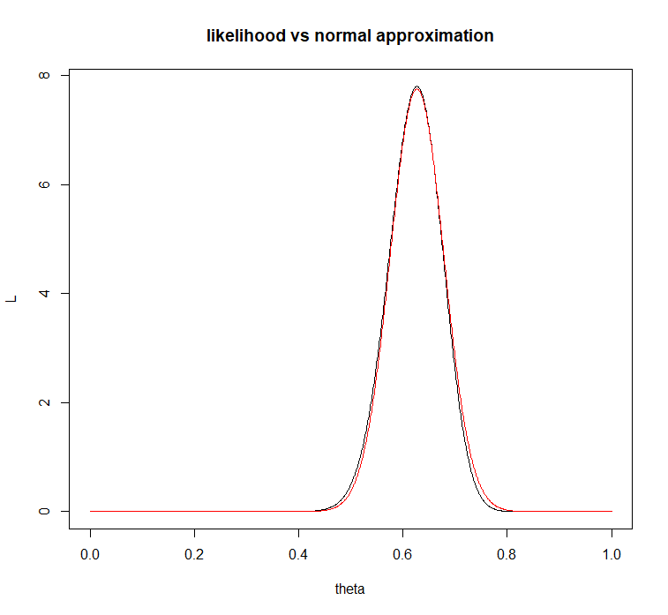
likelihood vs normal approximation

Slide 5
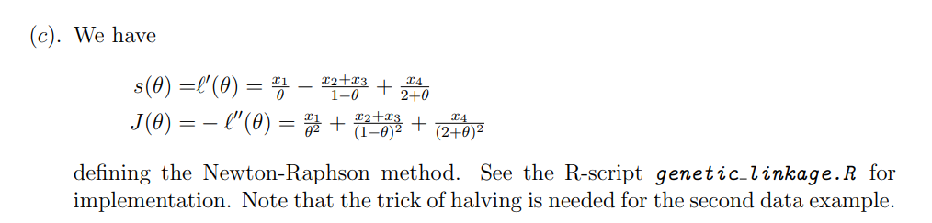
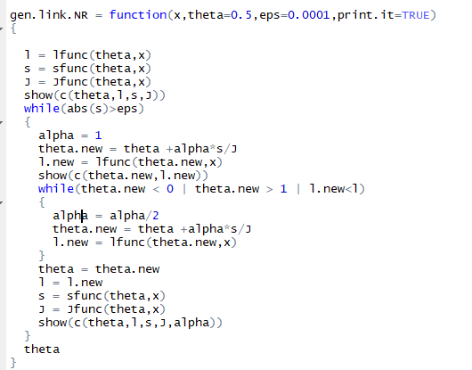

Slide 6
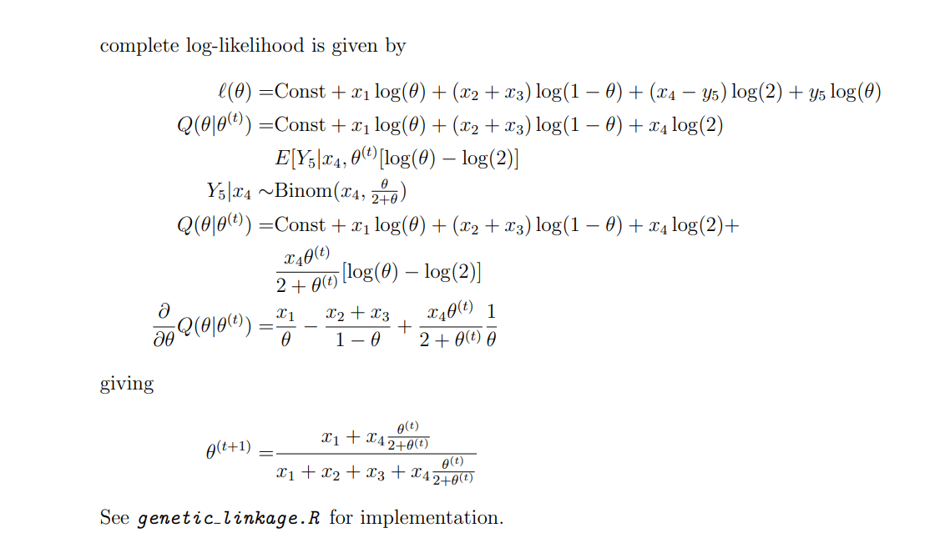
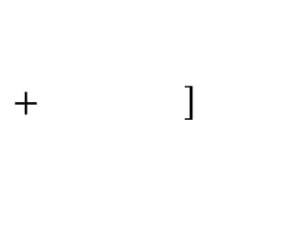
EM
$+ \left.\right]$

Slide 7
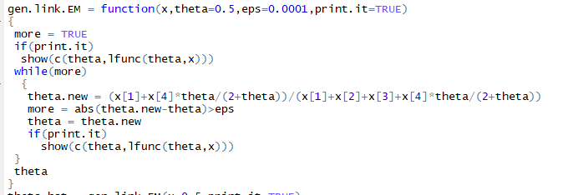

Slide 8
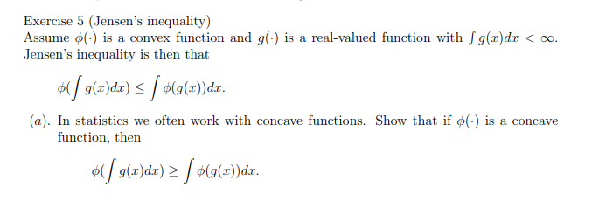


Slide 9
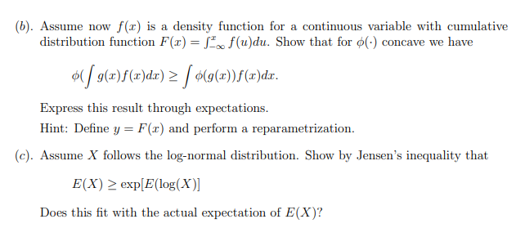
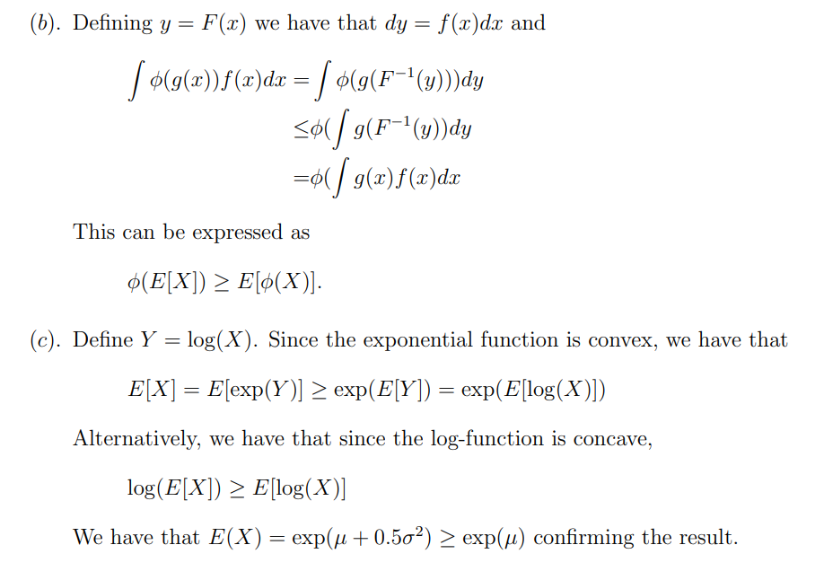

Slide 11


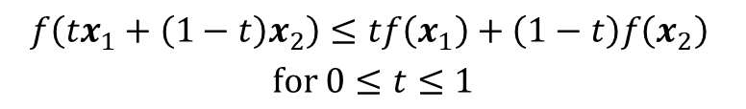

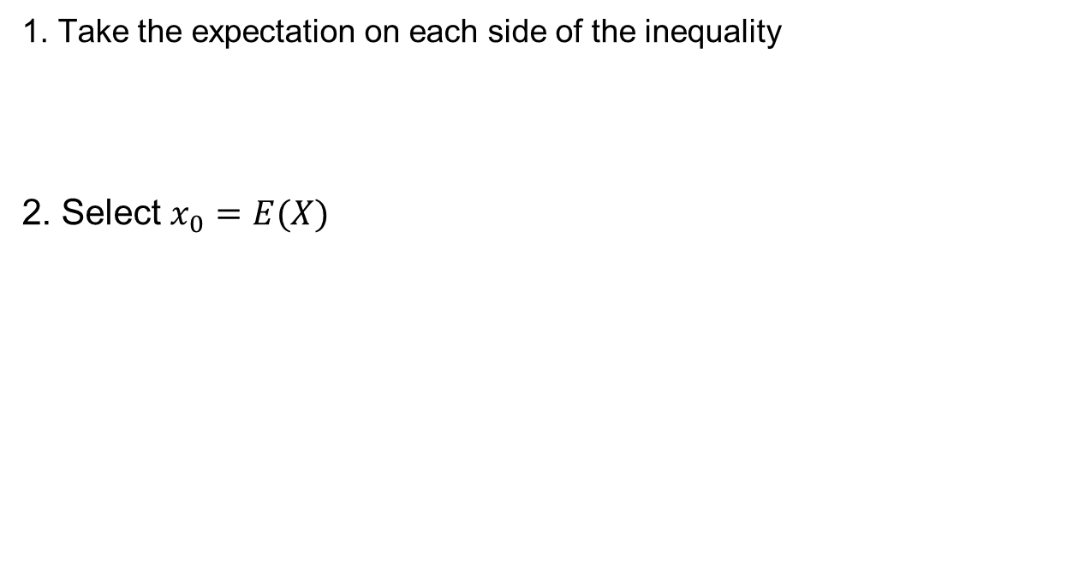


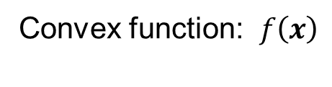


Jensens inequality
Convex function: $f\left(x\right)$
Interpolation always above function
$$f\left({tx}_{1}+\left(1−t\right)x_{2}\right)≤tf\left(x_{1}\right)+\left(1−t\right)f\left(x_{2}\right)$$
$$for 0≤t≤1$$
$$f\left(x\right)$$
$$\left(x_{2},f(x_{2})\right)$$
$$\left(x_{1},f(x_{1})\right)$$
Tangent always below function
$f\left(x\right)≥f\left(x_{0}\right)+\left(x−x_{0}\right)f^{′}\left(x_{0}\right) ∀ x_{0}$
1. Take the expectation on each side of the inequality
2. Select $x_{0}=E(X)$
$$E\left(f\left(X\right)\right)≥E[ f\left(x_{0}\right)+ \left(X−x_{0}\right)f^{′}\left(x_{0}\right) ]$$
$E\left(f\left(X\right)\right)≥$ $f\left(x_{0}\right) +\left(E(X)−x_{0}\right)f′(x_{0}$)
$$=0 when x_{0}=E(X)$$
$E\left(f\left(X\right)\right)≥$ $f\left(E(X)\right)$

