Slide 1
STK3100 and STK4100
Modeling correlated responses:
Prediction of random effects
Marginal models and generalized linear mixed models
GEE estimation for marginal models
Covers the following material in chapter 9:
Sections 9.1.2, 9.1.3, 9.3.2, 9.4.1, 9.4.2, 9.5.1,
9.5.2, 9.6.1, 9.6.3, 9.6.4, and 9.7
Department of Mathematics
University of Oslo

Slide 2
A strategy for fitting linear mixed models
Start with a «large model» for the fixed effects, i.e. a model that contains all main effects and «sufficiently many» interactions
Keep the fixed effects as in 1 and use likelihood ratio testing or AIC based on REML to determine the appropriate form of the variance components (special attention is needed for null hypotheses on the boundary of the parameter space)
Keep the variance components as determined in 2 and use likelihood ratio testing or AIC based on ML to determine the appropriate form of the fixed effects
Present the «final model» obtained in 3 using REML estimation
R code for the FEV data is given on the course web-page

Slide 3
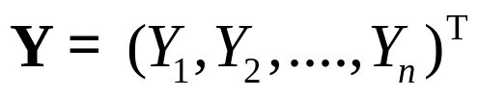




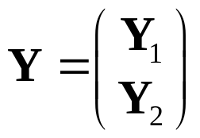
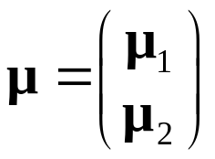
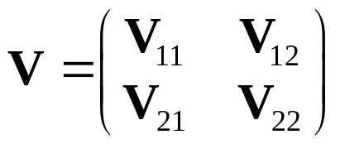
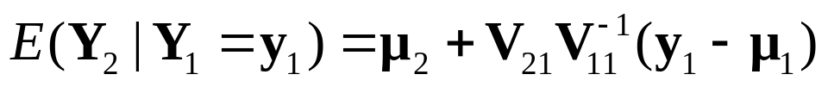
Towards prediction of random effects:
Conditional expectation for multivariate normal distribution (recap from chapter 3)
Let be multivariate normally distributed with mean vector and positive definite covariance matrix
, i.e.
Suppose is partitioned as
with and
Then
In particular

Slide 4


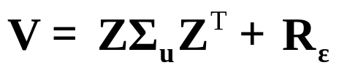







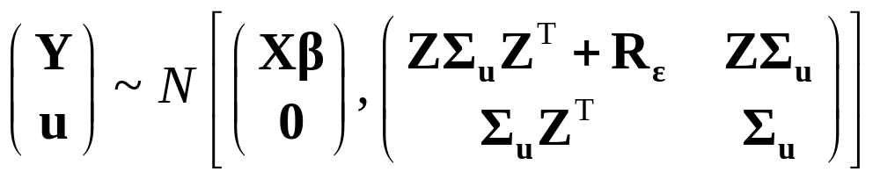
Prediction of random effects
We will first see how we may predict the values of the random effects assuming that and are known
We have
where
and
Note that
It follows that

Slide 5
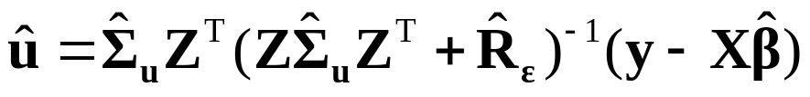
By the result on conditional expectation for multivariate normal distributions, we have
We may now insert estimates for the unknown parameters and obtain the predictions
The course web-page gives examples of R code (fecal fat and fev data)

Slide 6
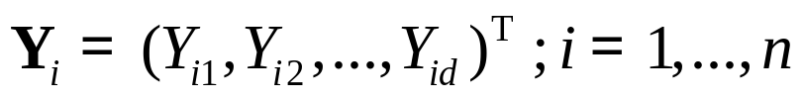
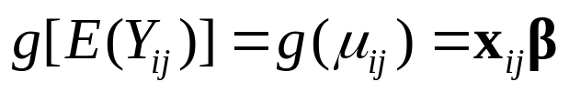

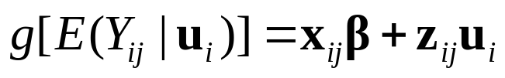

General correlated responses: Marginal models and GLMMs
We assume that are independent vectors that corresponds to observations from each of n clusters
A marginal model with link function g has the form
for
A generalized linear mixed model (GLMM) has the form
where the parameters are the fixed effects and
give the random effects

Slide 7
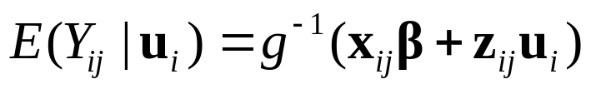
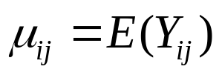
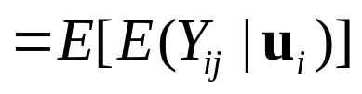
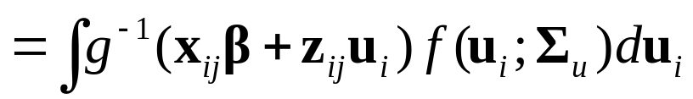


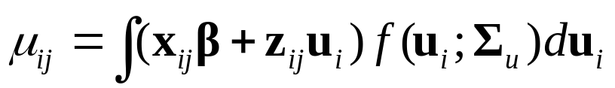
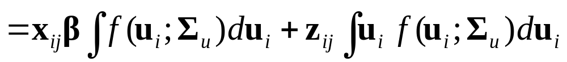
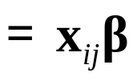
For a GLMM we have
This gives marginally
where is the density function
For the identity link we have
Thus we have an identity link (with the same effects) also for the marginal model, but a similar result does not necessarily hold for other link functions

Slide 8




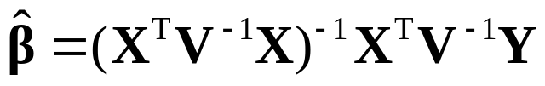

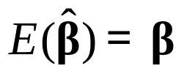

Marginal normal linear models
We have independent vectors that corresponds to the measurements in each of n clusters
As above we combine the vectors into a vector
We assume that but we may be uncertain about the correct specification of the covariance matrix
We therefore specify a working covariance matrix
and use the estimator
Then we have that is approximately multivariate normal, and that
[this applies also when ]

Slide 9

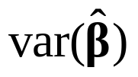

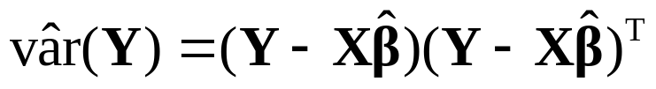
Further we have
which reduce to the expression for the ML estimator (only) when
We obtain an estimator of the covariance matrix by replacing by
This gives us the «sandwich estimator»

Slide 10
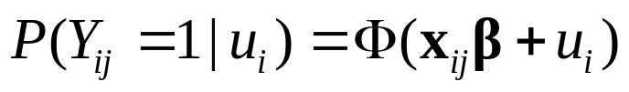
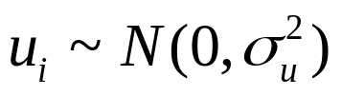


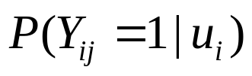
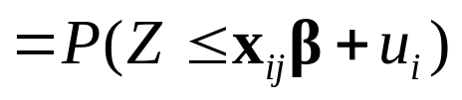
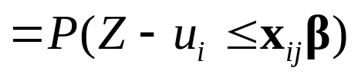
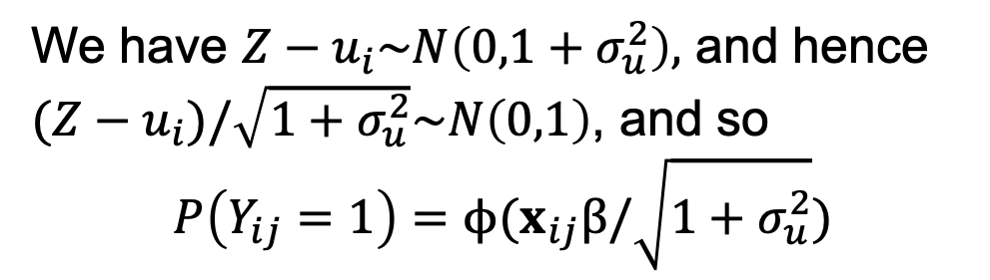
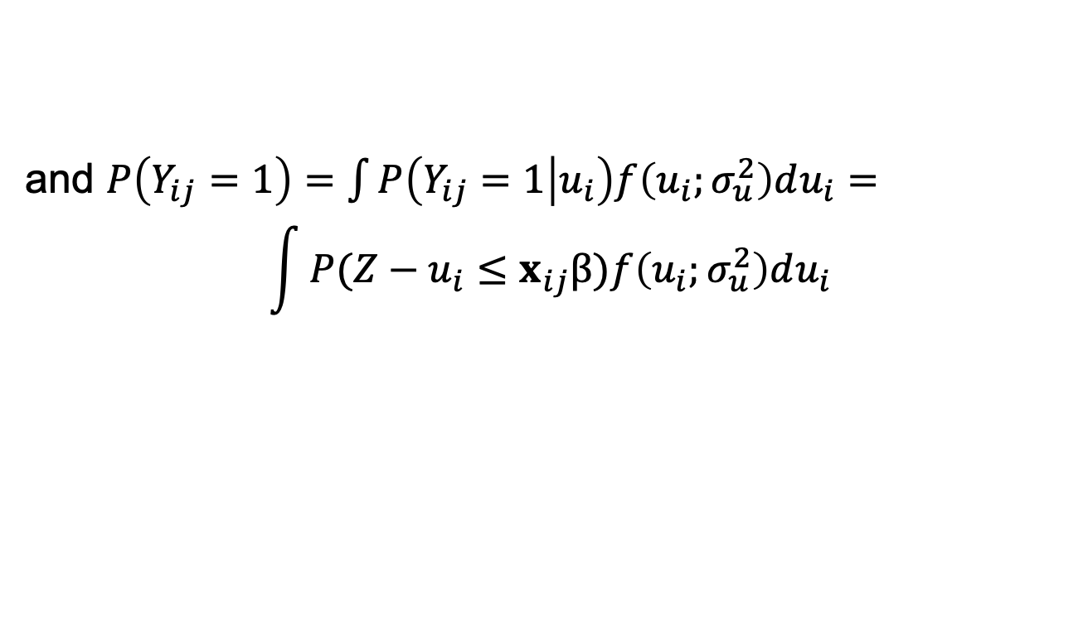
Models for a binary response
Consider first the mixed probit model for binary data
where and is the cdf of
Then
and $P\left(Y_{ij}=1\right)=\int{P\left(Y_{ij}=1 | u_{i}\right)f\left(u_{i};σ_{u}^{2}\right)du_{i}=}$
$$\int{P(Z−u_{i}≤x_{ij}β)f\left(u_{i};σ_{u}^{2}\right)du_{i}}$$
We have $Z−u_{i}\sim N\left(0,1+σ_{u}^{2}\right),$ and hence $(Z−u_{i})/\sqrt{1+σ_{u}^{2}}\sim N\left(0,1\right)$, and so
$$P\left(Y_{ij}=1\right)=ϕ(x_{ij}β/\sqrt{1+σ_{u}^{2}})$$

Slide 11
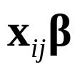
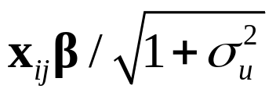
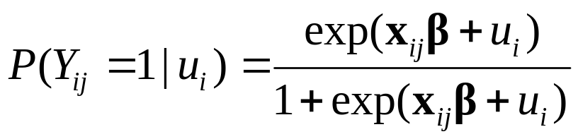
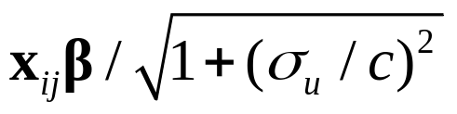

Thus the implied marginal model is also a probit model, but with replaced by
For the logistic mixed model
the implied marginal model is not exactly of logistic form
But it is approximately a logistic model with replaced by where

Slide 12
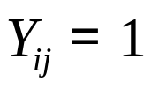
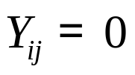
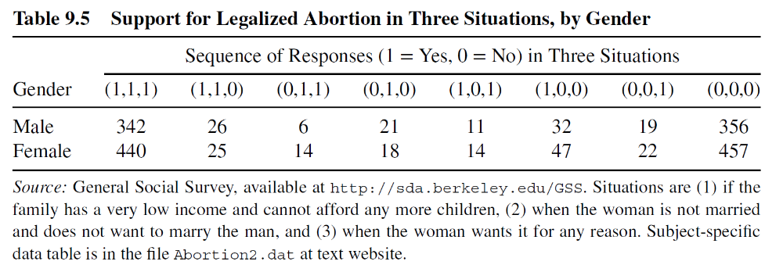
Example: Survey on attitude to abortion
Survey in the US on supporting legalized abortion under d = 3 three different situations
if person i supports legalized abortion under situation j , otherwise
Summary of data:

Slide 13
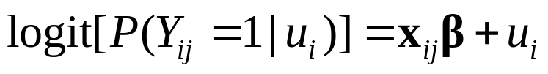
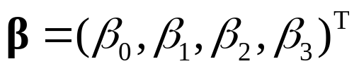
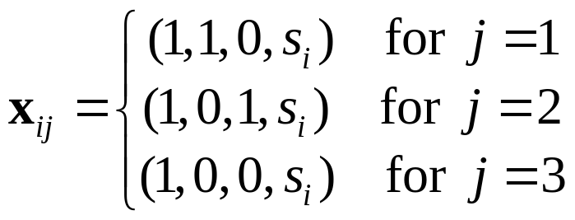


When modelling the data, we need to take into account that the three responses for a person are dependent
A possible model is a logistic regression model with a random effect for persons:
Here , , and
where if person i is a female and if person i is a male
R code is given on course web-page

Slide 14
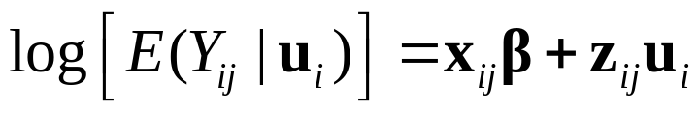


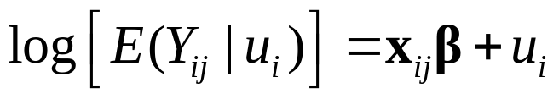
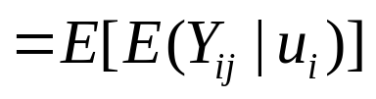
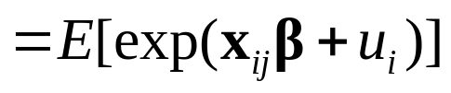
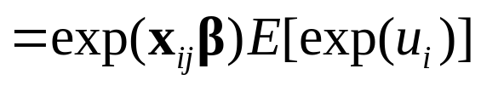
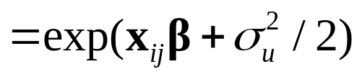
Poisson models for correlated count data
A mixed Poisson GLMM with log link is given by
where , and given we have that
are independent and Poisson distributed
For the random intercept model [ ]
we have (using the moment generating function)
Thus the derived marginal model has the same effect of the covariates, but a different intercept

Slide 15
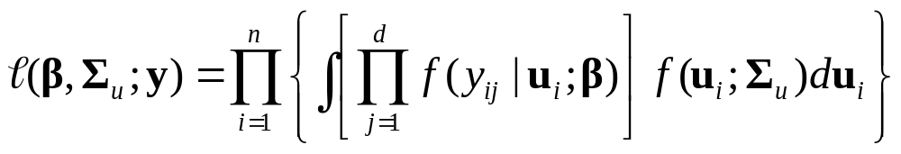
Maximum likelihood estimation for GLMMs
The likelihood function for a GLMM is given as
This is a complicated expression, and the integral (typically) has no closed form solution
The integral has to be evaluated by numeric techniques
Common approaches are Laplace approximations and Gauss-Hermite quadrature approximations

Slide 16
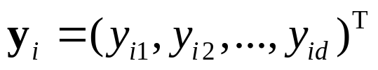
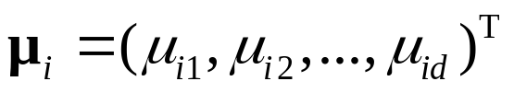
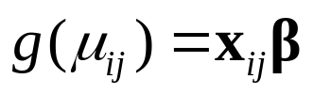




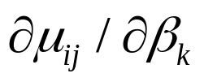


GEE estimation for marginal models
For cluster i with observations and means , the marginal model with link function g is
Let denote the working covariance matrix and let
be the matrix with element equal to
Remember the quasi-likelihood equations for univariate responses
$\sum_{i=1}^{n}{v(μ_{i})^{−1}x_{ij}\left(y_{i}−μ_{i}\right)(∂μ_{i}/}∂η_{i})^{}=\sum_{i=1}^{n}{v(μ_{i})^{−1}(y_{i}−μ_{i})(∂μ_{i}/}∂β_{j})^{}$
Analogous for the multivariate setting we have the generalized estimating equations (GEE)

Slide 17



The GEE estimator is approximately multivariate normal with mean , and with covariance matrix
Analogous to the univariate case, we obtain sandwich estimator for the covariance matrix by inserting estimates for the unknown parameters and by replacing by
R code for attitude to abortion example is given on the course web-page

