Slide 1
STK3100 and STK4100
Modeling correlated responses:
Normal linear mixed models
Covers the following material in chapter 9:
Sections 9.2, 9.3.1, and 9.3.3
Department of Mathematics
University of Oslo

Slide 2
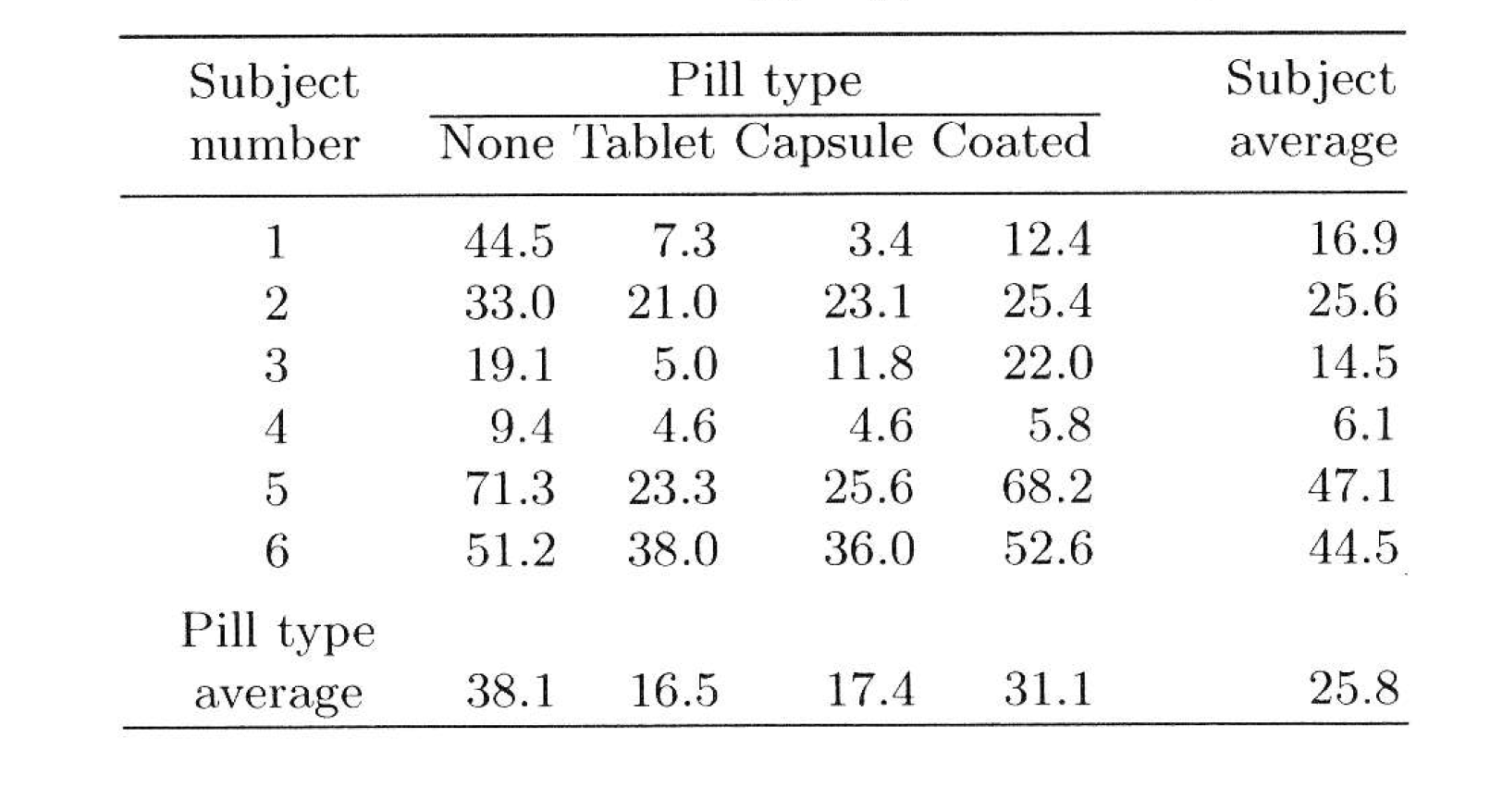
Two-way mixed effect ANOVA
Example: Fecal fat
Lack of digestive enzymes in the intestine can cause bowel absorption problems, which will be indicated by excess fat in the feces. Pancreatic enzyme supplements can reduce the problem. The data are from a study to determine if the form of the supplement makes a difference

Slide 3
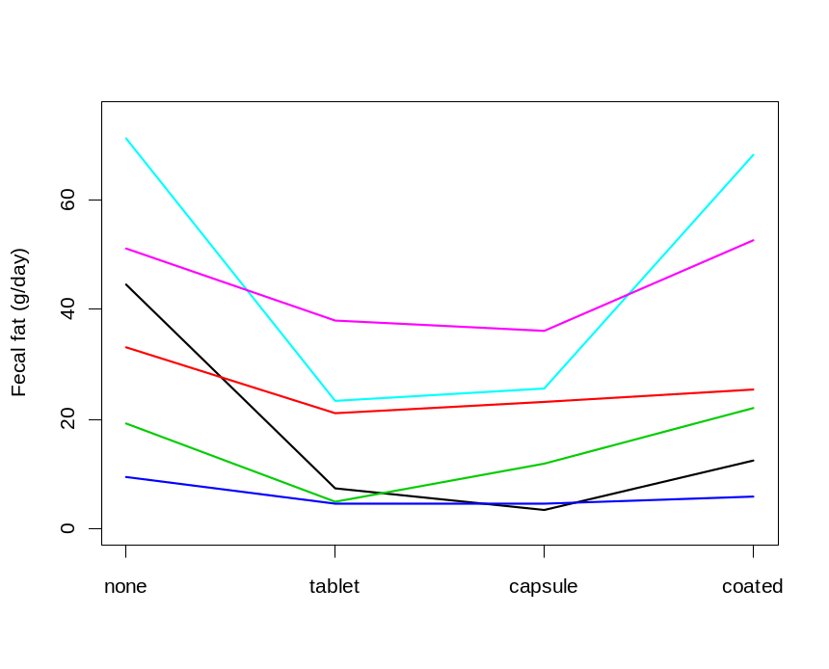
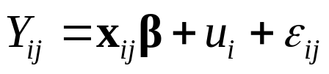
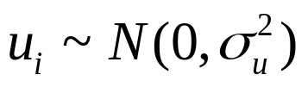
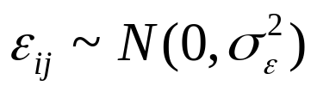
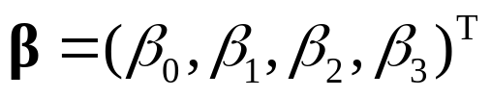

The values for a patient are not independent, and this has to be taken into account when we analyze the data
Mixed effects model (for j-th treatment for i -th patient):
Here and are independent
Further and (e.g)

Slide 4











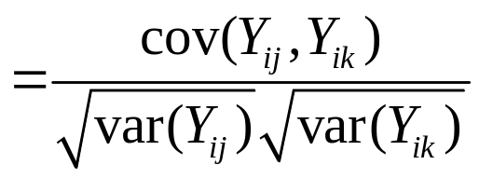
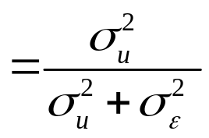

Covariance for two measurements from same patient ( ):
Variance for a measurement:
Correlation for two measurements from the same patient:
This is the intraclass (or intracluster) correlation
R code for the fecal fat data is given on the course web-page

Slide 5

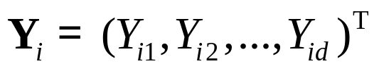
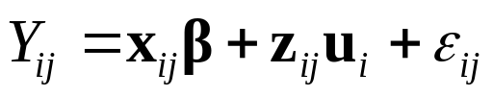




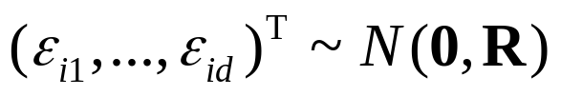



Normal mixed models – general formulation
We assume that are independent vectors that corresponds to the measurements in each of n «clusters»
For ease of presentation, we assume that there are d observations in each cluster, and write
(but it is easy to generalize to the situation where the number of observations may vary between the clusters)
We consider a mixed effects model:
Here is a vector of fixed effects, is a vector of random effects, and , and is independent of
In some situations, we will assume that $R=σ_{ε}^{2}I$, so that the are independent and

Slide 6







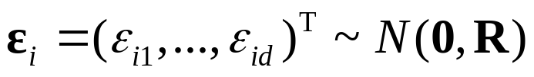



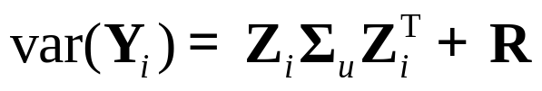
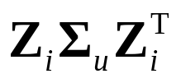

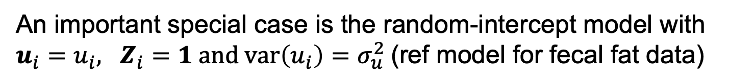
Thus we assume that the independent vectors
are given as
where
is the matrix that has in row j
is the matrix that has in row j
and are independent
An important special case is the random-intercept model with $u_{i}=u_{i}, Z_{i}=1 and var\left(u_{i}\right)=σ_{u}^{2}$(ref model for fecal fat data)
Note that is multivariate normal with mean vector
and covariance matrix
Here describes the between-cluster variability and describes the within-cluster variability

Slide 7
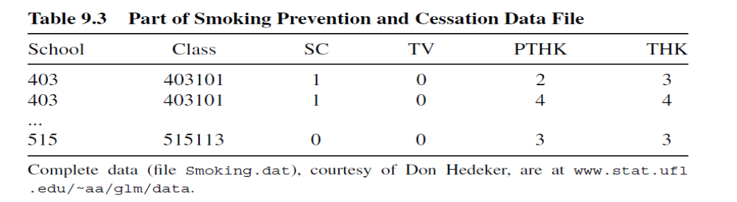
Multilevel models
Example: Smoking prevention and cessation study
Study the effect of two programs for discouraging seventh-grade pupils from starting or continuing to smoke (school-based (SC) and tv-based (TV))
The response is the score on a tobacco and health knowledge scale (THK), which was also measured at the beginning of the study (PTHK)
The data have a hierarchical structure with pupils nested in classes that are nested in schools

Slide 8
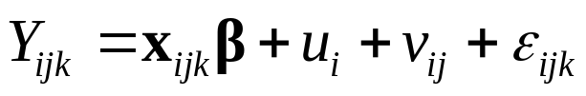

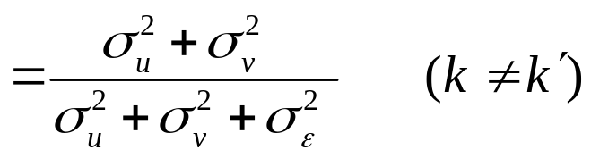

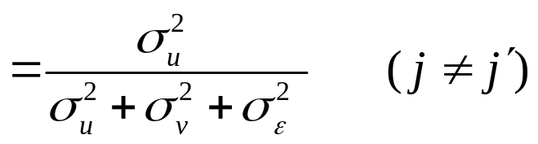


Hierarchical model for the response for the k -th pupil in the j-th class in the i -th school:
Here $u_{i}\sim N(0,σ_{u}^{2})$, $v_{ij}\sim N(0,σ_{v}^{2})$ and $ε_{ijk}\sim N(0,σ_{ε}^{2})$ are independent
Further and are the regression coefficients and covariates for the fixed effects (PTHK and indicators for the programs)
Here we have the correlations
R code for the smoking data is given on the course web-page

Slide 9
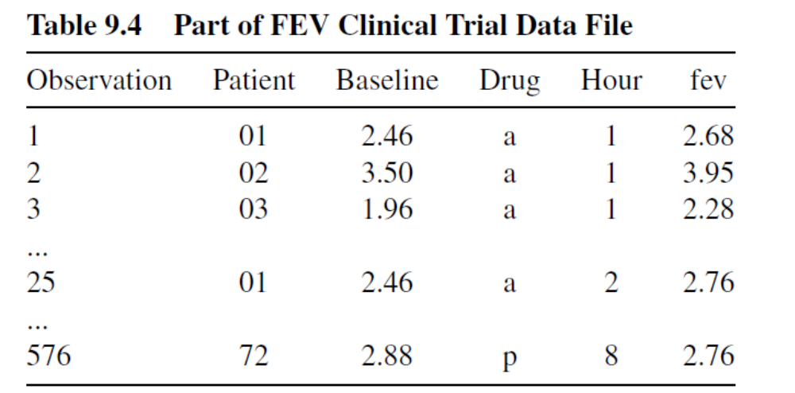
Random intercept and slope
Example: FEV measurements
In a study 24 patients with respiratory problems were randomized to one of three treatments (two active treatments and placebo) and FEV (forced expiratory volume in 1 second in liters) was measured at baseline and then for each of the 8 hours following drug administration

Slide 10

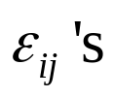
A possible model for the j-th measurement for the i -th patient is a model with random intercept and slope:
Here we assume that are bivariate normal,
and that the are independent of
Further a simple model formulation assumes that the are independent
R code for the FEV data with independent errors is given on the course web-page

Slide 11
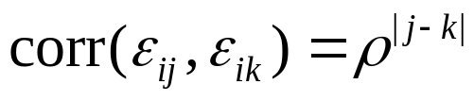
Allowing for correlated errors
As we have seen, sometimes it is assumed that the are independent
More generally we may assume that the are correlated for a subject
One option is to assume an autoregressive correlation structure, i.e.
R code for the FEV data using this correlation structure will be shown in relation to model selection later

Slide 12
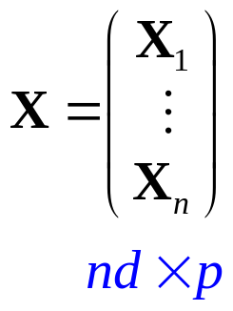
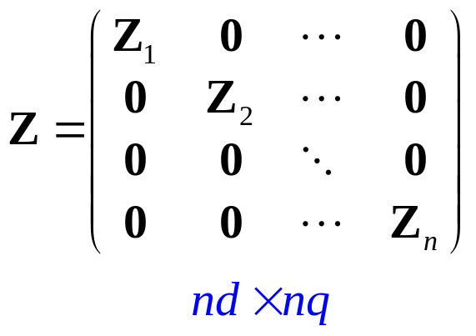
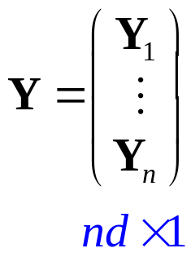
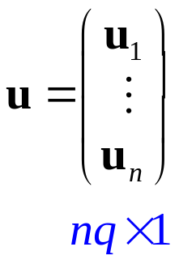
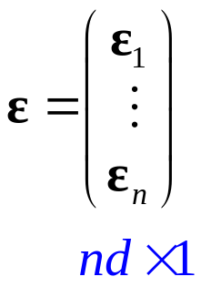

Normal mixed models – estimation of fixed effects
We have independent vectors given as
We introduce the vectors and matrices
We may then write

Slide 13
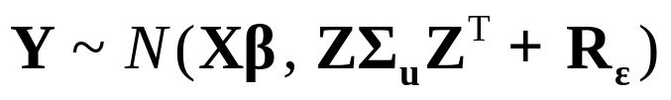
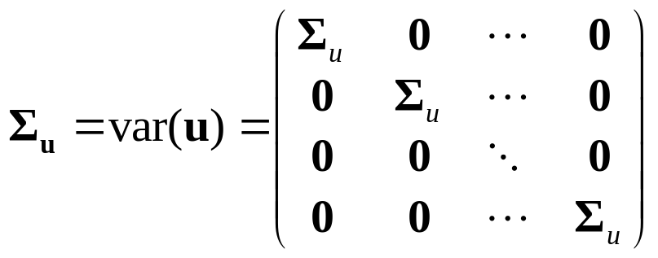
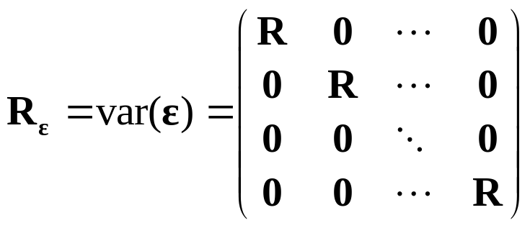
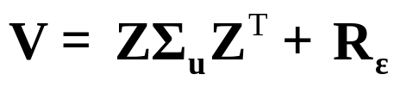


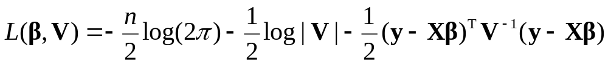
It follows that
where
If we introduce , the likelihood for an observed value of is given by
The log-likelihood becomes

Slide 14
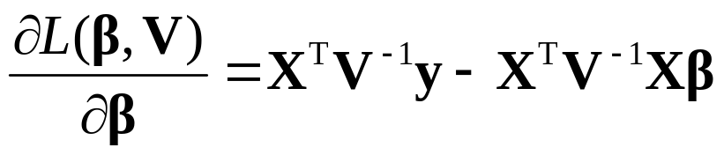
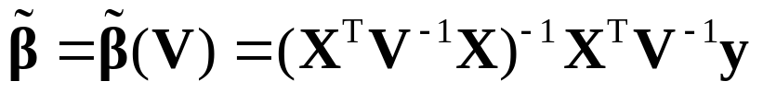
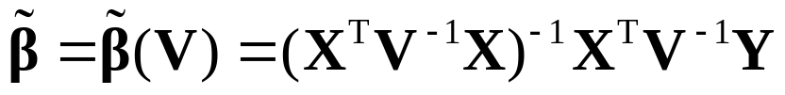
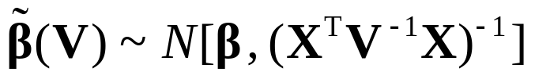
Hence we have (cf. additional exercise 1)
For given value of V, the log-likelihood is maximized by
Hence for given value of V, the MLE of is given by
We have (approximately)

Slide 15

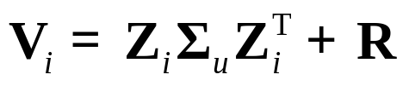
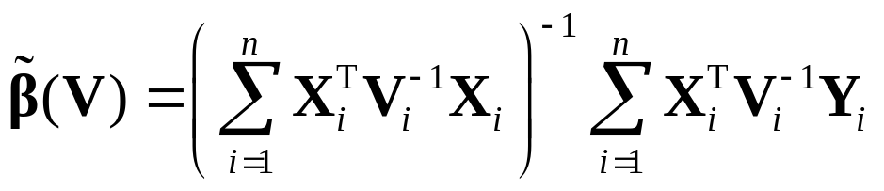
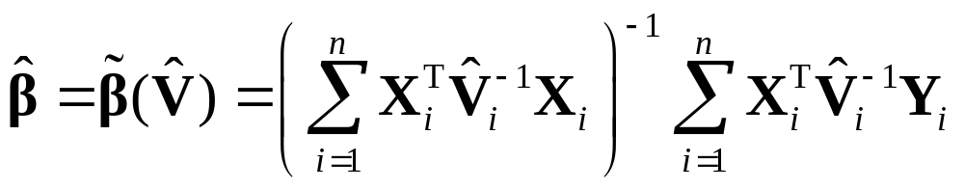
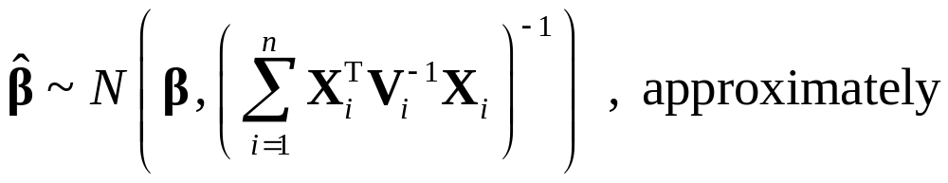
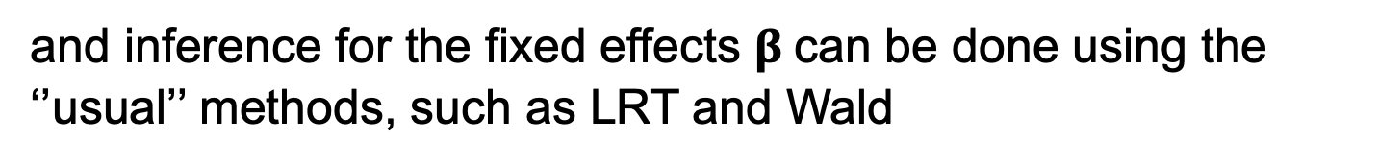
V has a block-diagonal form with blocks
so we may write the estimator as
In practice V has to be estimated (cf. below), so we obtain the estimator
We have
and inference for the fixed effects $β$can be done using the ‘’usual’’ methods, such as LRT and Wald

Slide 16

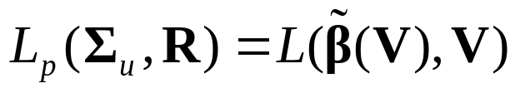
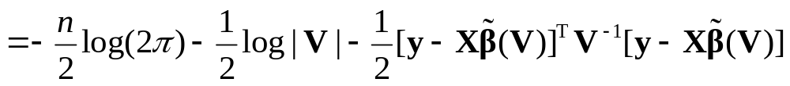
Estimation of variance components
The covariance matrix is a block diagonal matrix with blocks
We have to estimate (the parameters of) and R
One option is to use maximum likelihood, i.e. maximize the profile log-likelihood
A disadvantage with this approach is that a wrong specification of the fixed effects will influence the estimation of the variance components

Slide 17










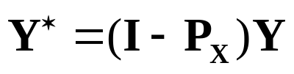

We avoid this problem by using restricted maximum likelihood (or residual maximum likelihood) estimation (REML)
The idea is to consider transformed data ,
where L satisfies
We then have
where
We then obtain the estimates of the variance components by maximizing the likelihood based on (which does not depend on )
Note that we may choose where
is the projection matrix for the model space
Then we have that are the residuals
Additional exercise 26 gives more details

