Slide 1
STK3100 and STK4100
GLM models for overdispersed count data
Quasi-likelihood methods and variance inflation
Covers the following material from chapters 7 and 8:
Sections 7.3.1. 7.3.2, 7.3.3, 7.3.4, 7.4.1, 7.5.1, and 7.5.2
Sections 8.1.1, 8.1.2, 8.1.3, 8.2.4 (only to middle of p. 276),
8.3.1, 8.3.2, 8.3.3, and 8.3.4
Department of Mathematics
University of Oslo
Notes:
1

Slide 2
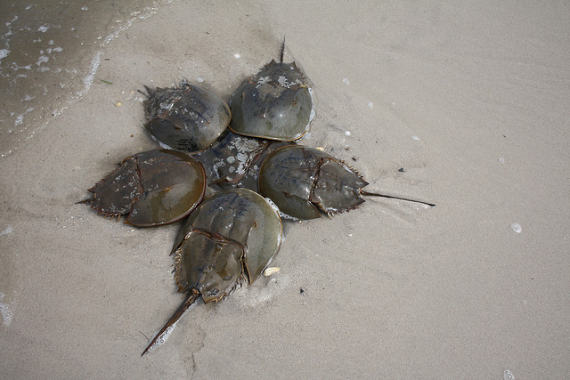
Overdispersion
For the Poisson distribution, the variance equals the mean
It is quite common that the variance is larger than the mean
This phenomenon is called overdispersion (relative to a Poisson model)
An example: Horseshoe crabs
http://en.wikipedia.org/wiki/horseshoe_crab
During mating of horseshoe crabs, a number of male crabs may cluster around a mating couple. These male crabs are called satellites
The number of satellites have been recorded for 173 female crabs (cf. section 1.5)

Slide 3





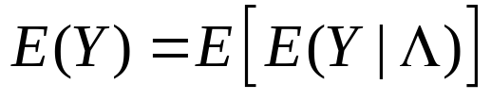


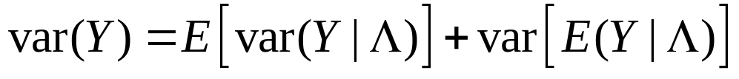


Overdispersion and negative binomial distribution
One situation when overdispersion may occur is when we have a mixture of a number of Poisson distributed groups [where the groups e.g. may correspond to different combinations of (observed or not observed) categorical covariates that are not included in the model]
One way to formulate this situation is the following:
Let the random variable have mean and variance. ,
and assume that the conditional pmf of Y given is
Then we have (cf. additional exercise 23)
and

Slide 4

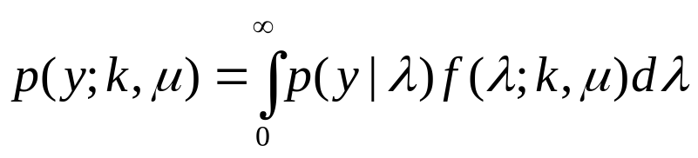
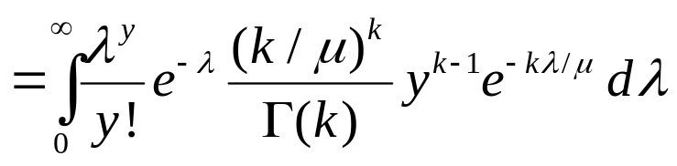
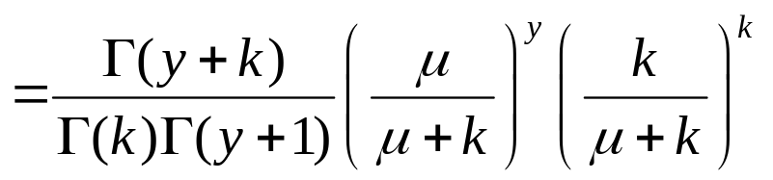


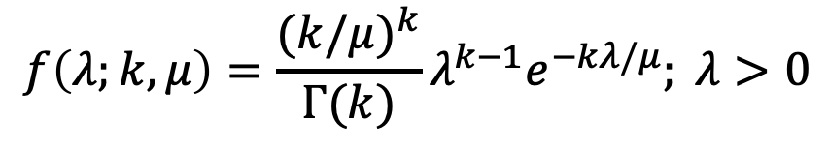
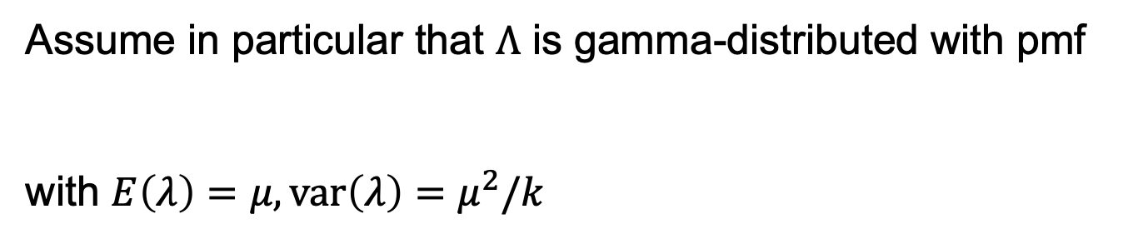
Assume in particular that $Λ$ is gamma-distributed with pmf
with $E\left(λ\right)=μ, \operatorname{var}\left(λ\right)=μ^{2}/k$
$$f\left(λ;k,μ\right)=\frac{(k/μ)^{k}}{Γ(k)}{λ^{k−1}e}^{−kλ/μ}; λ>0$$
Then the marginal pmf of Y is given by
Thus Y has a negative binomial distribution (cf. second mandatory assignment)
Here we have

Slide 5

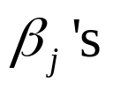

If k is fixed, we may show that has a distribution from the exponential dispersion family (cf. second mandatory assignment), and the «usual machinery» may be used to fit a GLM model
When k is considered as an unknown parameter, one may compute the MLEs by an iteration process where one alternates between estimation of the for given value of k and estimation of k for given values of the
This estimation scheme is implemented for the command glm.nb in the MASS package (where k is denoted )
R code for the crab data is given on the course web page

Slide 6

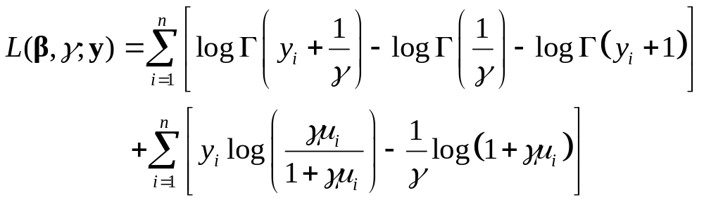

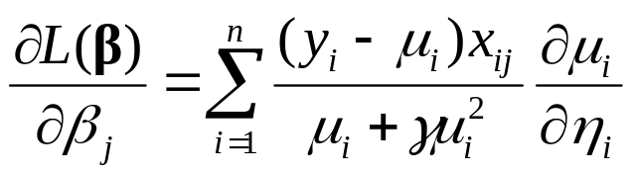
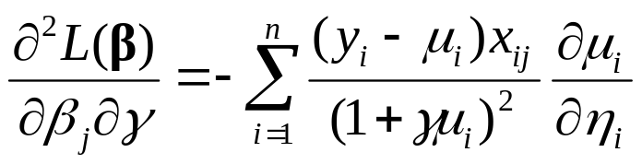



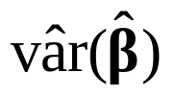

The book by Agresti uses the parameterization
Then the log-likelihood is given by
The score functions are given by (for )
smartboard
Further
smartboard
Therefore
, so and are asymptotically independent and takes the same form whether is known or estimated

Slide 7

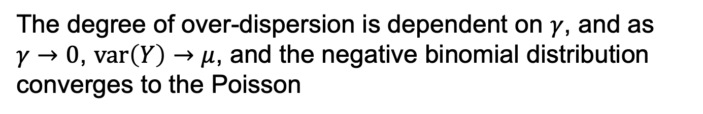

For the parameterization , we have
$$E\left(Y\right)=μ, var\left(Y\right)=μ+γμ^{2}$$
The degree of over-dispersion is dependent on $γ$, and as $γ→0$, $var\left(Y\right)→μ$, and the negative binomial distribution converges to the Poisson
Hence as a test for overdispersion, we may test the null hypothesis

Slide 8

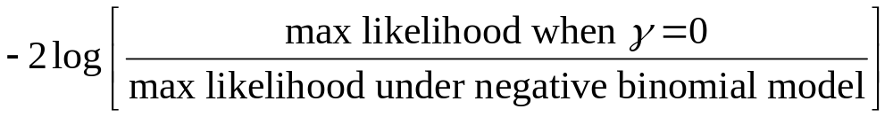




Here the null hypothesis is on the boundary of the parameter space, and then the usual properties of the likelihood ratio test do not hold
One may show that under the approximate distribution of
is an equal mixture of a single point distribution at 0 and a chi-squared distribution with . Hence the p-value is half of the probability from pretending the distribution is chi-squared with
smartboard
Note that since the command glm.nb estimates we have when the iterative procedure provides an «infinitely large» value of

Slide 9
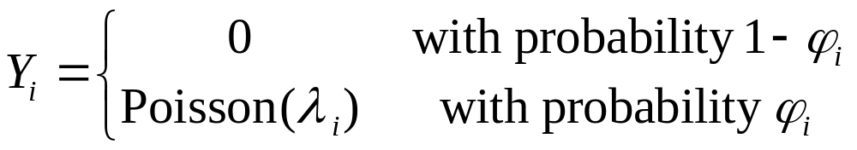



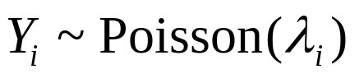



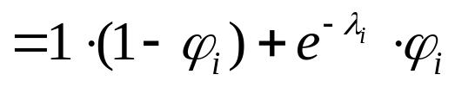
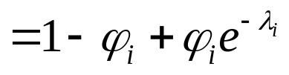

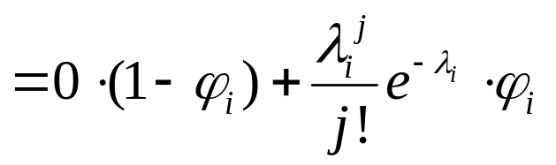
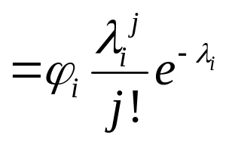
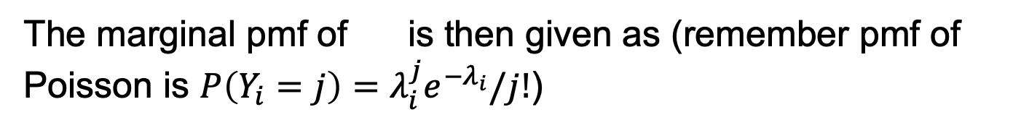
Zero-inflated data
The zero-inflated Poisson model assumes that
This is a mixture distribution, which may be expressed by means of a latent variable that takes the values 0 and 1
We let when and when
The marginal pmf of is then given as (remember pmf of Poisson is $P\left(Y_{i}=j\right)=λ_{i}^{j}e^{−λ_{i}}/j!$)
and for
$P\left(Y_{i}=j\right)=P\left(Y_{i}=j|Z_{i}=0\right)P(Z_{i}=$0)+ $P\left(Y_{i}=j|Z_{i}=1\right)P(Z_{i}=1$)

Slide 10

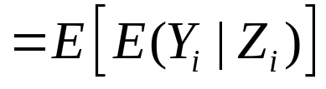
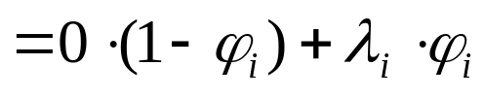
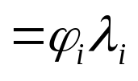
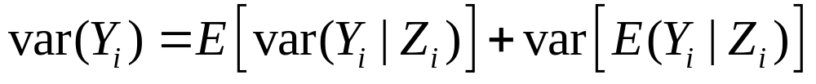
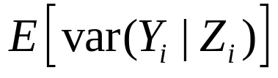
We have that
Further we have
where

Slide 11
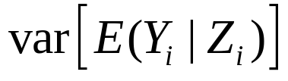
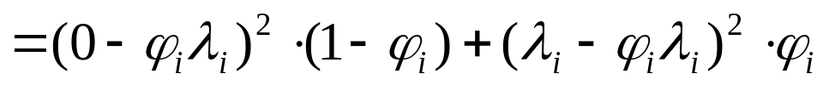
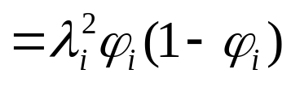

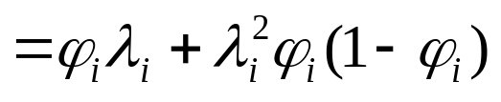
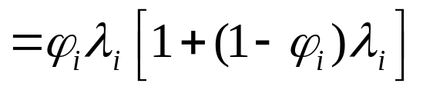
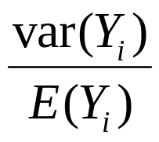
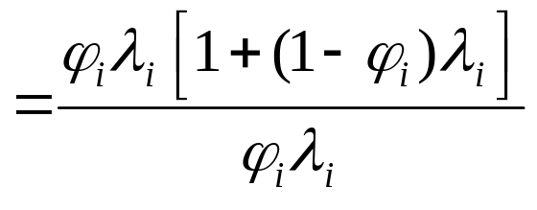
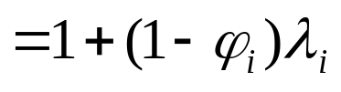


And (remember )
$${=λ}_{i}^{2}φ_{i}\left(1−φ_{i}\right)(φ_{i}+1−φ_{i})$$
It follows that
Thus we have
so there is overdispersion relative to a Poisson model

Slide 12


For regression modelling we may assume that
and
Estimation may be performed by maximum likelihood
A more general model is obtained by replacing the Poisson distribution with a negative binomial, resulting in a zero-inflated negative binomial model
R code for the crab data is given on the course web page

Slide 13


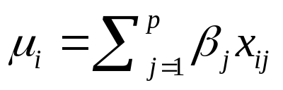


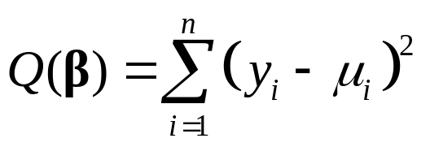
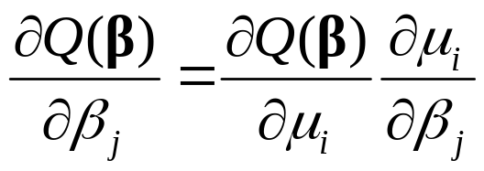
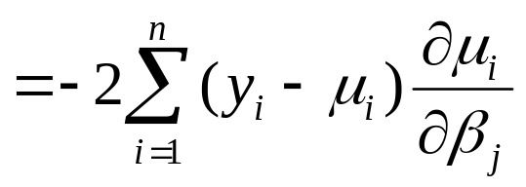
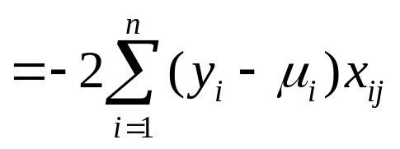
Least squares and quasi-likelihoods
Let be independent random variables
with means and common variance
We assume the linear model
We do not make any assumptions on the distribution of the
For observed values of the , we may estimate the by least squares, i.e. by minimizing
We have that

Slide 14
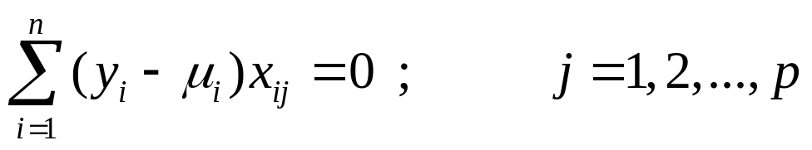
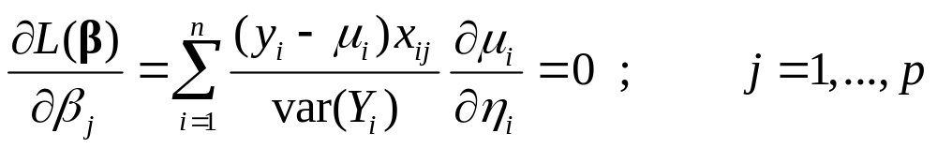

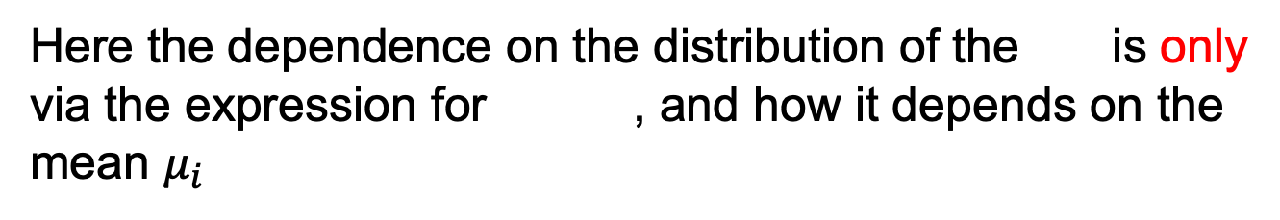
Thus the least squares estimates are the solutions of the equations
We will now consider a similar method for GLMs, i.e. a method that may be used without assuming a specific distribution of the
For a GLM, with a given distribution of the , the ML estimates are obtained by solving the equations
Here the dependence on the distribution of the is only via the expression for , and how it depends on the mean $μ_{i}$

Slide 15


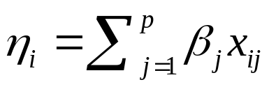





Assume now that we do not make any assumption on the distribution of the
We only assume that are independent random variables with means given by
for a linear predictor
and a link function , and that
Here the variance function may depend on the (via ) and also on a dispersion parameter (that is not made explicit in the notation)

Slide 16
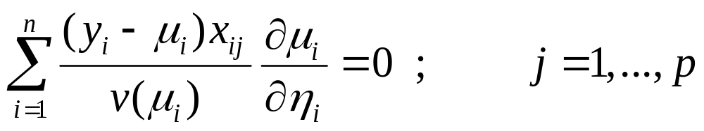
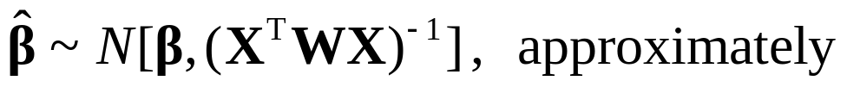
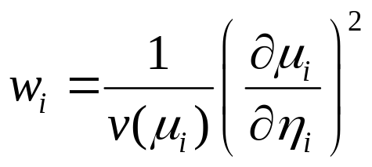
We may then estimate the by solving the equations
This is called quasi-likelihood estimation
If the variance function is correctly specified, we have that (cf. later)
where W is (as before) a diagonal matrix with diagonal elements

Slide 17
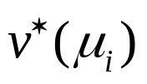

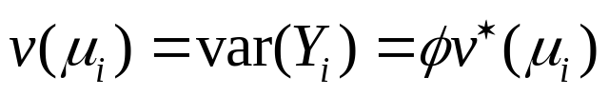
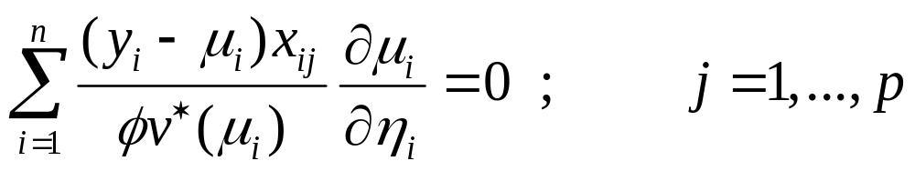
Quasi-likelihood and variance inflation
Assume that a «standard GLM» specifies the variance function
However we believe that the actual variance of may be larger than
To allow for this we assume that
Then the quasi-likelihood equations take the form
The overdispersion parameter cancels from the equations, so the estimates of the are the same as for the «standard GLM»

Slide 18




If the variance function is correctly specified, we have that
Here W is a diagonal matrix with diagonal elements
where the are the weights used for the «standard GLM»
It follows that the covariance matrix for the «standard GLM» should be multiplied by to obtain the covariance matrix for the corresponding quasi-likelihood estimator

Slide 19




How should we estimate ?
To this end, we assume that the model for both the linear predictor and the variance function are correctly specified
Consider the Pearson statistic for the «standard GLM»
Then (approximately)
, and $E(X^{2}/φ$)$≈n−p$,
and hence $E(X^{2}/(n−p)$)$≈φ$, which motivates the estimator

Slide 20




Variance inflated Poisson model
The method we have described may be used for overdispersed «Poisson data»
Then the «standard GLM» is a Poisson GLM with
so for the quasi-likelihood approach we assume
The estimates of the are the same as for the Poisson GLM
The overdispersion parameter is estimated by
R code for the crab data is at the course web page

Slide 21







Variance inflated binomial model
The approach with variance inflation may also be used for overdispersed and grouped binary data
So assume that is the number of «successes» in Bernoulli trials with parameter for each trial, and let
be the proportion of successes
However, there may be larger variability than given by the binomial distribution
The «standard GLM» is a binomial GLM with
so for the quasi-likelihood approach we assume

Slide 22

Example: iron-deficiency in rats
Consider a study with 58 rats on an iron deficient diet
The rats were divided in four groups: a placebo group and three groups that got injection of an iron supplement on three different schedules
The rats were made pregnant and killed after 3 weeks
The number of dead fetuses were counted for each mother, and the mother’s hemoglobin level was measured
R code is at the course web page

Slide 23




Quasi-likelihood and model misspecification
We consider a model with
linear predictor
link function
variance function
Then the quasi-likelihood estimators are the solutions of the quasi-score equations
The quasi-likelihood equations may be written (for convenience in the following)

Slide 24



We have
so the quasi-likelihood equations are unbiased estimating equations (also if the variance function is not correctly specified)
By a general version of the central limit theorem, one may prove that (under certain regularity conditions)
where

Slide 25








By a Taylor series expansion of around the true value
of , we have that
, and we obtain
Now
The observed quasi-information matrix is approximately equal to the expected quasi-information matrix (we will not show this)
which is an approximation of a model-based covariance matrix for $β$

Slide 26








Hence we have
, where
It follows that
A robust variance estimator (which is also valid when the variance function is not correctly specified) is obtained by replacing by and by . This is called a sandwich estimator, because the empirical evidence cov. matrix $Σ$ is sandwiched between two model-based (V)
If the variance function is correctly specified ( ) , we have (cf. slide 24), and

