Slide 1
STK3100 and STK4100
GLMs for binomial and multinomial data and ordinal response
Covers the following material from chapters 5 and 6:
Link functions for binomial data (sections 5.6.1, 5.6.3, 5.7.2)
Summarizing predictive power for GLMs for binomial data (sections 5.2.4-5.2.5)
Baseline-category logit models for multinomial responses (sections 6.1.1-6.1.4, 6.3.2)
Ordinal responses, cumulative logit model (Sections 6.2.1, 6.2.2, 6.3.3)
Department of Mathematics
University of Oslo

Slide 2

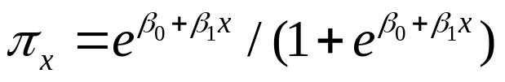

Link functions for binomial GLMs
We motivate the discussion by the beetle example
Let be the probability that a beetle dies at dose x
Logistic regression
and the probit model
give similar model fit, but quite different parameter estimates (cf. R code on web page)
How can this be explained?

Slide 3











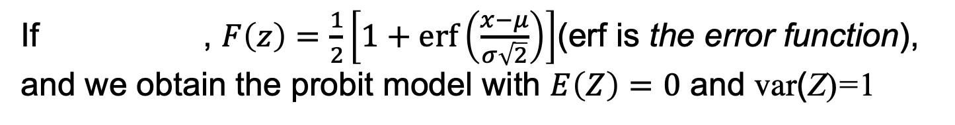
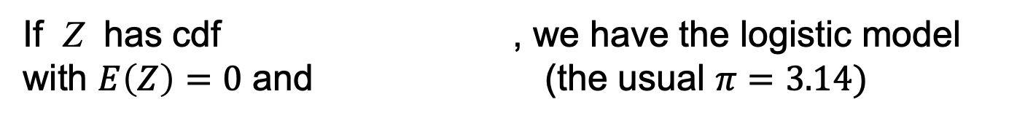
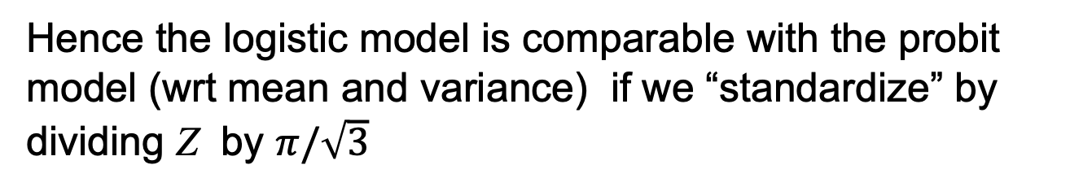
Assume the lethal dose for a beetle is given as
where with
If a beetle is given a dose x, the probability that it will die is
where $β_{0}=−d/σ$ and $β_{1}=1/σ$
If , $F\left(z\right)=\frac{1}{2}\left[1+\operatorname{erf}\left(\frac{x−μ}{σ\sqrt{2}}\right)\right]$(erf is the error function), and we obtain the probit model with $E\left(Z\right)=0$ and var(Z)=1
If Z has cdf , we have the logistic model with $E\left(Z\right)=0$ and (the usual $π=3.14)$
Hence the logistic model is comparable with the probit model (wrt mean and variance) if we “standardize” by dividing Z by $π/\sqrt{3}$
This corresponds to dividing the estimates by $π/\sqrt{3}≈1.8$

Slide 4





The logit and probit links are symmetric around 1/2, in the sense that
so the response curve is symmetric around
An alternative asymmetric link function is obtained from
which gives
The corresponding link function is the complementary log-log link
See See R code on the lecture plan for results for the beetle data

Slide 5
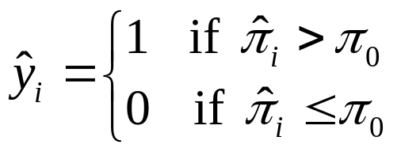
Predictive power: classification and ROC curves
From a fitted model with binary data we may obtain a prediction rule (typically to be used for new data):
For a particular cut-off $π_{0}$ we have
A ROC (receiver operating characteristic) curve is a plot of tpr as a function of fpr for all possible cut-offs
A measure of the predictive power of the model is the area under the ROC curve, denoted AUC
See R code on the lecture plan for illustration

Slide 6
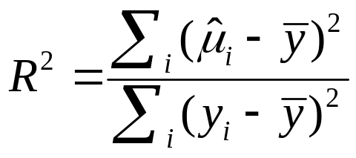
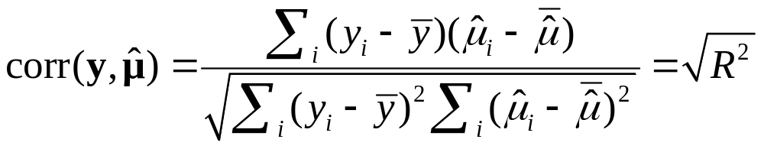

Predictive power: correlation
For a normal linear model it is common to use
as a measure of «explained variation»
One may show that (if the model has an intercept, see page 55 in text book)
This motivates that we also for GLMs may use as a measure of predictive power of a model (see R code on the lecture plan for illustration)

Slide 7
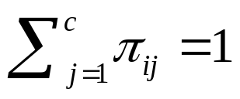

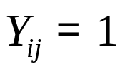

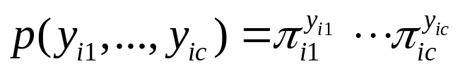

Multinomial response
We consider a situation with c response categories
We may distinguish between nominal (unordered) and ordinal (ordered) responses
We consider N independent subjects, and let $π_{ij}$ denote the probability that subject i has response in category j
We have
The response for subject i may be given by the vector
, where if the response of subject i is in category j , and all other
The multinomial pmf of takes the form

Slide 8
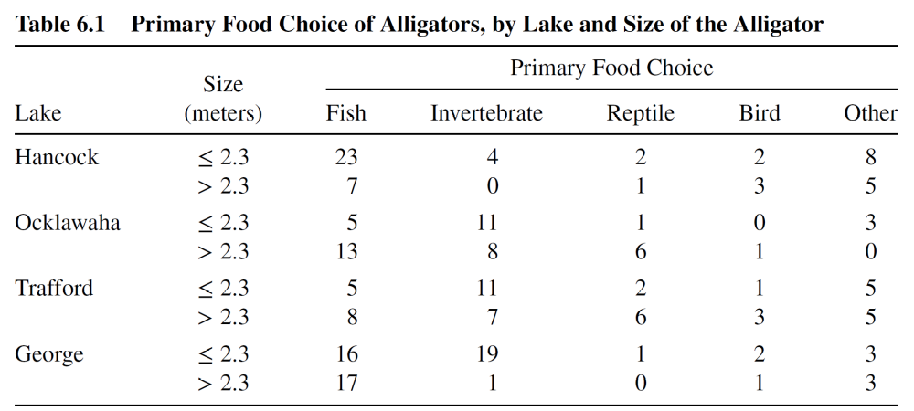
Multinomial models for nominal response
For illustration we consider a data set on food choice of 219 alligators in four Florida lakes (section 6.3.2)
Here the response categories (food choices) are nominal
(R code for the example is given on the lecture plan)

Slide 9
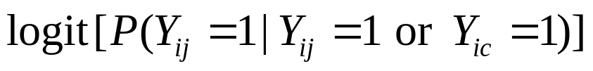
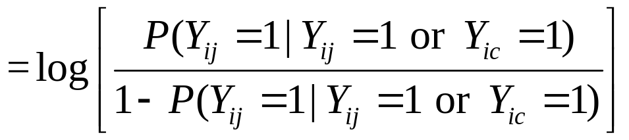
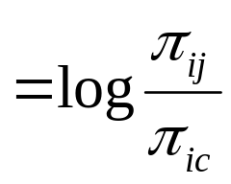
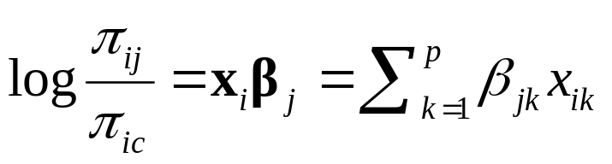
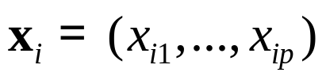
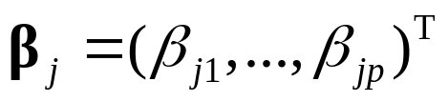

We will consider the multinomial logit model (or baseline-category logit model) using category c as a reference
The model is given by equating the linear predictor to the baseline-category logit, which is the logit of a conditional probability
smartboard
where is a row vector of covariates for subject i,
is a vector of parameters for the j-th category and (without loss of generality, see ex. 6.2 in the textbook)

Slide 10
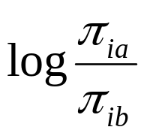
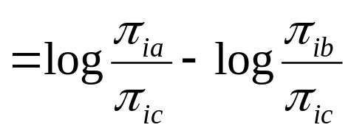

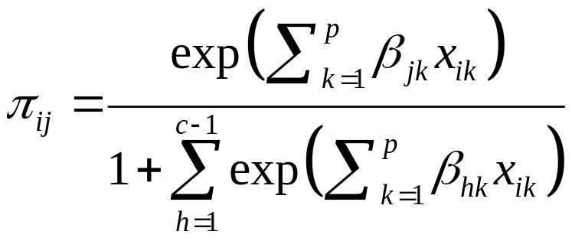
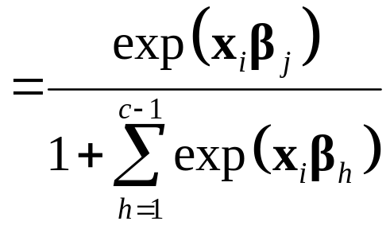
Note that we have
Note also that
smartboard

Slide 11







Multivariate GLMs
The multinomial logit model is an example of a multivariate generalized linear model
For a multivariate GLM we have independent vectors with a distribution from the following multivariate generalization of the exponential dispersion family
where is the (vector-valued) natural parameter, and is the dispersion parameter
For the response vector with mean vector , we have a vector g of link functions such that
Here, $X_{i}$ is the model matrix for subject i with explanatory variables for response $Y_{ij}$ in row j

Slide 12
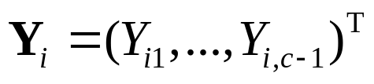
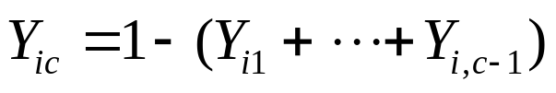
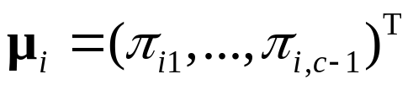
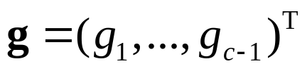
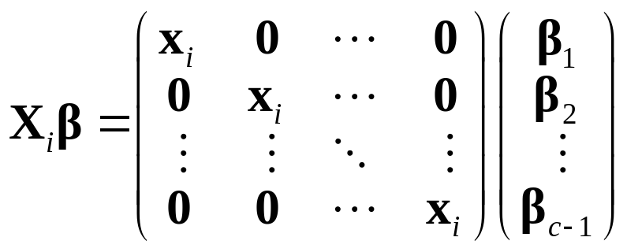
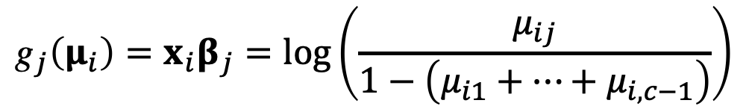
When we write the multinomial logit model as a multivariate GLM, we let and note that
Here we have and the vector
of link functions is given by
$${\text{g}}_{j}\left(μ_{i}\right)=x_{i}β_{j}=\log\left(\frac{μ_{ij}}{1−\left(μ_{i1}+⋯+μ_{i,c−1}\right)}\right)$$
smartboard
The linear predictors take the form

Slide 13
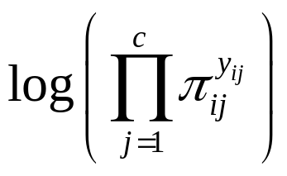
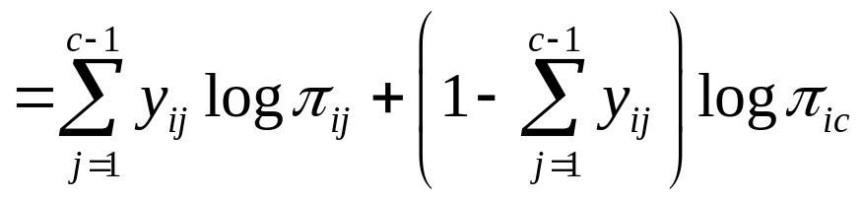
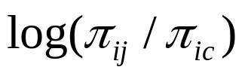
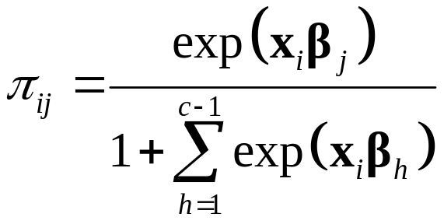
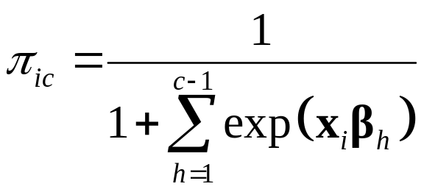
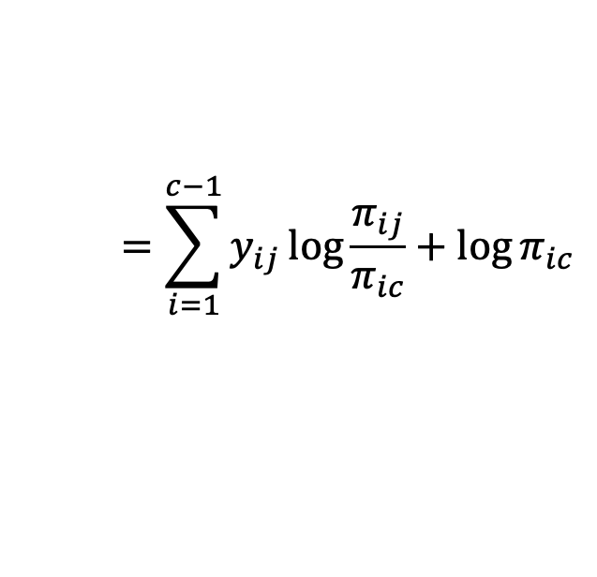
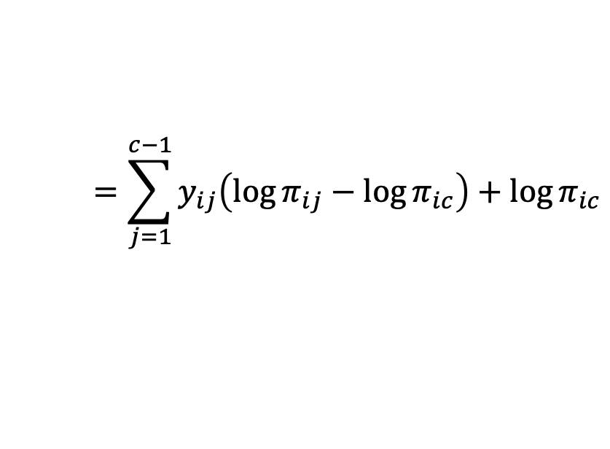
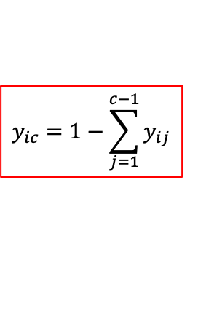
Fitting the multinomial logit model
The contribution to the log-likelihood from the i-th subject is
$$=\sum_{j=1}^{c−1}{y_{ij}\left(\log{π_{ij}}−\log{π_{ic}}\right)+\log{π_{ic}}}$$
$$=\sum_{i=1}^{c−1}{y_{ij}\log{\frac{π_{ij}}{π_{ic}}+\log{π_{ic}}}}$$
$$y_{ic}=1−\sum_{j=1}^{c−1}{y_{ij}}$$
From this we see that are the natural parameters and hence the link in the multinomial model is the canonical link
Remember that
and

Slide 14
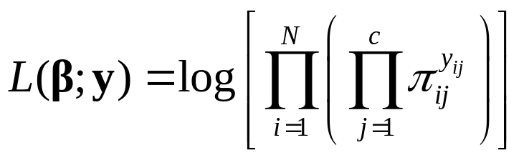
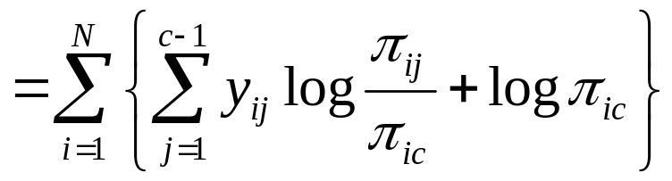
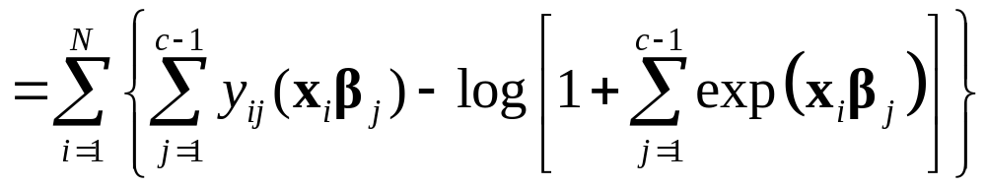
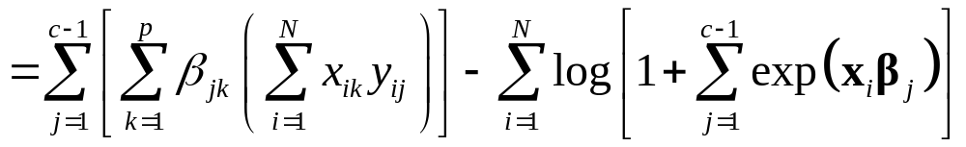

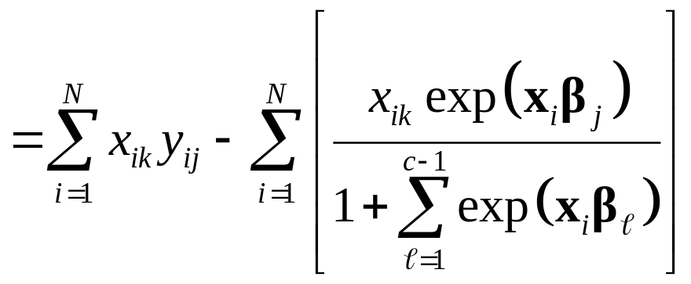
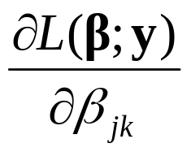
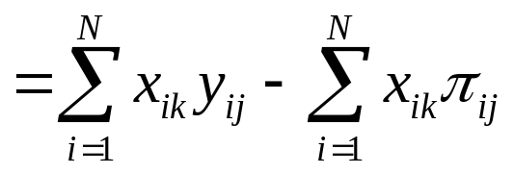
Thus the log-likelihood may be written
smartboard
smartboard
The score functions take the form ( )

Slide 15
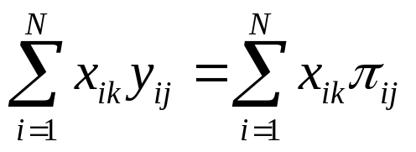
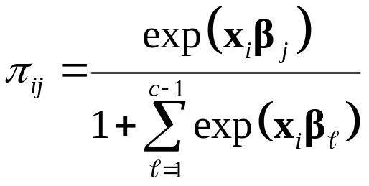
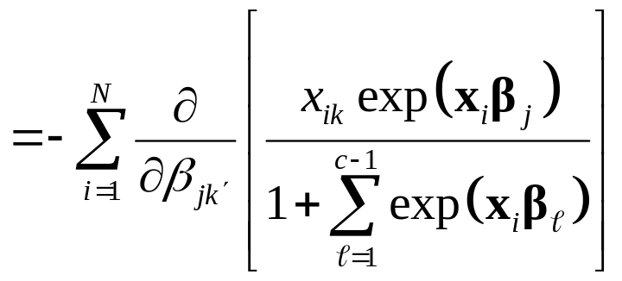
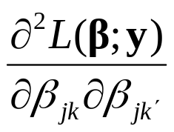
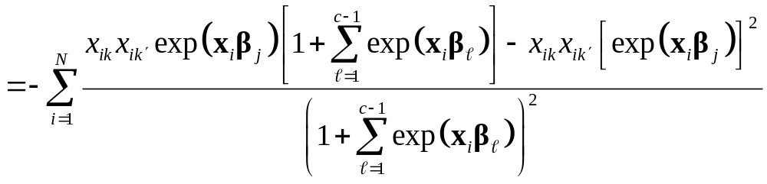
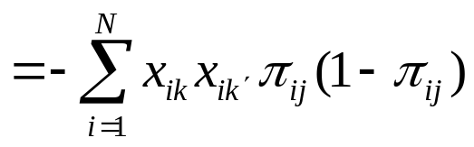
The likelihood equations become ( )
where
The elements of the Hessian matrix are given by
smartboard

Slide 16


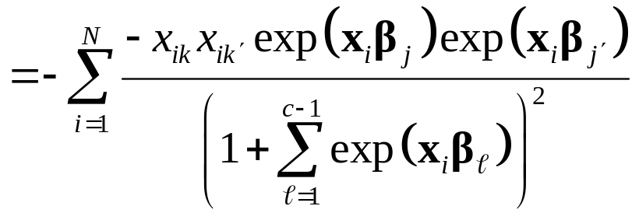
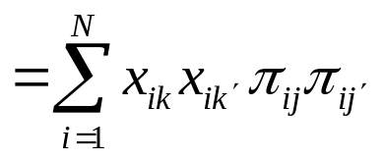




and for
smartboard
The expected (=observed, because of the canonical link) information matrix consists of blocks of size , and block takes the form (remember x_{i} is a row vector)
The information matrix is positive semi-definite, so the log-likelihood function is concave

Slide 17







Deviance and Pearson statistic
Assume now that we have grouped data, and that we have observations with corresponding covariate vector
Let be the proportion of the observations that are in category j
Then the likelihood is given by
The deviance becomes (because $φ=1)$
$$D\left(y;\hat{μ}\right)=−2\log\left[\frac{\max{likelihood for actual model}}{\max{likelihood for saturated model}}\right]$$

Slide 18





The Pearson statistic is given by
If the fitted model holds, and we replace by in the formulas above, the deviance and the Pearson statistic are approximately chi-squared distributed with

Slide 19

Multinomial models for ordinal response
For illustration we consider a data set on mental health for a random sample of adults in a county in Florida (section 6.3.3)
Here the response categories are ordinal
(R code for the example is given on the course web)

Slide 20
Reminder: Multinomial response
We consider a situation with c response categories
We may distinguish between nominal (unordered) and ordinal (ordered) responses
We consider N independent subjects, and let $π_{ij}$ denote the probability that subject i has response in category j
We have
The response for subject i may be given by the vector
, where if the response of subject i is in category j , and all other
The multinomial pmf of takes the form

Slide 21







We assume that the categories are ordered from the lowest to the highest, and consider the cumulative logit model of proportional odds
Let be the response category for subject i
That is, means and for
We express the model in terms of the cumulative probabilities
The cumulative logits are given by

Slide 22





Now the cumulative logit model is given by
Note that each cumulative logit has its own intercept, but the effect of the covariates is assumed to be the same for each cumulative logit
Note further that the are increasing in j (because $P(Y_{i}≤j)$ increases in j for fixed $x_{i}$)
Illustration of the model for

Slide 23





Note that if we reverse the order of the categories, i.e. we consider , then
so the cumulative logit model still holds
But it does not hold for other orderings of the categories

Slide 24


Note also that (the cumulative odds ratio)
smartboard
Hence, for all $j=1,…,c−1$, the odds for $Y_{i}≤j$ multiplies by $β_{k}$ for 1 unit increase in $x_{ik}$ (when $x_{il},l≠k$ are held constant)
This is the proportional odds property: Same proportionality constant for all c-1 response categories

Slide 25









Latent variable motivation
A latent variable formulation gives a motivation for the cumulative logit model
Let be the underlying latent variable for subject i , where has mean zero and cdf
Suppose we have cut-points and that we observe
Then we have
so we have a cumulative model with link
If is the logistic cdf, we obtain the cumulative logit model

