Slide 1
KJM 3110 Electrochemistry
Chapter 3. Electrochemical cells

Slide 2
Recap from Ch. 1 Electricity
In Chapter 1 we familiarised ourselves with the most fundamental concepts of electricity itself.
Charge
Electrostatic force
Electrical work
Potential and voltage
Capacitance
Current
Conductance and resistance
DC and AC voltage and current and impedance
Different disciplines, textbooks, articles, teachers use different symbols for many of these entities. For instance, e vs q, q vs Q, f vs F, U vs E, i vs I…
We could try to be completely consistent here.
Instead we allow variations, to train ourselves for reality, but aim to always define and/or make clear what we mean.

Slide 3
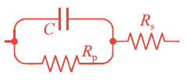
Remaining parts of Ch. 1 we considered non-mandatory for now
Electrical circuits
Models of electrochemical behaviour
AC signals
AC impedance, Fourier transforms
Real and imaginary contributions, loss, and power dissipated

Slide 4




Ch. 1 Summary – four selected important concepts
Charge and field
Charge capacitance of insulator (dielectric)
Current transport in a conductor
Conductivity

Slide 5
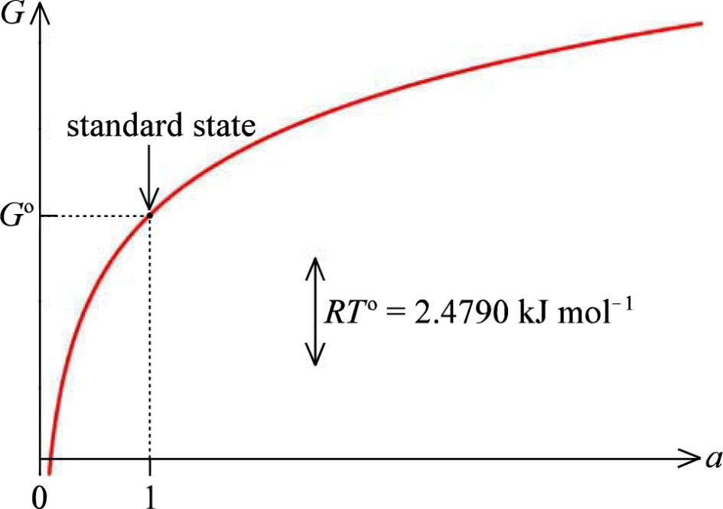
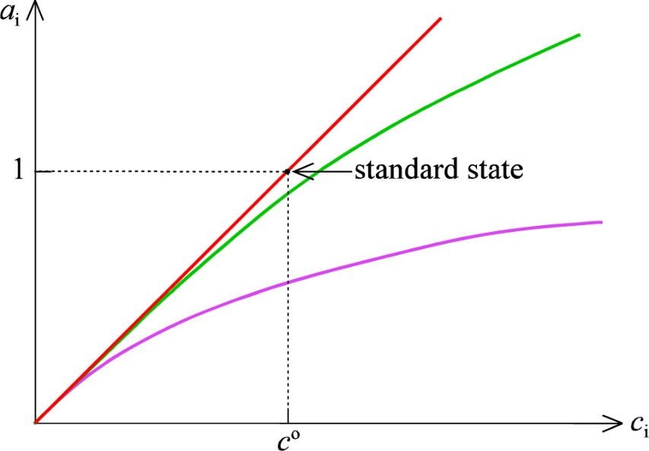
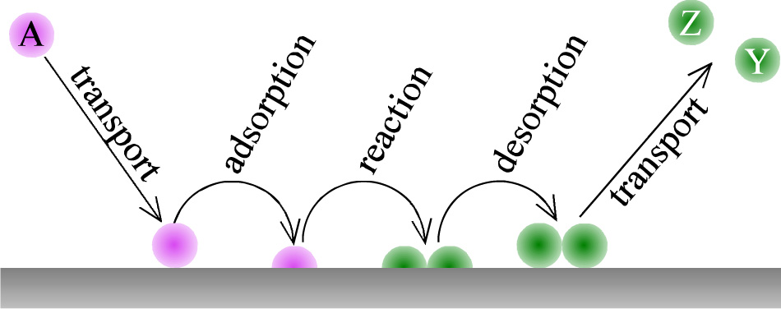
A brief look at Chapter 2 Chemistry; Concepts

Slide 6
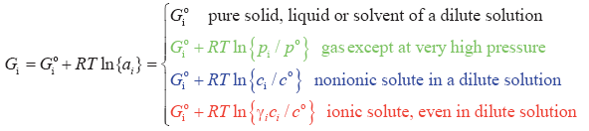


A brief look at Chapter 2 Chemistry; Summary

Slide 7
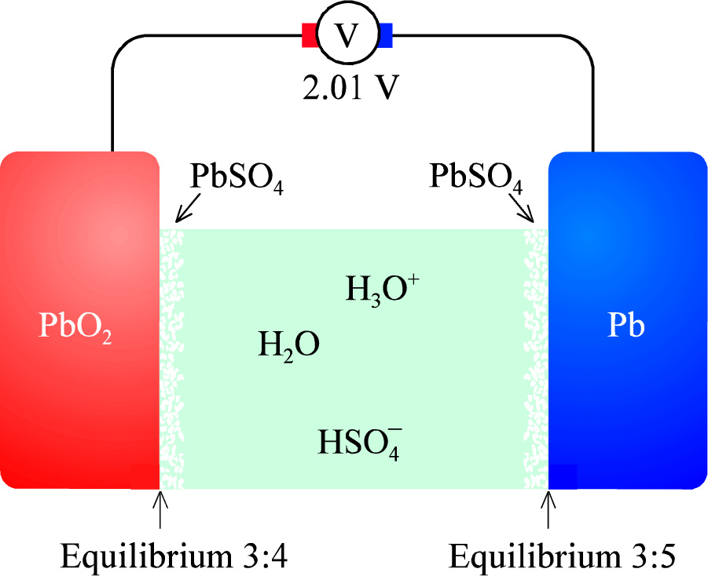
Electrochemical cells
Lead-acid cell as example

Slide 8


The lead-acid cell – half and full cell reactions
Positrode
Negatrode
Total, chemical, cell reaction
Total, electrical

Slide 9
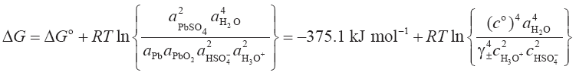
The lead-acid cell – Gibbs energy change
The activity of pure condensed phases is defined as unity. Hence, for instance a_{Pb(s)} = 1

Slide 10


The lead-acid cell – electrical work and cell voltage
Electrical work
w = ΔG (J) = -neΔE
W = N_{A}w = ΔG (J/mol) = -nFΔE

Slide 11

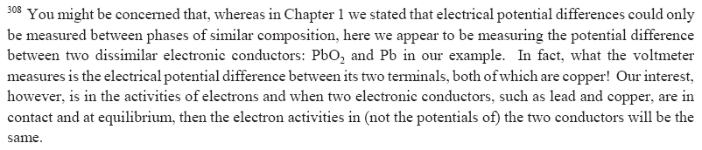
The lead-acid cell – cell voltage

Slide 12


The lead-acid cell – standard state
Standard state: All activities = 1
Temperature can, but need not be, 298.15 K
This is not equilibrium, it is the standard state

Slide 13

The lead-acid cell – equilibrium
From Ch. 2:
Important to understand this
Now becomes:

Slide 14
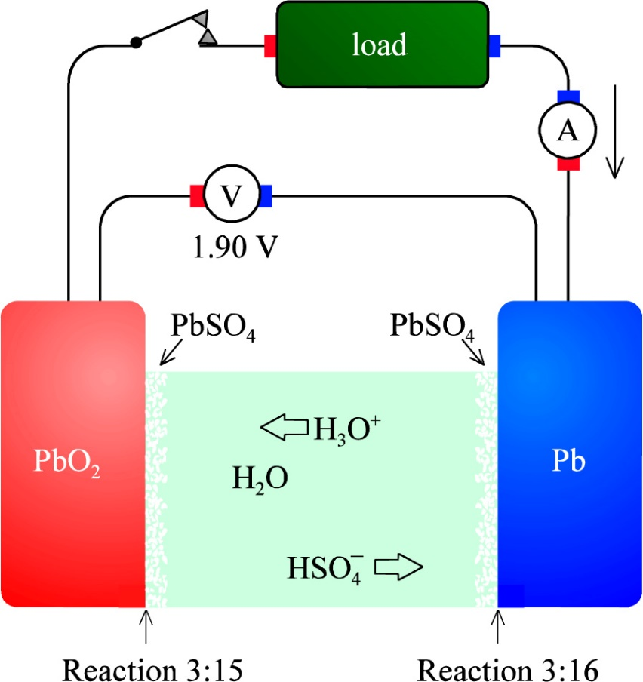
The lead-acid cell – galvanic operation
Galvanic cell:
The chemical potential differences – the spontaneous change according to ΔG – drives the cell.
Battery under discharge
Fuel cell
Cathode (positrode)
Anode (negatrode)

Slide 15
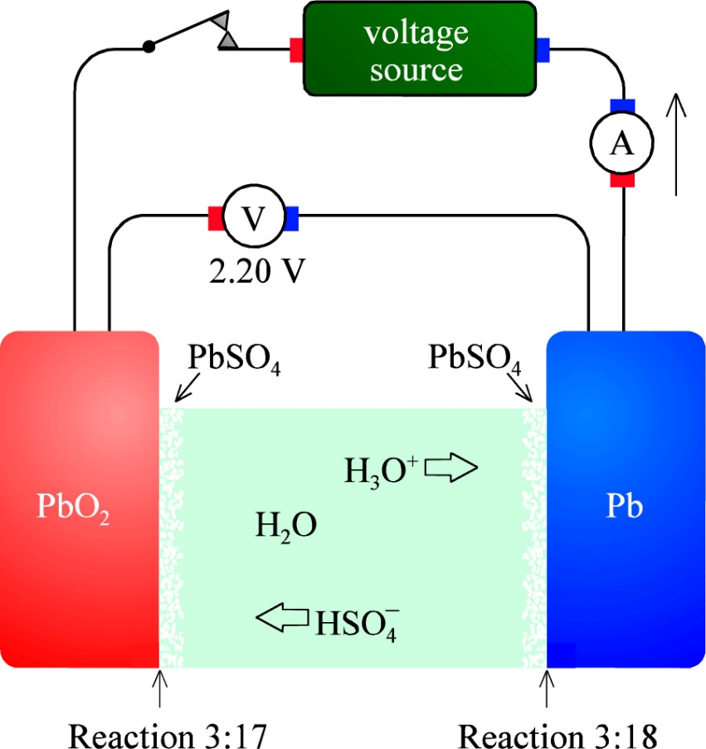
The lead-acid cell – electrolytic operation
Electrolytic cell:
The applied electrical potential difference drives the cell against the spontaneous change according to ΔG.
Battery under charge
Electrolyser
Anode (positrode)
Cathode (negatrode)

Slide 16
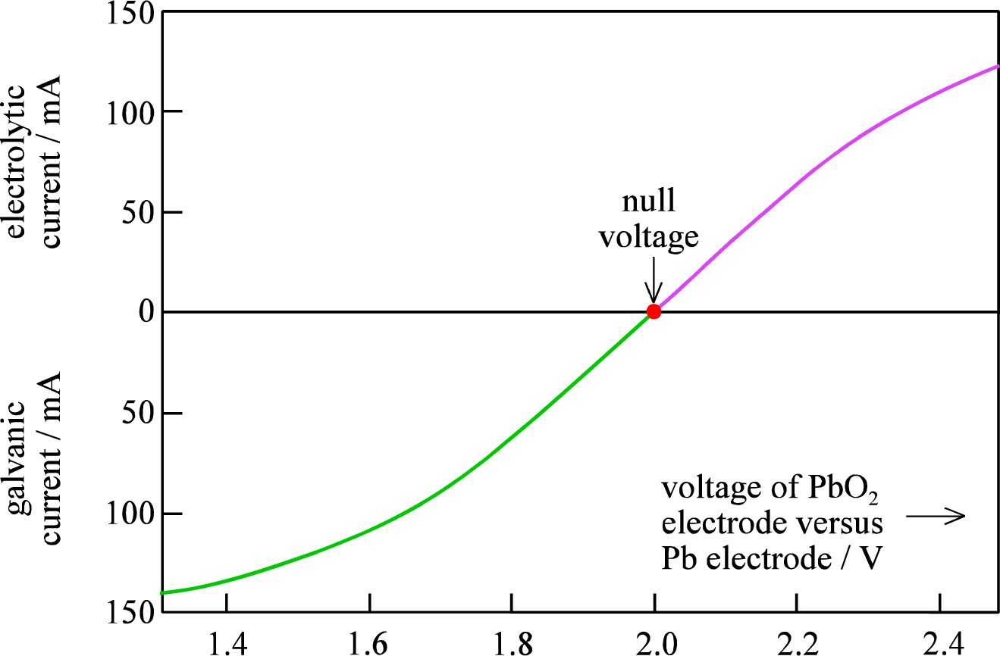
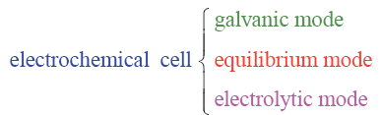
Electrochemical cells – three modes of operation
Polarisation curve for a lead-acid cell
aka Open Circuit Voltage (OCV)

Slide 17
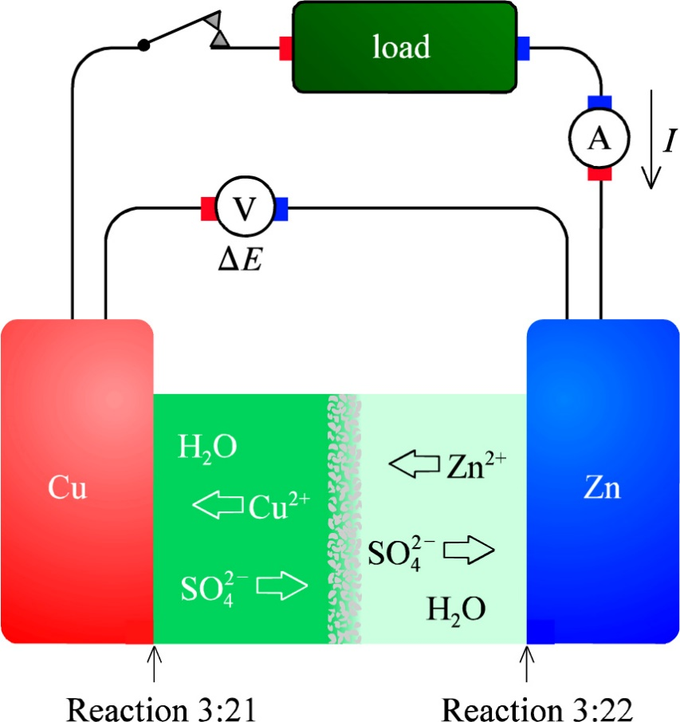
Cells with junctions – The Daniell cell
Self study and check – this and Eqs. 3.20-3.23 is standard from general and physical chemistry.
What goes on at the diaphragm under open circuit and under galvanic conditions?

Slide 18
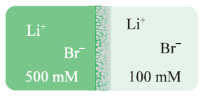

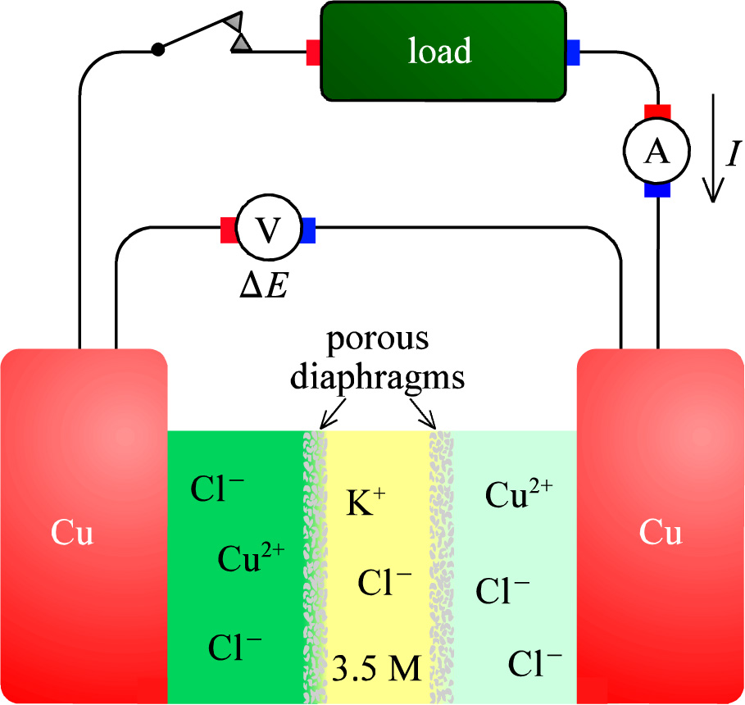
Electrolyte junctions - liquid junctions
Junction potentials arise from different mobilities µ and charges z for anions and cations.
KCl(aq) gives almost zero junction potential
Similar with KNO₃(aq) which is much used.

Slide 19
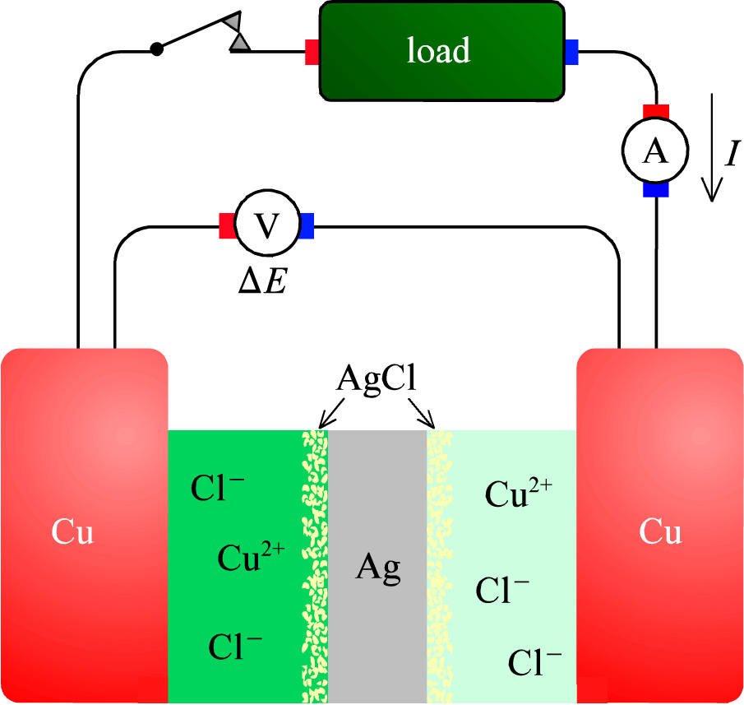
Another possibility: Bipolar electrodes
We consider taking the details here as part of our colloquium….

Slide 20
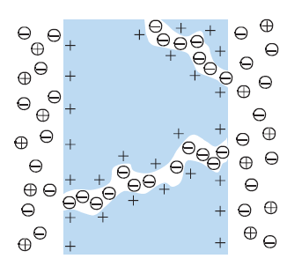
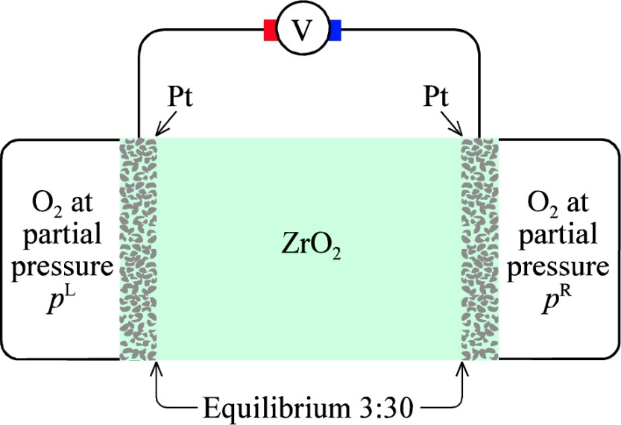


Semipermeable and solid electrolyte membranes
Semipermeable membranes
  Selective permeation
  Allows recharging without e.g. cation intermixing
  Adds resistance
Solid electrolyte membranes
  E.g. Y-stabilized ZrO₂ (YSZ)
  Selective transport
  Proton conducting solids. Other ions?

Slide 21
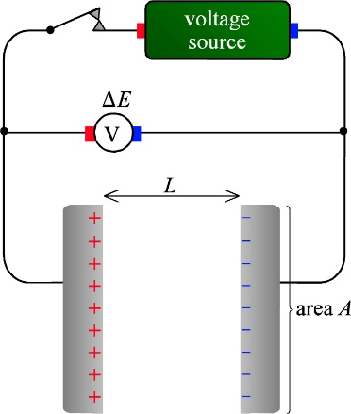
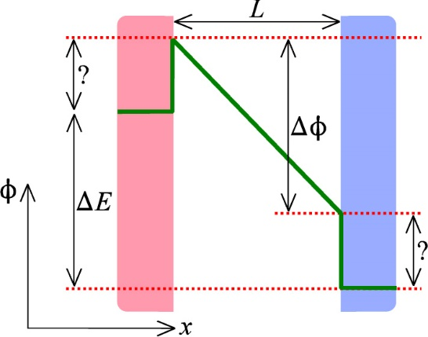
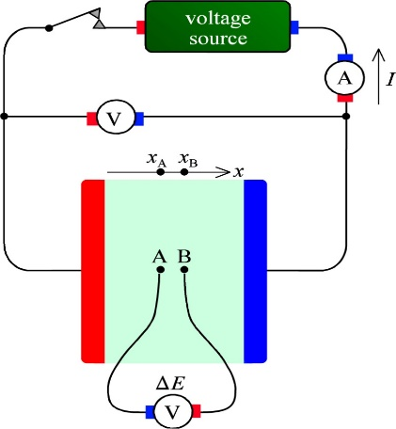
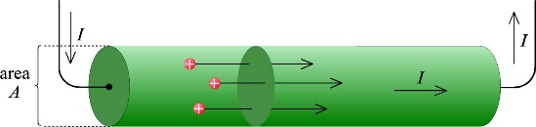
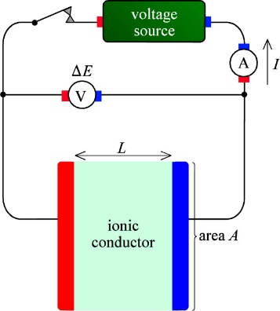
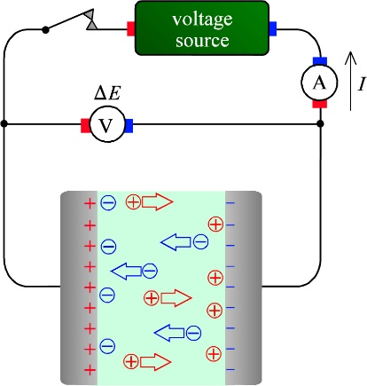
Electrochemical potentials – a motivation
We have seen three types of “cells”:
Ch. 1: Contacts (“electrodes”) on a dielectric
Ch. 1: Contacts (“electrodes”) on a resistor (= conductor)
Ch. 3: Electrodes on an electrolyte, i.e. an electrochemical cell
How do the electrical potentials vary over the cell in each case?

Slide 22
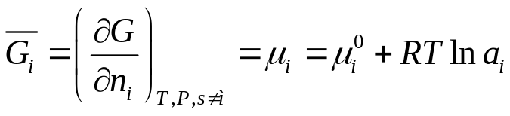
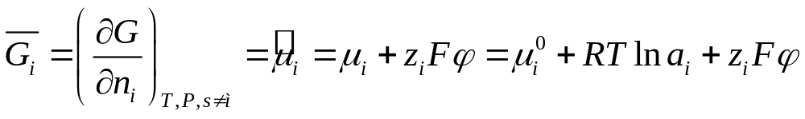
Electrochemical potential
Curriculum extra to the textbook
In chemistry, the partial molar Gibbs energy is called the chemical potential.
For a species i, this is the partial molar change in Gibbs energy of a system when we add species i, but keep everything else constant – including the amount of all other species.
In electrochemistry it also includes the electrostatic energy of a potential given that the species is charged, making up the electrochemical potential:
Both chemical and electrochemical potentials have units of (molar) energy
The standard state cannot be realised for charged species, and hence only differences and changes in the electrochemical potential can be considered.
Variably, the chemical potential and electrochemical potential of electrons is termed the Fermi level in physics.

Slide 23
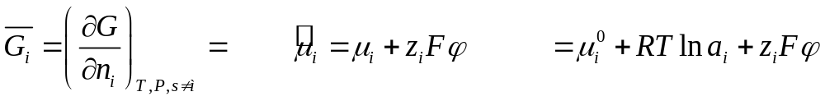
Electrochemical potential
Curriculum extra to the textbook
The electrochemical potential is not used in our text book. But it is too important to omit, so we add it to the curriculum via these extra slides, and will use it and understand it better throughout the course
It contains the chemical potential – which in turn contains the standard chemical potential – and the electrostatic potential
In a chemical system in equilibrium, all chemical potentials are constant
In a chemical reaction at equilibrium, the chemical potentials of reactants and products are equal
In an electrochemical system (with charged species) in equilibrium, all electrochemical potentials are constant
In an electrochemical reaction at equilibrium, the electrochemical potentials of reactants and products are equal
A voltage – the Nernst voltage – compensates chemical unbalance to achieve overall balance.

Slide 24


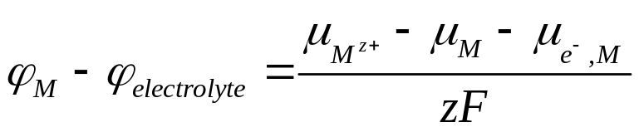
Electrochemical potential
Curriculum extra to the textbook
The electrochemical potential
M^{z+} + ze⁻ ↔ M
At equilibrium:
Source or load
I
U
Cu
M
φ
M’
Cu
M’^{z+}
M^{z+}
+
Metal M
More noble metal M’

Slide 25
Electrochemical potential
Curriculum extra to the textbook
Electrochemical equilibrium:
M^{z+} + ze⁻ ↔ M
M’^{z+} + ze⁻ ↔ M’
Electronic equilibrium with Cu:
e_{M}⁻ ↔ e_{Cu}⁻
We know hardly any of these quantities or differences – only the grand total difference
Despite the voltage over the cell, we consider φ_{electrolyte} constant
Source or load
I
U
Cu
M
φ
M’
Cu
M’^{z+}
M^{z+}
+
Metal M
More noble metal M’

Slide 26
Electrochemical potential
Curriculum extra to the textbook
M^{z+} + ze⁻ → M
M’^{z+} + ze⁻ ← M’
Increase cell voltage above OCV
Run current into the positive electrode
Electrolytic operation
Overpotentials increase the cell voltage
Source or load
I
U
Cu
M
φ
M’
Cu
M’^{z+}
M^{z+}
+
Metal M
More noble metal M’

Slide 27
Electrochemical potential
Curriculum extra to the textbook
M^{z+} + ze⁻ ← M
M’^{z+} + ze⁻ → M’
Decrease cell voltage below OCV
Draw current from the positive electrode
Galvanic operation
Overpotentials decrease the cell voltage
Source or load
I
U
Cu
M
φ
M’
Cu
M’^{z+}
M^{z+}
+
Metal M
More noble metal M’

Slide 28


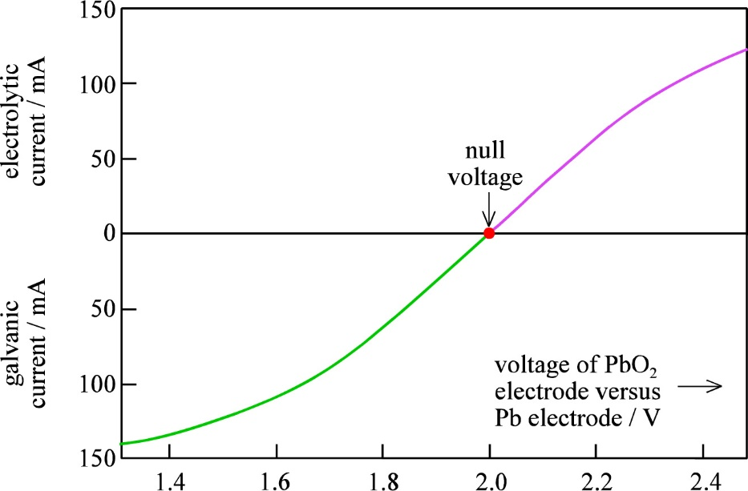
Summary Ch. 3 Electrochemical cells
Equilibrium
  I = 0
Galvanic operation
  I > 0
Electrolytic operation
  I < 0

