Slide 1
Lecture 15 – Course recap
TEK4500
26.11.2025
Håkon Jacobsen
hakon.jacobsen@its.uio.no

Slide 2
Agenda
Recap of course
Q&A
Go through old exams

Slide 3

What is cryptography?
Alice
Bob
M
Adversary
Security goals:
Data privacy: adversary should not be able to read message M
Data integrity: adversary should not be able to modify message M
Data authenticity: message M really originated from Alice

Slide 4
What is cryptography?
Alice
Bob
M
M'
Adversary
Security goals:
Data privacy: adversary should not be able to read message M
Data integrity: adversary should not be able to modify message M
Data authenticity: message M really originated from Alice

Slide 5
Ideal solution: secure channels
But how to build?
Alice
Bob
M
Adversary
Security goals:
Data privacy: adversary should not be able to read message M ✓
Data integrity: adversary should not be able to modify message M ✓
Data authenticity: message M really originated from Alice ✓

Slide 6


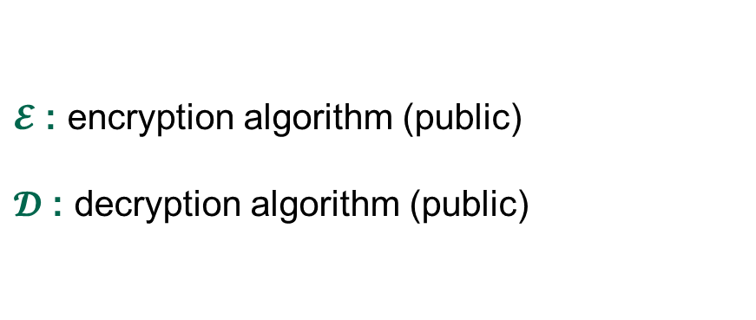
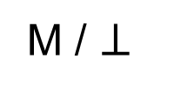
Creating secure channels: encryption schemes
Alice
Bob
K
K
$$ℰ$$
C
$$𝒟$$
M
M / $⊥$
Adversary
$𝓔$ : encryption algorithm (public)
$𝓓$ : decryption algorithm (public)
K : encryption / decryption key (secret)

Slide 7
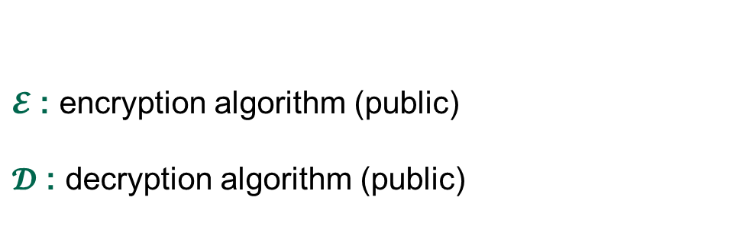
Creating secure channels: encryption schemes
Alice
Bob
K_{e}
K_{d}
$$ℰ$$
C
$$𝒟$$
M
M / $⊥$
Adversary
$𝓔$ : encryption algorithm (public)
$𝓓$ : decryption algorithm (public)
K_{e} : encryption key (public)
K_{d} : decryption key (secret)

Slide 8
Basic goals of cryptography
AEAD
IND-CPA, IND-CCA
UF-CMA
 | Message privacy | Message integrity / authentication
Symmetric keys | Symmetric encryption | Message authentication codes (MAC)
Asymmetric keys | Public-key encryption / Key Encapsulation Mechanisms (KEM) | Digital signatures
PRNG
PRNG
Key exchange
IND-CPA, IND-CCA
UF-CMA
Unkeyed primitives
Hash functions
TRNG
Collision resistance, one-wayness
Enough
min-entropy

Slide 9
Basic goals of cryptography
ChaCha20 (stream cipher)
Encrypt-then-MAC
AES-GCM
AES-CCM
AES-OCB
AES-CTR, AES-CTR$
AES-CBC$
CBC-MAC, CMAC,
HMAC
 | Message privacy | Message integrity / authentication
Symmetric keys | Symmetric encryption | Message authentication codes (MAC)
Asymmetric keys | Public-key encryption / Key Encapsulation Mechanisms (KEM) | Digital signatures
ChaCha20
CTR mode
PRNG
Key exchange
Diffie-Hellman
ElGamal, ML-KEM
Schnorr, ECDSA, ML-DSA
Unkeyed primitives
Hash functions
TRNG
SHA2-256, SHA2-512
SHA3-256, SHA3-512
Ring-oscillators, lava lamps
quantum effects,
mouse wiggling…

Slide 10


Constructions and relations
GCM++, CCM, OCB++
TRNG
PRNG
Stream cipher
CTR
CTR
Symmetric-key encryption
PRF
AE
AEAD
CBC$
EtM
AES
Feistel
Thm.
PRP
MAC schemes
CBC-MAC, CMAC, PMAC
Protocols
TLS, SSH, IPsec, What's App
Davies-Mayer
HMAC
SHA2
Hash functions
Public-key encryption
KEM
Merkle-
Damgård
ElGamal
Key exchange
Discrete Logarithm
Problem
ML-KEM
Diffie-Hellman
$$\left(Z_{p}^{∗} , .⋅.\right)$$
$$\left(E\left(F_{p}\right),+\right)$$
Digital signatures
Schnorr, ECDSA
Learning With Errors
ML-DSA
PKI
digital certificates
Short Integer Solutions

Slide 11
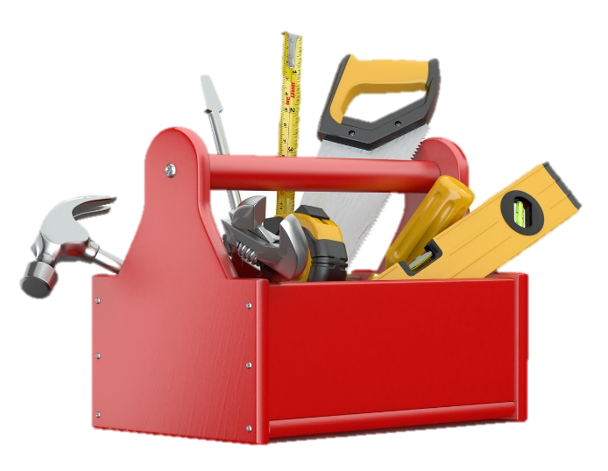
The crypto toolbox
Symmetric tools
Asymmetric tools
GCM
Diffie-Hellman
MAC
AES
ML-DSA
EtM
CMAC
ElGamal
ML-KEM
CTR
KDF
Signatures
PRNG
Elliptic curves
Unkeyed
tools
Protocols
Hash functions
TLS
Signal
Forward-secrecy
SHA2
SHA3
PKI
TRNG
Digital certificates
Mathematics
Electronics
Politics
Informatics
Philosophy
Physics

Slide 12
Exam
Wednesday December 3, 09:00-13:00 (4 hours)
Digital, on-campus (Silurveien 2, Sal 3C)
Closed-book
I will make a round approximately 2 hours into the exam for any possible questions
  Make sure to look through all problems before you start answering
  in case you have questions for the some of the later problems
https://www.uio.no/studier/emner/matnat/its/TEK4500/h25/eksamen/index.html

