Slide 1
Lecture 4 – Message authentication, UF-CMA,
CBC-MAC, CMAC
TEK4500
14.09.2022
Håkon Jacobsen
hakon.jacobsen@its.uio.no

Slide 2

What is cryptography?
Internet
Alice
Bob
M
Adversary
Security goals:
Data privacy: adversary should not be able to read message M
Data integrity: adversary should not be able to modify message M
Data authenticity: message M really originated from Alice

Slide 3
What is cryptography?
Internet
Alice
Bob
M
M'
Adversary
Security goals:
Data privacy: adversary should not be able to read message M
Data integrity: adversary should not be able to modify message M
Data authenticity: message M really originated from Alice

Slide 4
Basic goals of cryptography
 | Message privacy | Message integrity / authentication
Symmetric keys | Symmetric encryption | Message authentication codes (MAC)
Asymmetric keys | Asymmetric encryption (a.k.a. public-key encryption) | Digital signatures

Slide 5
Motivation
Goal: integrity, but not privacy
Examples:
  Protecting OS system files against tampering
  Browser cookies stored by web servers
  Control signals in network management

Slide 6





Encryption ≠ integrity
0110100 1110 100101100110
$$CTR.Enc(K, ⋅)$$
$$CTR.Dec(K, ⋅)$$
"Send
Bob
$10"
1001010 1010 000000001010
1111110 0100 100101101100
1111110 0100 011001101100
1111110 0100 011001101100
0110100 1110 100101100110
=
1001010 1010 111100001010
"Send
Bob
$3850"

Slide 7








Message authentication – idea
Sender
Receiver
VALID
$$M$$
$$T$$
$M$
$M$
$⊥$
INVALID
Generate tag $T$
Verify $\left(M,T\right)$

Slide 8
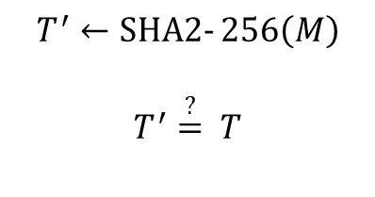

Message authentication – idea
Sender
Receiver
VALID
$$M$$
$$T$$
$M$
$M$
$⊥$
INVALID
$$T←SHA2‐256\left(M\right)$$
$$T^{′}←SHA2‐256\left(M\right)$$
$$T^{′}\overset{?}{=} T$$

Slide 9



Message authentication – idea
Sender
Receiver
VALID
$$M$$
$$T$$
$M$
$M$
$⊥$
$$M′$$
$$T$$
INVALID
$$T←SHA2‐256\left(M\right)$$
$$T^{′}←SHA2‐256\left(M\right)$$
$$T^{′}\overset{?}{=} T$$
$$T←SHA2‐256(M′)$$

Slide 10

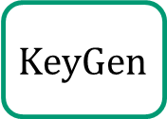


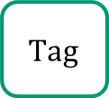

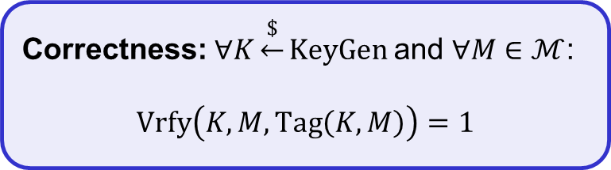




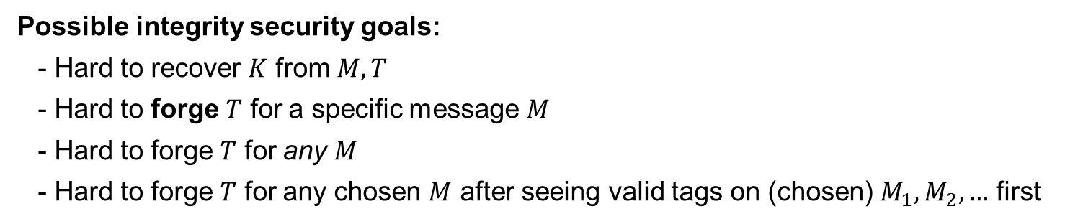


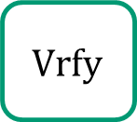
Message authentication schemes – syntax
A message authentication scheme is a triple $Σ=\left(KeyGen, Tag, Vrfy\right)$ of algorithms:
$$Tag :𝒦×ℳ→𝒯$$
Correctness: $∀K\underset{←}{\$}KeyGen$ and $∀M∈ℳ$:
$$Vrfy\left(K, M,Tag\left(K, M\right)\right)=1$$
$$Tag\left(K, M\right)={Tag}_{K}\left(M\right)=T$$
$$KeyGen$$
$$Vrfy :𝒦×ℳ×𝒯→\left\{0,1\right\}$$
$$\$$$
$$Vrfy\left(K, M,T\right)={Vrfy}_{K}\left(M, T\right)=1/0$$
$K$
$$Tag$$
$$\$$$
$$T$$
$$M,T$$
$$Vrfy$$
$$\$$$
$$M$$
$1/0$
Possible integrity security goals:
  Hard to recover $K$ from $M, T$
  Hard to forge $T$ for a specific message $M$
  Hard to forge $T$ for any $M$
  Hard to forge $T$ for any chosen $M$ after seeing valid tags on (chosen) $M_{1}, M_{2}, …$ first
Adversary
Notes:
Delivery of K outside the "responsibility" of encryption scheme

Slide 11
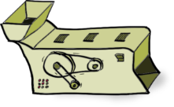
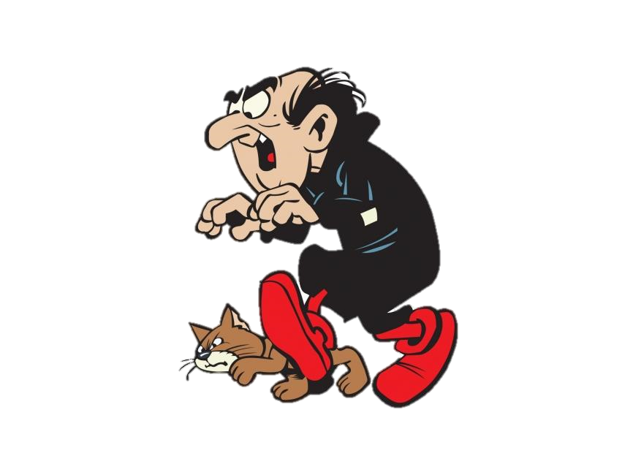

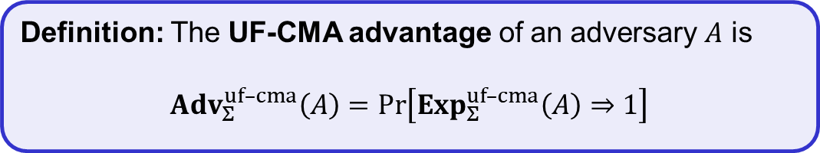

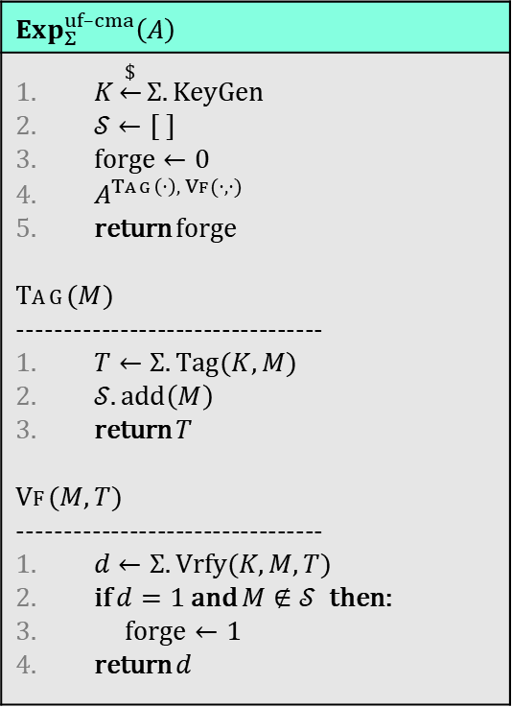
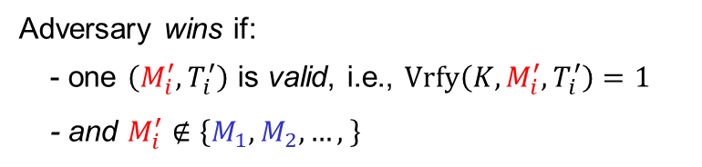






UF-CMA – Unforgability against chosen-message attacks
Challenger
$$Exp_{Σ}^{uf–cma}\left(A\right)$$
$K\underset{←}{\$}Σ.KeyGen$ $𝒮←[ ]$ $forge←0$ $A^{Tag\left(⋅\right), Vf(⋅,⋅)}$ return forge $$Tag(M)$$ --------------------------------- $T←Σ.Tag(K, M)$ $𝒮.add\left(M\right)$ return $T$ $$Vf(M,T)$$ --------------------------------- $d←Σ.Vrfy(K, M, T)$ if $d=1$ and $M∉𝒮$ then: $forge←1$ return $d$
$$Tag(K, ⋅)$$
$M_{1},$ $M_{2}, …$
$T_{1},$ $T_{2}, …$
$$\left(M_{1}^{′},T_{1}^{′}\right)$$
$,$ $\left(M_{2}^{′},T_{2}^{′}\right), …$
$$Vrfy(K, ⋅,⋅)$$
$$1/0$$
$,$ $1/0, …$
Adversary wins if:
- one $\left(M_{i}^{′},T_{i}^{′}\right)$ is valid, i.e., $Vrfy\left(K, M_{i}^{′},T_{i}^{′}\right)=1$
- and $M_{i}^{′}∉\left\{M_{1},M_{2}, …, \right\}$
Definition: The UF-CMA advantage of an adversary $A$ is
$${Adv}_{Σ}^{uf–cma}\left(A\right)=\operatorname{Pr}\left[Exp_{Σ}^{uf–cma}\left(A\right)⇒1\right]$$

Slide 12

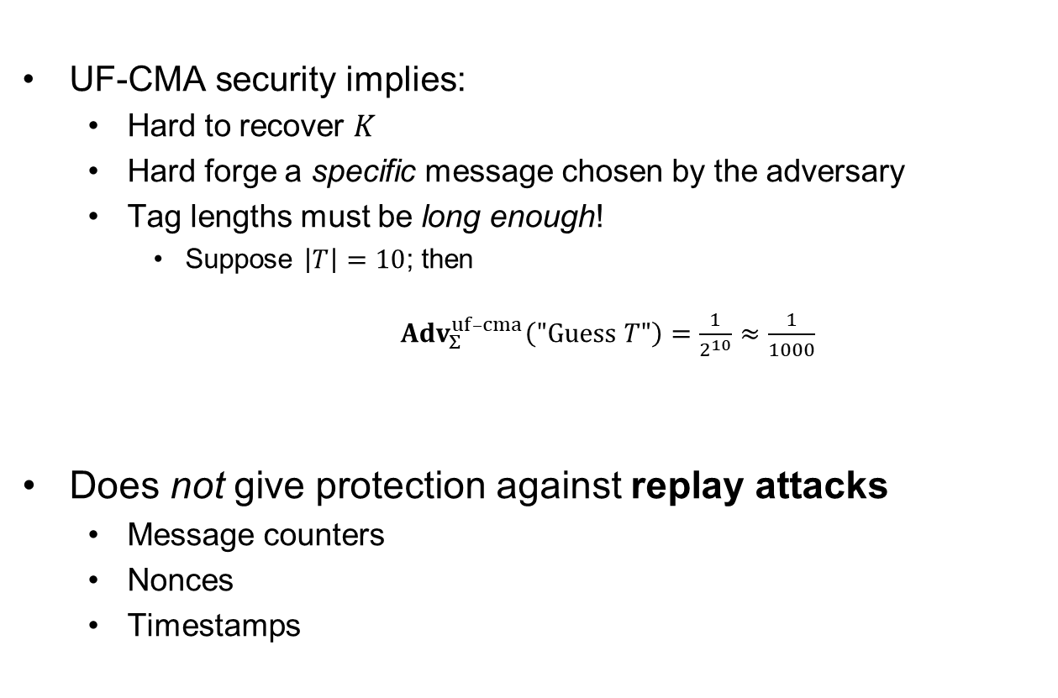
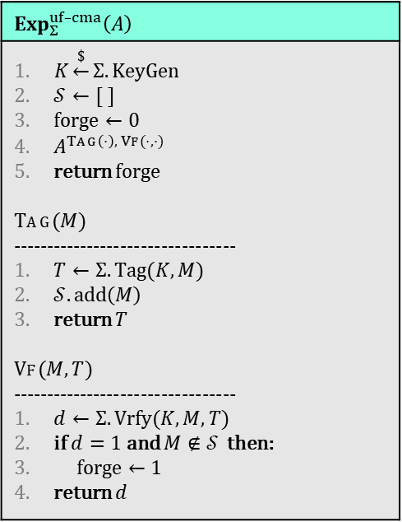
Properties of UF-CMA definition
UF-CMA security implies:
  Hard to recover $K$
  Hard forge a specific message chosen by the adversary
  Tag lengths must be long enough!
    Suppose $\left|T\right|=10$; then
    ${Adv}_{Σ}^{uf–cma}\left("Guess T"\right)=\frac{1}{2^{10}}≈\frac{1}{1000}$
Does not give protection against replay attacks
  Message counters
  Nonces
  Timestamps
$$Exp_{Σ}^{uf–cma}\left(A\right)$$
$K\underset{←}{\$}Σ.KeyGen$ $𝒮←[ ]$ $forge←0$ $A^{Tag\left(⋅\right), Vf(⋅,⋅)}$ return forge $$Tag(M)$$ --------------------------------- $T←Σ.Tag(K, M)$ $𝒮.add\left(M\right)$ return $T$ $$Vf(M,T)$$ --------------------------------- $d←Σ.Vrfy(K, M, T)$ if $d=1$ and $M∉𝒮$ then: $forge←1$ return $d$
$${Adv}_{Σ}^{uf–cma}\left(A\right)=\operatorname{Pr}\left[Exp_{Σ}^{uf–cma}\left(A\right)⇒1\right]$$

Slide 13
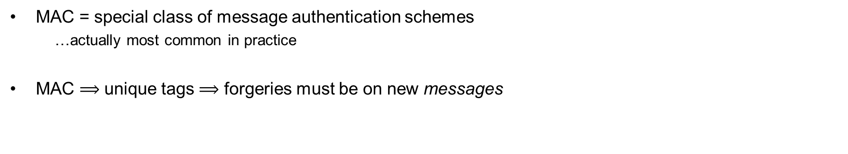


Message authentication codes (MACs)
deterministic function
$${Tag}_{K}\left(M\right)=T$$
$${Vrfy}_{K}\left(M, T′\right)= “ {Tag}_{K}\left(M\right)\overset{?}{=}T^{′} ”$$
"recompute and check"
MAC = special class of message authentication schemes
  …actually most common in practice
MAC $⟹$ unique tags $⟹$ forgeries must be on new messages
Notes:
Verification algorithm uniquely determined by Tag algorithm

Slide 14
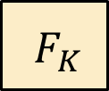
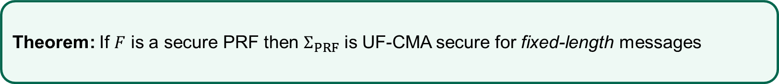


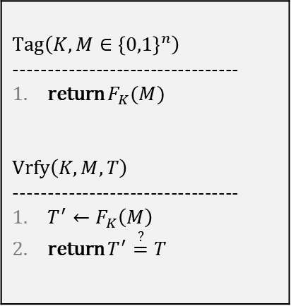

PRFs are good MACs
$$F :{\left\{0,1\right\}}^{k}×{\left\{0,1\right\}}^{n}→{\left\{0,1\right\}}^{τ}$$
$$Tag\left(K,M∈{\left\{0,1\right\}}^{n}\right)$$ --------------------------------- return $F_{K}(M)$ $$Vrfy\left(K, M,T\right)$$ --------------------------------- $T^{′}←F_{K}\left(M\right)$ return $T^{′}\overset{?}{=}T$
$$M$$
$${ F}_{K}$$
$$T$$
Theorem: If $F$ is a secure PRF then $Σ_{PRF}$ is UF-CMA secure for fixed-length messages

Slide 15


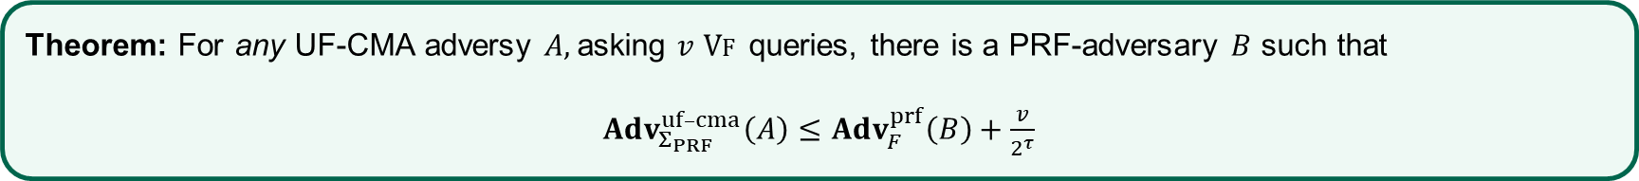



PRFs are good MACs – proof sketch
Theorem: For any UF-CMA adversy $A,$asking $v$ $Vf$ queries, there is a PRF-adversary $B$ such that
$Adv_{Σ_{PRF}}^{uf–cma}\left(A\right)≤Adv_{F}^{prf}\left(B\right)+\frac{v}{2^{τ}}$
$$M$$
$${ F}_{K}$$
$$T$$
$$\operatorname{Pr}\left[F_{K}\left(M\right)=T\right]=$$
$$?$$

Slide 16
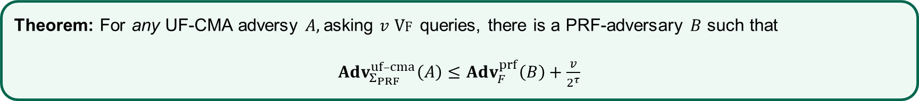


PRFs are good MACs – proof sketch
Theorem: For any UF-CMA adversy $A,$asking $v$ $Vf$ queries, there is a PRF-adversary $B$ such that
$Adv_{Σ_{PRF}}^{uf–cma}\left(A\right)≤Adv_{F}^{prf}\left(B\right)+\frac{v}{2^{τ}}$
$$M$$
$$ρ$$
$$T$$
$$ρ\underset{←}{\$}Func\left[n, τ\right]$$

Slide 17


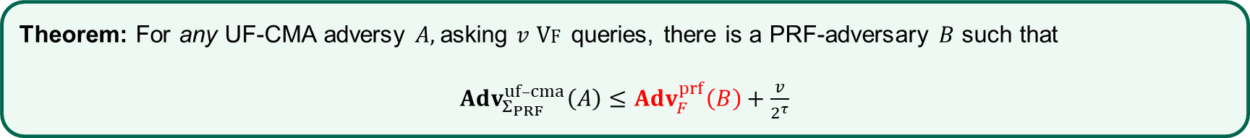
PRFs are good MACs – proof sketch
Theorem: For any UF-CMA adversy $A,$asking $v$ $Vf$ queries, there is a PRF-adversary $B$ such that
$Adv_{Σ_{PRF}}^{uf–cma}\left(A\right)≤Adv_{F}^{prf}\left(B\right)+\frac{v}{2^{τ}}$
$$M$$
$$ρ$$
$$T$$
$$ρ\underset{←}{\$}Func\left[n, τ\right]$$
$$\operatorname{Pr}\left[ρ\left(M\right)=T\right]=$$
$$\frac{1}{{ 2}^{τ}}$$

Slide 18





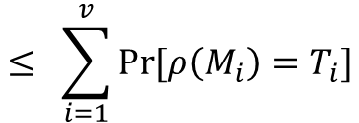





PRFs are good MACs – proof sketch
Theorem: For any UF-CMA adversy $A,$asking $v$ $Vf$ queries, there is a PRF-adversary $B$ such that
$Adv_{Σ_{PRF}}^{uf–cma}\left(A\right)≤Adv_{F}^{prf}\left(B\right)+\frac{v}{2^{τ}}$
$${ M}_{1}$$
$${ M}_{2}$$
$${ M}_{v}$$
$$ρ$$
$$ρ$$
$$⋯$$
$$ρ$$
$${ T}_{1}$$
$${ T}_{2}$$
$${ T}_{v}$$
$$≤ \sum_{i=1}^{v}{\operatorname{Pr}{[ρ\left(M_{i}\right)=T_{i}]}}$$
$$= \frac{v}{2^{τ}}$$
$$\operatorname{Pr}\left[ρ\left(M_{1}\right)=T_{1} ∨ ⋯ ∨ ρ\left(M_{v}\right)=T_{v}\right]$$

Slide 19
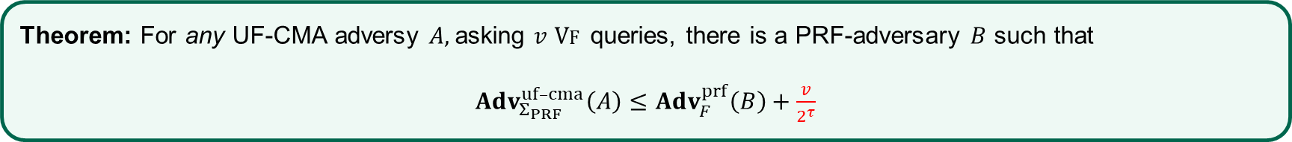
PRFs are good MACs – proof sketch
Theorem: For any UF-CMA adversy $A,$asking $v$ $Vf$ queries, there is a PRF-adversary $B$ such that
$Adv_{Σ_{PRF}}^{uf–cma}\left(A\right)≤Adv_{F}^{prf}\left(B\right)+\frac{v}{2^{τ}}$
$${ M}_{1}$$
$${ M}_{2}$$
$${ M}_{v}$$
$$ρ$$
$$ρ$$
$$⋯$$
$$ρ$$
$${ T}_{1}$$
$${ T}_{2}$$
$${ T}_{v}$$
$$≤ \sum_{i=1}^{v}{\operatorname{Pr}{[ρ\left(M_{i}\right)=T_{i}]}}$$
$$= \frac{v}{2^{τ}}$$
$$\operatorname{Pr}\left[ρ\left(M_{1}\right)=T_{1} ∨ ⋯ ∨ ρ\left(M_{v}\right)=T_{v}\right]$$

Slide 20


PRFs are good MACs
$$M$$
$${ AES}_{K}$$
$$T$$
Conclusion: $AES˗256 :{\left\{0,1\right\}}^{256}×{\left\{0,1\right\}}^{128}→{\left\{0,1\right\}}^{128}$ is a good MAC

Slide 21


MACs for long messages

Slide 22














MACs from block ciphers – Attempt 1
$$M$$
$${ M}_{1}$$
$${ M}_{2}$$
$${ M}_{3}$$
$${ M}_{4}$$
$${ E}_{K}$$
$${ E}_{K}$$
$${ E}_{K}$$
$${ E}_{K}$$
$${ T}_{1}$$
$$T_{2}$$
$${ T}_{3}$$
$${ T}_{4}$$
$${T=T}_{1}||T_{2}||T_{3}||T_{4}$$

Slide 23





Attempt 1 – an attack
$$M$$
$${ M}_{1}$$
$${ M}_{3}$$
$${ M}_{2}$$
$${ M}_{4}$$
$${ E}_{K}$$
$${ E}_{K}$$
$${ E}_{K}$$
$${ E}_{K}$$
$${ T}_{1}$$
$$T_{3}$$
$${ T}_{2}$$
$${ T}_{4}$$
$${T=T}_{1}||T_{3}||T_{2}||T_{4}$$

Slide 24


Attempt 2
$$M$$
$${ M}_{1}$$
$${ M}_{2}$$
$${ M}_{3}$$
$${ M}_{4}$$
$${ E}_{K}$$
$$T$$

Slide 25
Attempt 2 – an attack
$$M$$
$${ M}_{1}$$
$${ M}_{3}$$
$${ M}_{2}$$
$${ M}_{4}$$
$${ E}_{K}$$
$$T$$

Slide 26








Attempt 3
$$M$$
$$1$$
$$M_{1}$$
$$2$$
$$M_{2}$$
$$3$$
$$M_{3}$$
$$4$$
$$M_{4}$$
$${ E}_{K}$$
$${ E}_{K}$$
$${ E}_{K}$$
$${ E}_{K}$$
$${ T}_{1}$$
$$T_{2}$$
$${ T}_{3}$$
$${ T}_{4}$$
$${T=T}_{1}||T_{2}||T_{3}||T_{4}$$

Slide 27




Attempt 3 – an attack
$$M′$$
$$1$$
$$M_{1}$$
$$2$$
$$M_{2}$$
$$3$$
$$M_{3}$$
$$4$$
$$M_{4}$$
$${ E}_{K}$$
$${ E}_{K}$$
$${ E}_{K}$$
$${ E}_{K}$$
$${ T}_{1}$$
$$T_{2}$$
$${ T}_{3}$$
$${ T}_{4}$$
$${T=T}_{1}||T_{2}||T_{3}||T_{4}$$

Slide 28











Attempt 4
$$M$$
$$\left|M\right|$$
$$1$$
$$M_{1}$$
$$2$$
$$M_{2}$$
$$3$$
$$M_{3}$$
$${ E}_{K}$$
$${ E}_{K}$$
$${ E}_{K}$$
$${ E}_{K}$$
Size in bits
$$T_{L}$$
$$T_{1}$$
$${ T}_{2}$$
$${ T}_{3}$$
$${T=T_{L}||T}_{1}||T_{2}||T_{3}$$

Slide 29































Attempt 4 – an attack
$$\left\langle 192\right\rangle$$
$$1$$
$$M_{1}$$
$$2$$
$$M_{2}$$
$${ E}_{K}$$
$${ E}_{K}$$
$${ E}_{K}$$
$$\left\langle 192\right\rangle$$
$$1$$
$$M_{1}$$
$$2$$
$$M_{2}$$
$$T_{L}$$
$${ T}_{1}$$
$$T_{2}$$
$${ E}_{K}$$
$${ E}_{K}$$
$${ E}_{K}$$
$\left\langle 192\right\rangle$
$$1$$
$$M_{1}$$
$$2$$
$$M_{2}$$
$$T_{L}$$
$${ T}_{1}$$
$$T_{2}$$
$${ E}_{K}$$
$${ E}_{K}$$
$${ E}_{K}$$
$$T_{L}$$
$${ T}_{1}$$
$$T_{2}$$
Notes:
In example:
Block size: 128
Block counter size: 32
Block message size: 96
$${|M}_{1}|=96⋅2=192$$

Slide 30






CBC-MAC
$$M$$
$${ M}_{1}$$
$${ M}_{2}$$
$${ M}_{3}$$
$${ M}_{4}$$
$${ E}_{K}$$
$${ E}_{K}$$
$${ E}_{K}$$
$${ E}_{K}$$
$$T$$
Theorem: secure if all messages have the same length
Warning: not secure if messages have different lengths!

Slide 31






CBC-MAC
$${ M}_{1}$$
$${ M}_{1}$$
$${ M}_{1}⊕T$$
$$Adv_{CBC–MAC}^{uf–cma}\left(A\right)=1$$
$${ E}_{K}$$
$${ E}_{K}$$
$${ E}_{K}$$
$$T$$
$$T$$
Warning: not secure if messages have different lengths!

Slide 32


















CBC-MAC vs. CBC$-ENC
$${ M}_{1}$$
$${ M}_{2}$$
$${ M}_{3}$$
$$IV$$
$${ M}_{1}$$
$${ M}_{2}$$
$${ M}_{3}$$
$${ E}_{K}$$
$${ E}_{K}$$
$${ E}_{K}$$
$${ E}_{K}$$
$${ E}_{K}$$
$${ E}_{K}$$
$$T$$
$${ C}_{0}$$
$${ C}_{1}$$
$${ C}_{2}$$
$${ C}_{3}$$
Warning 1: CBC-MAC is insecure with an IV!
Warning 2: CBC$-ENC is insecure without an IV!

Slide 33










Allowing variable-length messages
Want to support different-length messages
  Could use different keys for each length $⟹$ not practical
Want to support message not a multiple of the block length
  Padding needed
pad
$$M_{2}$$
$$1000$$
$${ M}_{1}$$
$${ M}_{2}$$
$${ M}_{1}$$
pad
$${ M}_{1}$$
$${ M}_{2}$$
$${ M}_{1}$$
$${ M}_{2}$$
$$100000000$$

Slide 34

Length-prepended CBC-MAC
$$M$$
$$\left|M\right|$$
$${ M}_{1}$$
$${ M}_{2}$$
$${ M}_{3}$$
$${ E}_{K}$$
$${ E}_{K}$$
$${ E}_{K}$$
$${ E}_{K}$$
$$T$$
Theorem: Length-prepended CBC-MAC is UF-CMA secure if $E$ is a secure PRP
Question: What if you instead add the length to the end?

Slide 35









Length-prepended CBC-MAC
$$M$$
$$M$$
$$M⊕T$$
Forgery!
$${ E}_{K}$$
$${ E}_{K}$$
$${ E}_{K}$$
$$T$$
$$T$$
$$\left\langle 128\right\rangle$$
$$M$$
$$\left\langle 256\right\rangle$$
$$M$$
$$M⊕T$$
$$T^{′}≠T$$
Not a forgery
$${ E}_{K}$$
$${ E}_{K}$$
$${ E}_{K}$$
$${ E}_{K}$$
$${ E}_{K}$$
$$T$$
$$T$$

Slide 36





















ECBC-MAC
$${ M}_{3}$$
$$pad$$
$${ M}_{1}$$
$${ M}_{2}$$
$${ M}_{3}$$
$${ M}_{1}$$
$${ M}_{2}$$
$${ E}_{K}$$
$${ E}_{K}$$
$${ E}_{K}$$
$${ E}_{K}$$
$${ E}_{K}$$
$${ E}_{K}$$
$${ E}_{K}$$
$${ E}_{K}$$
$$T$$
$$K$$
$$T$$
$$T$$
$$K$$
$$T$$
Notes:
Use of K_2 and K_3 in F requires one additional run of key expansion function (say in AES) => bad for pipelining

Slide 37


















CBC-MAC vs ECBC-MAC
CBC-MAC
ECBC-MAC
$$M$$
$$M$$
$$M⊕T$$
$$M$$
$$M$$
$$M⊕T$$
$$T′$$
$$≠T$$
$$≠M$$
$${ E}_{K}$$
$${ E}_{K}$$
$${ E}_{K}$$
$${ E}_{K}$$
$${ E}_{K}$$
$${ E}_{K}$$
$$T$$
$$T$$
$${ E}_{K}$$
$${ E}_{K}$$
$$T$$
$$T$$
Forgery!
Not a forgery

Slide 38
ECBC-MAC
$${ M}_{3}$$
$$pad$$
$${ M}_{1}$$
$${ M}_{2}$$
$${ M}_{3}$$
$${ M}_{1}$$
$${ M}_{2}$$
$${ E}_{K}$$
$${ E}_{K}$$
$${ E}_{K}$$
$${ E}_{K}$$
$${ E}_{K}$$
$${ E}_{K}$$
$${ E}_{K}$$
$${ E}_{K}$$
$$T$$
a permutation
$$K$$
a permutation
$$T$$
$$T$$
$$K$$
$$T$$
Notes:
Use of K_2 and K_3 in F requires one additional run of key expansion function (say in AES) => bad for pipelining

Slide 39







FCBC-MAC
$${ M}_{3}$$
$$pad$$
$${ M}_{1}$$
$${ M}_{2}$$
$${ M}_{3}$$
$${ M}_{1}$$
$${ M}_{2}$$
$${ E}_{K}$$
$${ E}_{K}$$
$${ E}_{K}$$
$${ E}_{K}$$
$${ E}_{K}$$
$${ E}_{K}$$
$$T$$
$$T$$
$$K$$
$$K$$
$$T$$
Notes:
Use of K_2 and K_3 in F requires one additional run of key expansion function (say in AES) => bad for pipelining

Slide 40



XCBC-MAC
$${ M}_{3}$$
$$pad$$
$${ M}_{1}$$
$${ M}_{2}$$
$${ M}_{3}$$
$${ M}_{1}$$
$${ M}_{2}$$
$$K$$
$$K$$
$${ E}_{K}$$
$${ E}_{K}$$
$${ E}_{K}$$
$${ E}_{K}$$
$${ E}_{K}$$
$${ E}_{K}$$
$$T$$
$$T$$
$$K$$
$$K$$
$$T$$
Notes:
3 keys needed

Slide 41



CMAC a.k.a One-key MAC
$${ M}_{3}$$
$$pad$$
$${ M}_{1}$$
$${ M}_{2}$$
$${ M}_{3}$$
$${ M}_{1}$$
$${ M}_{2}$$
$$K$$
$$K$$
$${ E}_{K}$$
$${ E}_{K}$$
$${ E}_{K}$$
$${ E}_{K}$$
$${ E}_{K}$$
$${ E}_{K}$$
$$T$$
$$T$$
$$K=2⋇E_{K}\left(0^{n}\right)$$
Theorem: secure for messages of all lengths
$$K=4⋇E_{K}\left(0^{n}\right)$$
$$T$$
Notes:
3 keys needed

Slide 42






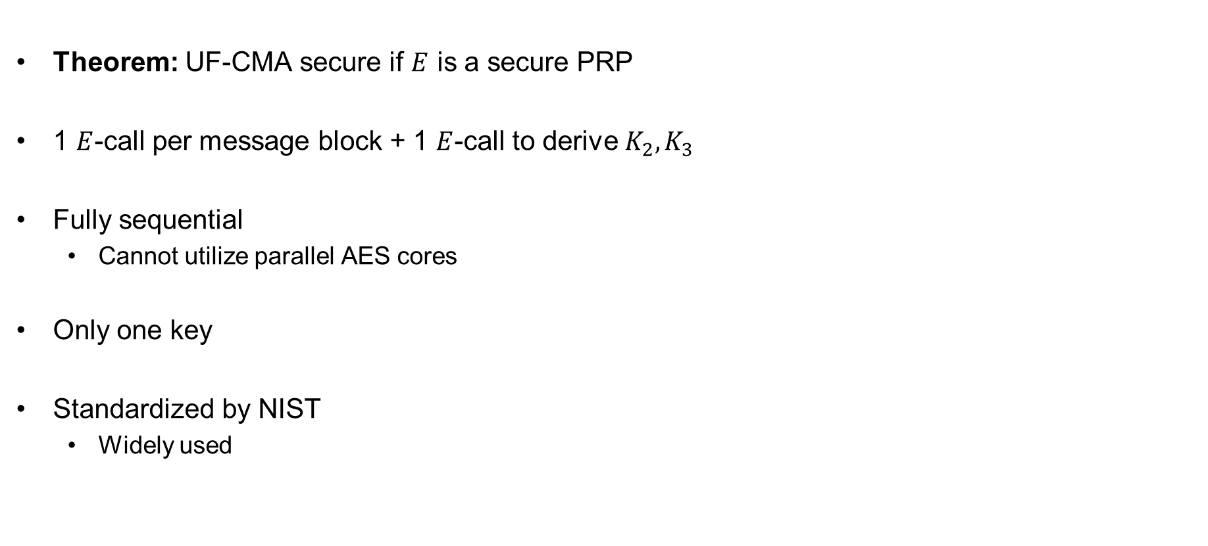









CMAC
Theorem: UF-CMA secure if $E$ is a secure PRP
1 $E$-call per message block + 1 $E$-call to derive $K_{2}, K_{3}$
Fully sequential
  Cannot utilize parallel AES cores
Only one key
Standardized by NIST
  Widely used
$${ M}_{3}$$
$${ M}_{1}$$
$${ M}_{2}$$
$$K$$
$${ E}_{K}$$
$${ E}_{K}$$
$${ E}_{K}$$
$$T$$
$${ M}_{1}$$
$${ M}_{2}$$
$${ M}_{3}$$
$$pad$$
$$K$$
$${ E}_{K}$$
$${ E}_{K}$$
$${ E}_{K}$$
$$T$$
$$K=2⋇F_{K}\left(0^{n}\right)$$
$$K=4⋇F_{K}\left(0^{n}\right)$$

Slide 43
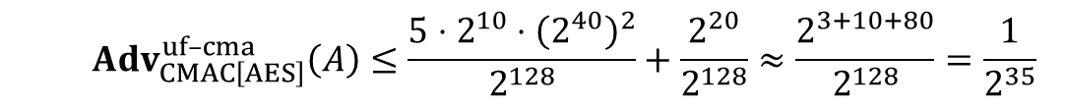
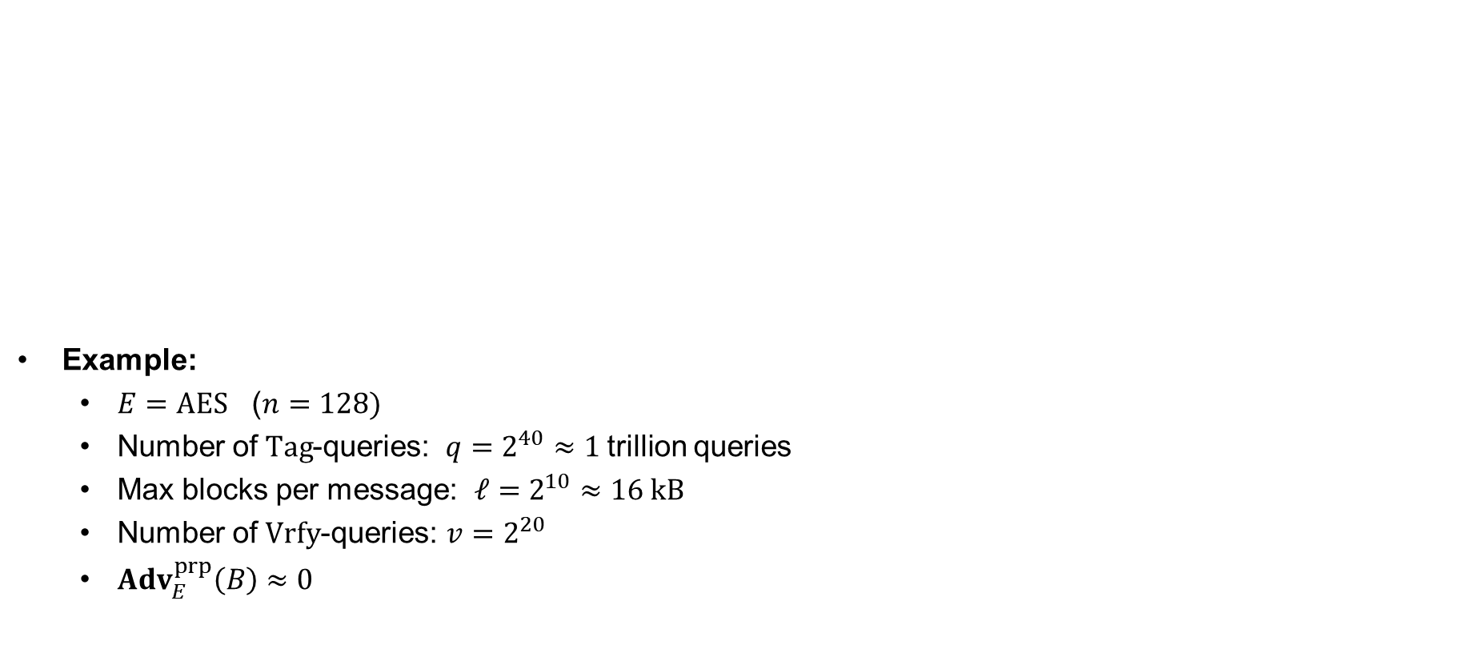
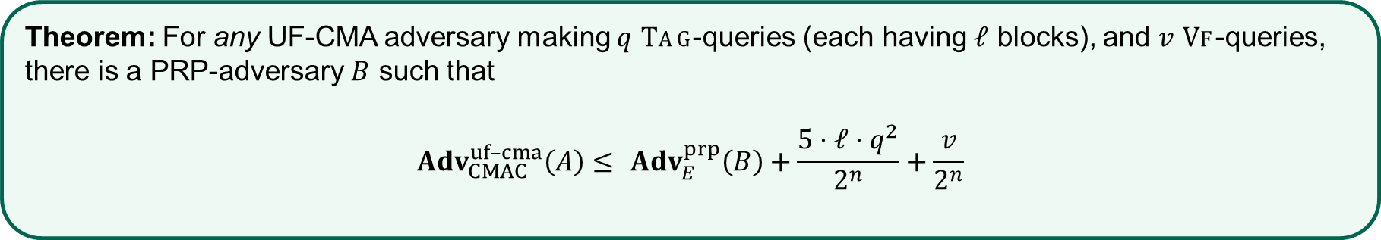
CMAC security
Example:
  $E=AES$ ($n=128)$
  Number of $Tag$-queries: $q=2^{40}≈1$trillion queries
  Max blocks per message: $ℓ=2^{10}≈16 kB$
  Number of $Vrfy$-queries: $v=2^{20}$
  $Adv_{E}^{prp}\left(B\right)≈0$
Theorem: For any UF-CMA adversary making $q$ $Tag$-queries (each having $ℓ$ blocks), and $v$ $Vf$-queries, there is a PRP-adversary $B$ such that
$$Adv_{CMAC}^{uf–cma}\left(A\right)≤ Adv_{E}^{prp}\left(B\right)+\frac{5⋅ℓ⋅q^{2}}{2^{n}}+\frac{v}{2^{n}}$$
  $$Adv_{CMAC\left[AES\right]}^{uf–cma}\left(A\right)≤\frac{5⋅2^{10}⋅{\left(2^{40}\right)}^{2}}{2^{128}}+\frac{2^{20}}{2^{128}}≈\frac{2^{3+10+80}}{2^{128}}=\frac{1}{2^{35}}$$

Slide 44
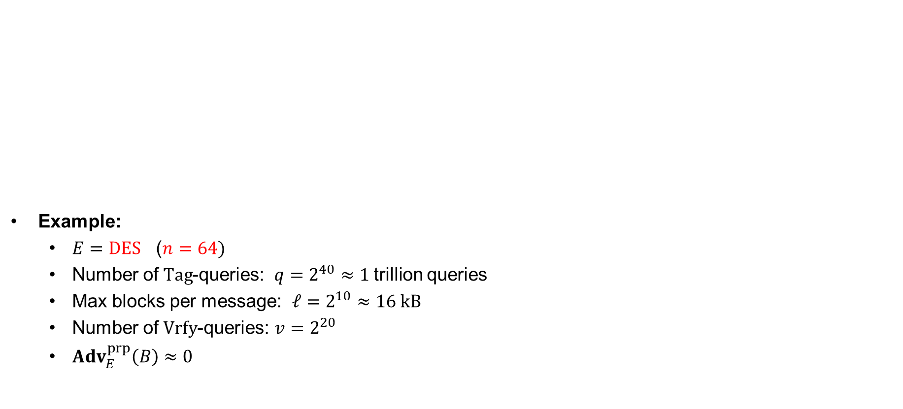
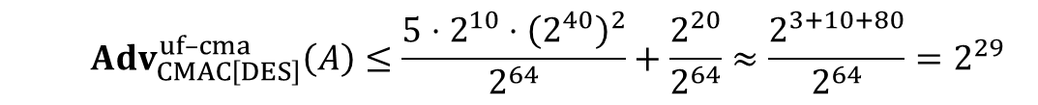
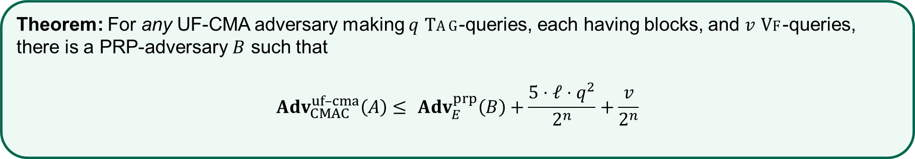
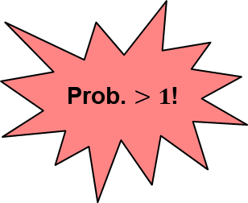
CMAC security
Example:
  $E=DES$ ($n=64)$
  Number of $Tag$-queries: $q=2^{40}≈1$trillion queries
  Max blocks per message: $ℓ=2^{10}≈16 kB$
  Number of $Vrfy$-queries: $v=2^{20}$
  $Adv_{E}^{prp}\left(B\right)≈0$
Theorem: For any UF-CMA adversary making $q$ $Tag$-queries, each having blocks, and $v$ $Vf$-queries, there is a PRP-adversary $B$ such that
$$Adv_{CMAC}^{uf–cma}\left(A\right)≤ Adv_{E}^{prp}\left(B\right)+\frac{5⋅ℓ⋅q^{2}}{2^{n}}+\frac{v}{2^{n}}$$
Prob. $>1$!
  $$Adv_{CMAC\left[DES\right]}^{uf–cma}\left(A\right)≤\frac{5⋅2^{10}⋅{\left(2^{40}\right)}^{2}}{2^{64}}+\frac{2^{20}}{2^{64}}≈\frac{2^{3+10+80}}{2^{64}}=2^{29}$$

Slide 45
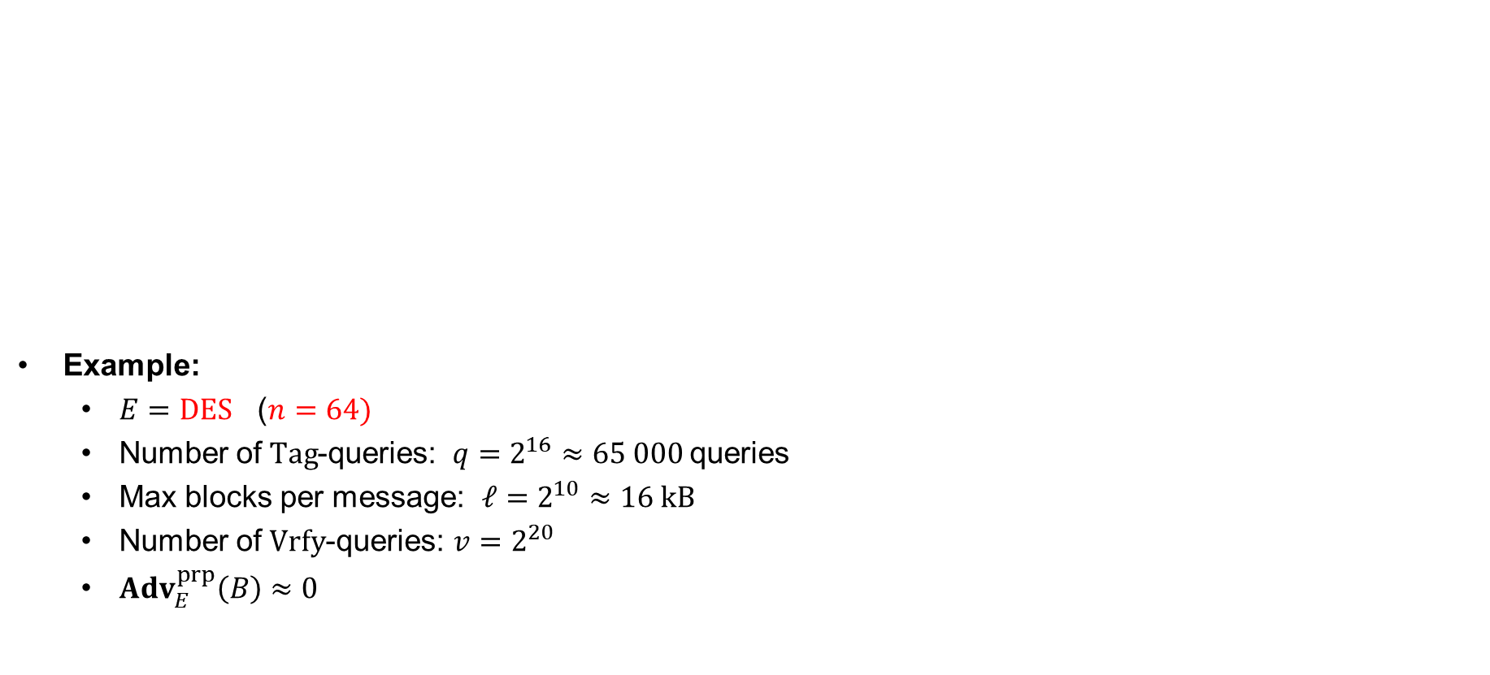
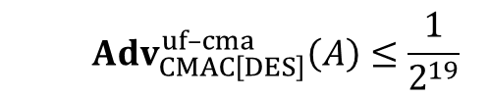
CMAC security
Example:
  $E=DES$ ($n=64)$
  Number of $Tag$-queries: $q=2^{16}≈65 000$queries
  Max blocks per message: $ℓ=2^{10}≈16 kB$
  Number of $Vrfy$-queries: $v=2^{20}$
  $Adv_{E}^{prp}\left(B\right)≈0$
Theorem: For any UF-CMA adversary making $q$ $Tag$-queries, each having blocks, and $v$ $Vf$-queries, there is a PRP-adversary $B$ such that
$$Adv_{CMAC}^{uf–cma}\left(A\right)≤ Adv_{E}^{prp}\left(B\right)+\frac{5⋅ℓ⋅q^{2}}{2^{n}}+\frac{v}{2^{n}}$$
  $$Adv_{CMAC\left[DES\right]}^{uf–cma}\left(A\right)≤\frac{1}{2^{19}}$$

Slide 46















PMAC
$${ M}_{1}$$
$${ M}_{2}$$
$${ M}_{3}$$
$${ M}_{4}$$
$$pad$$
$${ M}_{3}$$
$$γ_{1}⋇L$$
$$γ_{2}⋇L$$
$$γ_{3}⋇L$$
$${ E}_{K}$$
$${ E}_{K}$$
$${ E}_{K}$$
$${ E}_{K}$$
$$L=F_{K}\left(0^{n}\right)$$
$γ_{i}=$ Gray codes
$$T$$

Slide 47




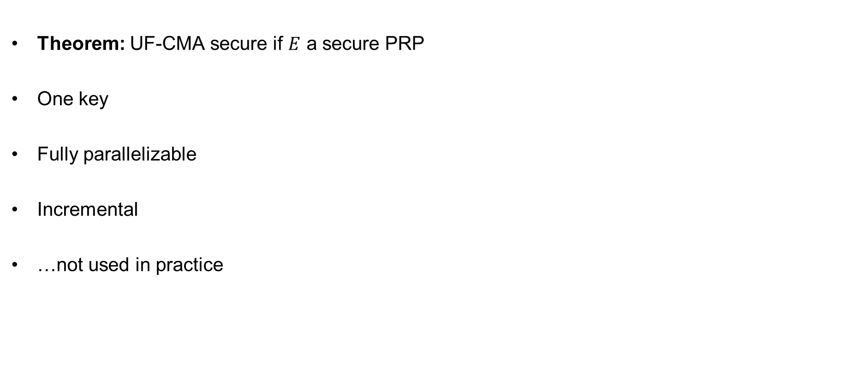























PMAC properties
Theorem: UF-CMA secure if $E$ a secure PRP
One key
Fully parallelizable
Incremental
…not used in practice
$${ M}_{1}$$
$${ M}_{2}$$
$${ M}_{3}$$
$${ M}_{4}$$
$$pad$$
$${ M}_{3}$$
$$γ_{1}⋇L$$
$$γ_{2}⋇L$$
$$γ_{3}⋇L$$
$${ E}_{K}$$
$${ E}_{K}$$
$${ E}_{K}$$
$$T_{2}^{′}$$
$$T_{2}$$
$$E_{K}^{−1}\left(T\right)$$
$${ E}_{K}$$
$T$
$$T$$
$${PMAC}_{K}\left(M_{1}||M_{2}||…||M_{1000}\right)=T$$
$${PMAC}_{K}\left(M_{1}||M_{2}^{′}||…||M_{1000}\right)=$$
$$E_{K}^{−1}\left(T\right)$$
$$⊕T_{2}$$
$$⊕T_{2}^{′}$$
$$=T$$
$$E_{K}\left( \right)$$
$${T_{2}=E}_{K}\left(M_{2}⊕γ_{2}⋇L\right)$$
$${T_{2}^{′}=E}_{K}\left(M_{2}^{′}⊕γ_{2}⋇L\right)$$

Slide 48
Summary
UF-CMA the right security notion for message integrity
  Does not cover replay attacks
PRFs are good MACs
  But only for short (fixed) input length
CBC-MAC good MAC for messages of a single fixed length
CMAC upgrades CBC-MAC to variable-length messages

