Slide 1
DIGITAL LIVING

Slide 2
TWO THEMES:

Slide 3
HOW CAN DIGITAL STUDENT LIFE BE BETTER?

Slide 4
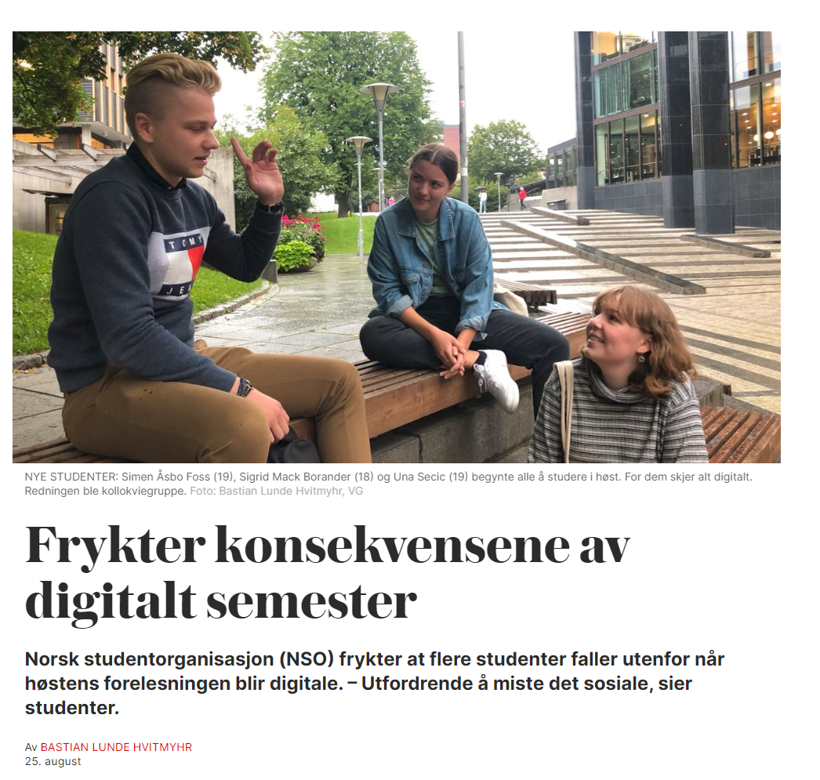
Kilde: https://www.nrk.no/tromsogfinnmark/internasjonale-studenter-pa-bar-bakke-i-koronakrisen_-_-sjokkerende-lite-hjelp-a-fa-1.14951930

Slide 5
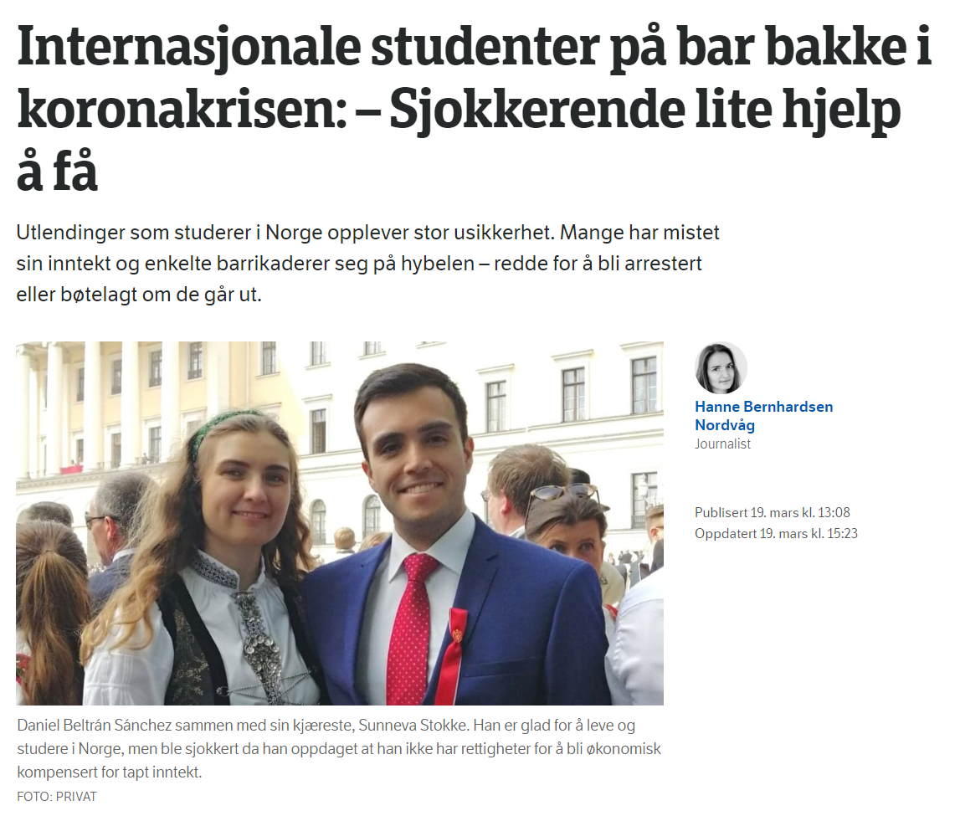
Kilde: https://www.nrk.no/tromsogfinnmark/internasjonale-studenter-pa-bar-bakke-i-koronakrisen_-_-sjokkerende-lite-hjelp-a-fa-1.14951930

Slide 6
HOW CAN WE DO DIGITAL PARTICIPATORY DESIGN?

Slide 7
Conduct a PD-process only through digital participation.
How can we conduct an exclusively digital PD-process?

Slide 8
Conduct a PD-process with one or more groups of co-students in IN5510 on how we can enable meaningful digital participation.
How we assist co-students in enabling a digital PD-process—using PD?

Slide 9
A challenging task, not fully understood.
Given the groups approach, you can use co-students.
We hypothesise that some groups might have a hard time gaining physical access. Therefore, it would be interesting if one or two groups could experiment with different digital participatory design processes—using PD.

