Slide 1
Data Justice for Development
Silvia Masiero
silvima@ifi.uio.no
IN5370 – ICT and Global Inequalities
14.09.2024

Slide 2
Overview
What is data justice?
Data injustices and socio-economic development
Building data justice into ICT artefacts!

Slide 3
After this lecture, you can…
Define data justice, specifying how issues of data justice are relevant to core problems of ICT for development research
Identify different forms of data injustice, distinguishing different ways in which data injustice is produced and stating how such injustices intersect with issues of socio-economic development
Discuss different ways in which data justice can be infused in technology, contributing to countering data injustice through ICT artefacts.

Slide 4
First of all…
What is “data justice” for you?

Slide 5
Data justice: A definition
Data justice: «fairness in the way people are made visible, represented and treated as a result of their production of digital data” (Taylor, 2017)
Just as an idea of social justice is needed in a (non-datafied) world to establish the rule of law, an idea of data justice is needed to understand justice in a world that is increasingly datafied.
Made necessary by the sudden availability of digital data on populations that were previously digitally invisible (Taylor, 2017).

Slide 6
For example...
Pick a card from the “persona” deck
What data of this persona are visible to the state (or the organisation, e.g. refugee management body, providing theiressential needs?)
How is the person represented in data by this organisation, and how are they treated as a result?

Slide 7
Data justice: Different perspectives
Many scholarly understandings of data justice!
Heeks & Renken (2018): four perspectives on data justice
  Instrumental: fair use of data (focus on outcomes)
  Procedural: fair handling of data (focus on process)
  Distributive/rights-based: fair distribution of data
  Structural: data as embedded in the power relations that characterise a given context
A structural approach as the basis for studying data justice in a development context (Heeks & Renken, 2018).

Slide 8
Data justice: Different perspectives
Dencik et al. (2019): the interdisciplinarity of the data justice notion
  How data is generated, collected and used in society has become an issue across disciplines
Data justice as related to datafication:
  The conversion of previously existing processes into data
  Acquires a different meaning when related to populations made more vulnerable by the visualisation, capture and treatment of their data.

Slide 9
So…
We conceive data justice with Taylor (2017) in terms of visualisation, representation and treatment of people as a result of the digital data they produce
The concept is per se delinked from development, as the need for data justice comes from a datafication of society that is inherently global
However, structural inequalities such as those examined by Heeks and Renken (2018) put data justice into direct relation with development.

Slide 10
Data injustices
Heeks and Renken (2018): structurally vulnerable people are made prone to data injustices, and may be put in the condition of being unable to overcome them
Weitzberg (2020): exclusion by design (data representations of citizens blocking access to essential social assistance in Kenya)
Madon & Schoemaker (2021): is datafying the humanitarian sector resulting in further perpetuation of injustice?

Slide 11
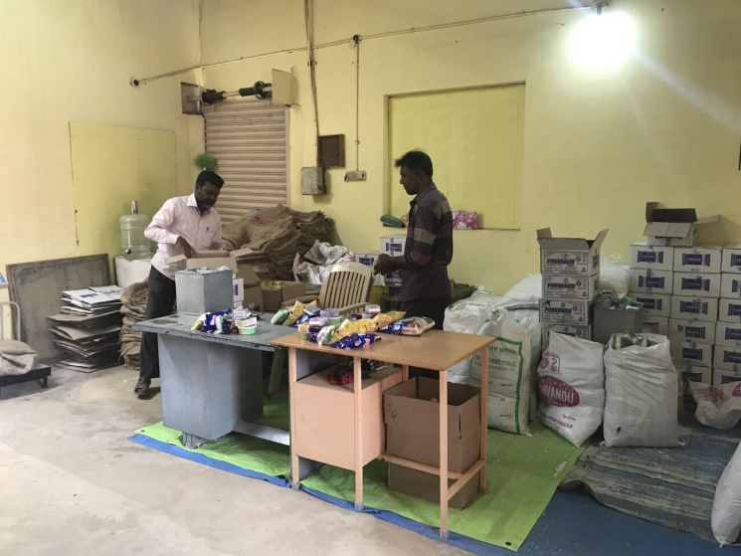
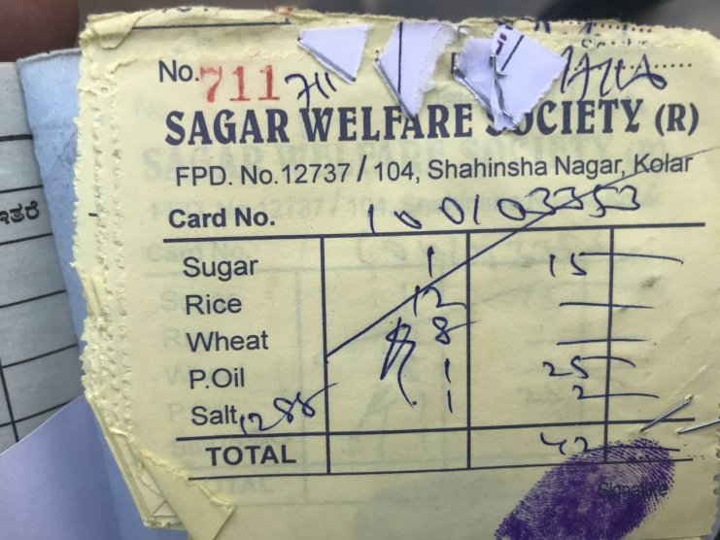
From lecture 5...
Masiero & Das (2019): three forms of data injustice in the biometric PDS in India
Legal – essential rights (right to food) made conditional to biometric registration of people in the Aadhaar database
Informational – users not fully informed of how biometric/demographic data are handled
Design-related – the system is designed to combat inclusion errors, but what grows is the exclusion of entitled users from food access

Slide 12
So…
Datafication comes with the promise of improving ends, such as social protection systems, by battling inclusion and exclusion errors
…in practice however, exclusions remain, along with legal and informational injustices!
More examples:
  Interoperability of refugee databases with police forces (Pelizza, 2020)
  Profiling of children through digital ID (Bhatia et al., 2021)
  Surveillance of informal workers through Aadhaar (Krishna, 2021)

Slide 13
Making a better world through data just ICTs!

Slide 14
Data just ICTs…
A slightly gloomy picture so far:
Research seems to be centred on data injustice, rather than on how to build a better world by infusing data justice into ICTs.
There is research that illustrates the development benefits of data, for example, Mukhopadhyay et al. (2019) illustrate the benefits of scaling up Aadhaar to improve India’s anti-poverty system.
However, this research that focuses on the infrastructure from an owners’ perspective, as opposed to a beneficiary one.

Slide 15
However…
A more recent stream of research exists, on how systems at risk of data injustice are reappropriated and operated towards fair visualisations, representations and treatment of people through their digital data.
The COVID-19 pandemic has (in many ways surprisingly) generated a spate of such research!

Slide 16
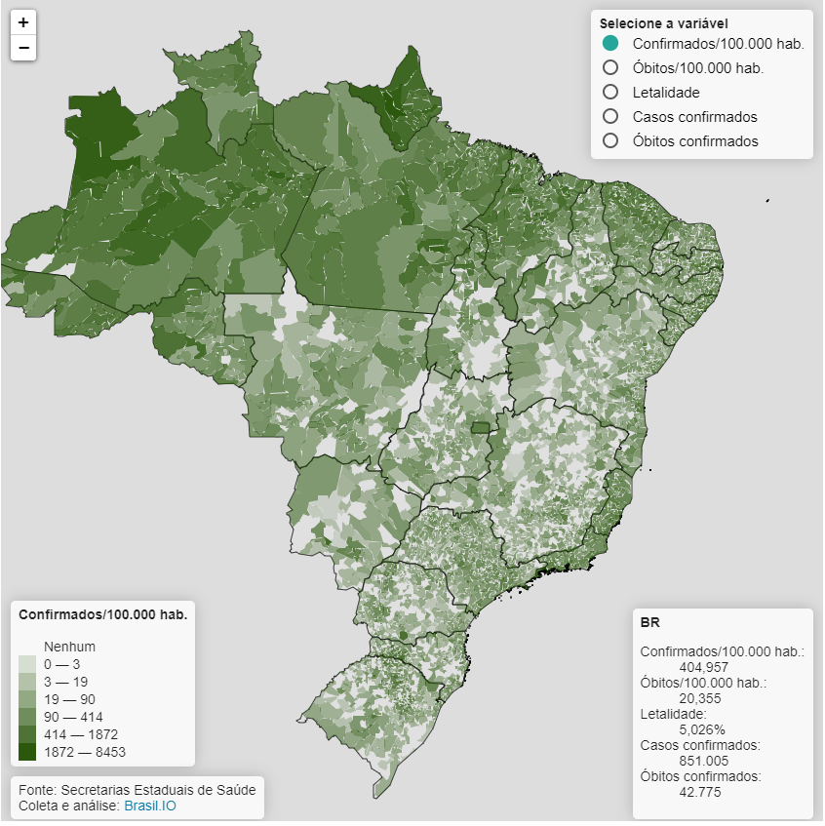
Making a Better World through Data Just ICTs
Some examples:
Fussy (2021) – data volunteerism against COVID-19 negationism in Brazil
Tarullo (2021) - micro-practices of activism in Argentina – organisation of self-help community groups on WhatsApp
Paisley (2021) – digital production of data feminist figures, which capture the different impacts of COVID-19 on women

Slide 17
What do examples of data just ICTs have in common?
Some common traits appear…
Development of collective awareness: understanding of a pre-existing condition of injustice (be it legal, informational, and/or design related) and its effect on collectivities
Reappropriation of infrastructure: shift in data ownership from (public and private) governing bodies to collectives close to beneficiaries
Continued data governance from such collectivities (from Brazil’s data volunteers to Argentina’s social committees).

Slide 18
…is it all about data ownership and governance?

Slide 19
To recap…
We have introduced the notion of data justice as fairness in how people are visualised, represented and treated through their production of digital data, and linked it to development
Our journey has taken us through data injustices in legal, informational and design-related terms, observing the structural vulnerability of variously disadvantaged populations to them…
…which has taken us to explore people-centred routes to overcome data injustice, converting means into the ends of a more just world in which ICTs are enabled to participate.

Slide 20
Thank you!
silvima@ifi.uio.no

Slide 21
Readings
Core Readings
Taylor, L. (2017). What is data justice? The case for connecting digital rights and freedoms globally. Big Data & Society, 4(2), 1-14.
Heeks, R., & Renken, J. (2018). Data justice for development: What would it mean?. Information Development, 34(1), 90-102.
Supplementary Readings
Akbari, A. (2021). Authoritarian surveillance: A corona test. Surveillance & Society, 19(1), 98-103.
Dencik, L., Hintz, A., Redden, J., & Treré, E. (2019). Exploring data justice: Conceptions, applications and directions. Information, Communication & Society, 22(7), 873– 881.
Krishna, S. (2021). Digital identity, datafication and social justice: understanding Aadhaar use among informal workers in south India. Information Technology for Development, 27(1), 67-90.

