Slide 1
Digital Identity: Between Development and Unfairness
Silvia Masiero
silvima@ifi.uio.no
IN5370 – ICTs and Global Inequalities
04.09.2024

Slide 2
Overview
Identity challenges: the digital ID game!
Unfairness in digital ID: a typology
Imagining fair digital identity

Slide 3
The digital ID game!

Slide 4
The digital ID game!
Choose your persona: cards in the persona deck describe people with fictional backgrounds based on real scenarios. Familiarise with the situation of your persona and draw a system card among the options presented.
Choose a system: each persona is presented with different system cards they can draw. Choose one, familiarise with the system’s features and when you are ready, draw a harm card among the options presented.
If you have time: discuss the causes and consequences of the form of harm that your card speaks about. Then familiarise with the mitigation options that the card presents!

Slide 5
…take-homes from the game!

Slide 6
Digital identity: what is it?
The term digital identity indicates the result of the conversion of human identities into digital, machine-readable data.
In digital identity systems, the functions of identification, authentication and authorisation are all performed digitally.
Global proliferation of digital identity systems!

Slide 7
Digital identity: what is it?
Digital identity systems involve the digital performance of three functions (Masiero & Arvidsson, 2021):
Identification – the process of establishing information about an individual, for example through breeder documents;
Authentication - the process of asserting an identity established during identification; for example through demographic or biometric details;
Authorisation - the process of determining what actions may be performed or services accessed based on the asserted and authenticated identity.

Slide 8
Digital identity: The Development Orthodoxy
By matching individuals with their digital credentials, digital identity schemes tackle inclusion errors (people being included in schemes they are note entitled to and exclusion errors (people being erroneously excluded from schemes and services they are entitled to).
For example, social protection programmes can easily identify entitled users, preventing leakage and ensuring that all the needful are served.
Sustainable Development Goal target 16.9: reaching a “free and universal legal identity, including birth registration, by 2030”.

Slide 9
But…
Empirical studies of digital identity offer many problematisations of the development orthodoxy.
Social welfare benefits: digital identity associated to erroneous exclusions of genuinely entitled users (cf. Masiero & Arvidsson, 2021)
Humanitarianism and assistance to minorities: coexistence of data-based assistance and surveillance, resulting into capture, deportation and even death (cf. Schoemaker et al., 2023)
Outright violation of human rights: Centre for Human Rights and Global Justice, NYU (2022) – digital identity systems funded by World Bank’s ID4D initiative result in documented human rights harm, while evidence of benefits remains “assumed, rather than proven”

Slide 10
How are harmful outcomes produced from digital ID?

Slide 11
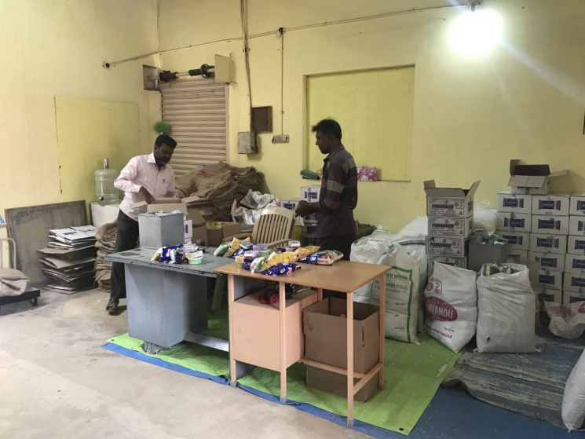
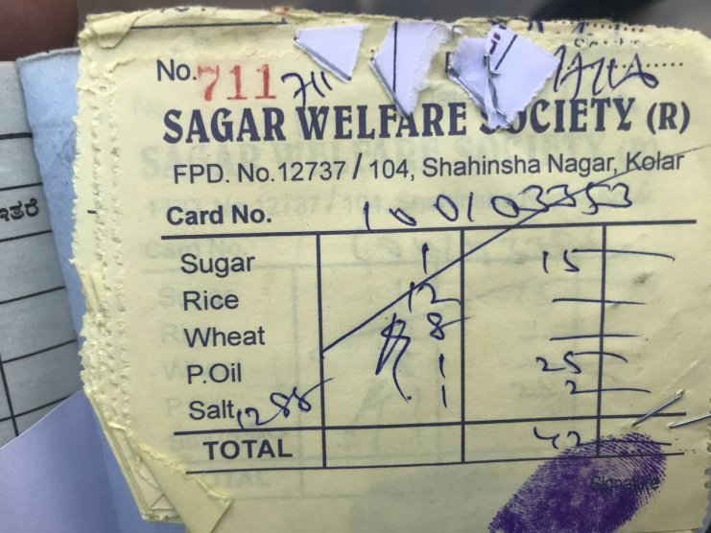
Harmful Outcomes of Digital ID
Three routes to unfairness in digital ID (from Masiero & Das, 2019):
Legal injustice – subordination of essential rights to correct provision of digital identity and functioning of digital identity systems
Informational injustice – injustice perpetrated through hiding or mishandling information on how digital identity data are used
Design-related injustice – injustice perpetrated through technology design, based on the technical features of digital identity systems

Slide 12
Harmful Outcomes of Digital ID
Legal injustice – subordination of essential rights to correct provision of digital identity and functioning of digital identity systems
Masiero & Das (2019): introducing digital authentication in ration shops results in new exclusions of users, who originally could smoothly access food rations in India’s Public Distribution System (PDS)
Extreme outcomes of exclusion: hunger deaths documented in relation to failed biometric authentication in India’s Jharkhand state
Harm generated by the breach of fundamental human rights, where rights as essential as the right to food are made conditional to the good functioning of digital identification and authentication.

Slide 13
Harmful Outcomes of Digital ID
Informational injustice – injustice perpetrated through hiding or mishandling information on how digital identity data are used
Masiero & Das (2019): little information among users on how biometric data will be used; no mention of the Indian government’s plan to shift from in-kind rations to cash transfers
With food subsidies made conditional to biometric registration, users are not in the position to meaningfully question how their data are handled
Harm generated by one-sided management of user data, leaving users in the position of either registering for digital ID or remaining without basic food rations.

Slide 14
Harmful Outcomes of Digital ID
Design-related injustice – a form of injustice perpetrated through technology design, based on the technical features of digital identity systems.
Masiero and Das (2019): exclusion of non-entitled users through biometrics, but no action towards entitled users (esp. widows; farmers; elderly) whose access to rations is hampered by misreadability of bodies
The system is not designed to fix wrongful exclusion, which results in magnified exclusions from food subsidies after the introduction of biometrics (Muralidharan et al., 2020)
Harm generated by the very design of the technology, which is misaligned with the urgent need for entitled people to access food rations.
Again the «dark matter» point from the previous lecture: injustice is not a «side» of the system, but directly designed into how the system is made.

Slide 15
So…
The digital ID for development promise (cf. Dahan & Gelb, 2015) builds on digital identity to tackle inclusion and exclusion errors, hence building better government services, social protection and humanitarian assistance
But: research shows at least three types (legal, informational and design-related) of harmful outcomes of digital identity!
An open letter from civil society organisations and researchers recently asked the World Bank to cease activities that promote harmful models of digital ID.

Slide 16
Building fair ID!

Slide 17
Some notes…
Recent research, having ascertained the harms caused by unfair ID, focuses on how to build models of digital ID that combat unfairness and ensure that the conditions for meeting the «development promise» are optimised
But: it can only happen if we take stock of unfair ID, and realise the magnitude of harm inflicted from digital identity systems since their inception.
One recent initiative: MOSIP, defined by its creators as “an open source platform on which national foundational IDs are built”.
Solves the problem of vendor lock-in…
…but questions on how the initiative will tackle issues of legal, informational and design injustices remain open.

Slide 18
…and so?
My view as digital ID researcher is that we should learn from grassroot efforts on digital ID, developed with awareness of all three types of injustice.
An important example from Kenya: Haki na Sheria (NGO promoting the rights of marginalized communities in Northern Kenya)
Supported over 10,000 persons in acquiring identification documents, such as birth and ID registration, during mobile registration events and throughout weekly outreach and legal aid support
Engages directly with the community on issues of digital ID and how these can be addressed
Research suggests that a fair ID starts from user engagement!

Slide 19
Thank you!
silvima@ifi.uio.no

Slide 20
Readings
Core Reading
Dahan, M., & Gelb, A. (2015). The role of identification in the post-2015 development agenda. Working Paper, World Bank, https://openknowledge.worldbank.org/bitstreams/c3187e7e-63be-5255-96de-087d563a3b8d/download.
Masiero, S., & Das, S. (2019). Datafying anti-poverty programmes: Implications for data justice. Information, Communication & Society, 22(7), 916-933.
Supplementary Reading
Masiero, S., & Arvidsson, V. (2021). Degenerative outcomes of digital identity platforms for development. Information Systems Journal, 31(6), 903-928.
Schoemaker, E., Martin, A., & Weitzberg, K. (2023). Digital Identity and Inclusion: Tracing Technological Transitions. Georgetown Journal of International Affairs, 24(1), 36-45.

