Slide 1
Java Microbench Harness
Magnus S. Espeland (magnuesp@ifi.uio.no)

Slide 2
Magnus S. Espeland
Part time masters student ProgNett
Teaching Assistant INF2440 (2018) and IN3030 (2019) (gruppelærer)
My thesis is about the importance of writing cache-friendly code, and I use the first part of Oblig 3 as an example to illustrate that
Mail : magnuesp@ifi.uio.no

Slide 3
What is JMH and Linux Perf?
Java Microbench Harness is a Java harness for building, running, and analysing nano/micro/milli/macro benchmarks written in Java and other languages targeting the JVM.
http://openjdk.java.net/projects/code-tools/jmh/
perf: it can instrument CPU performance counters, tracepoints, kprobes, and uprobes (dynamic tracing). It is capable of lightweight profiling. It is also included in the Linux kernel, under tools/perf, and is frequently updated and enhanced.
https://perf.wiki.kernel.org/index.php/Main_Page

Slide 4
So, what are they good for?
JMH can be used to benchmark your Java application, and even different algorithms in it. It takes care of warmup (getting the JVM with JIT into “steady state”), and executing each of your algorithms many times.
This scientific approach gives empiric data as to which algorithm performs better.
Together with perf it can show important details as to what happens in the CPU during execution.
(but, you can get interesting results without perf as well!)

Slide 5
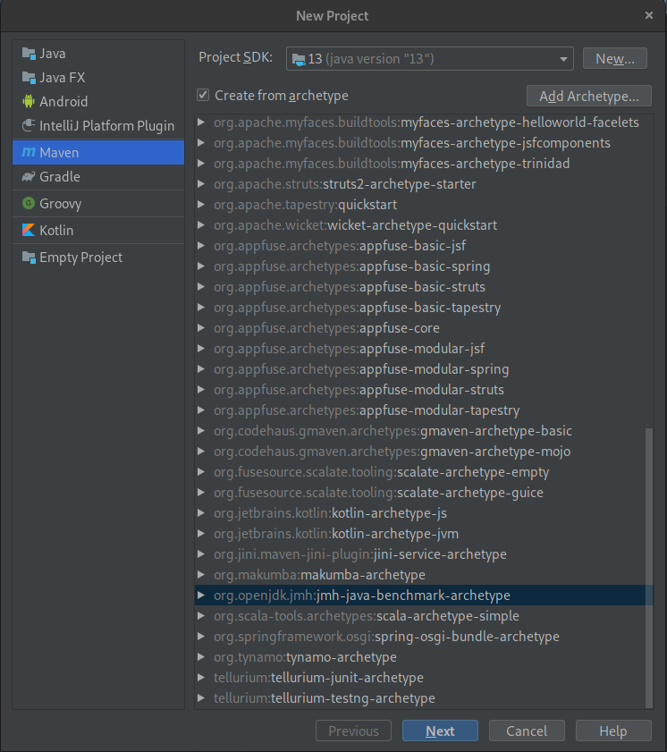
Creating the project ...
mvn archetype:generate \
-DinteractiveMode=false \
-DarchetypeGroupId=org.openjdk.jmh \
-DarchetypeArtifactId=jmh-java-benchmark-archetype \
-DgroupId=no.uio.ifi.yourusername \
-DartifactId=demo-benchmark \
-Dversion=1.0

Slide 6
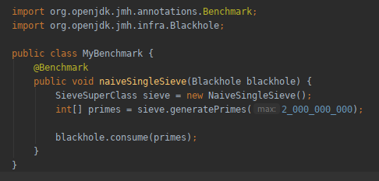
Now show me the code!
$ mvn clean install && java -jar target/benchmarks.jar -prof perf

Slide 7
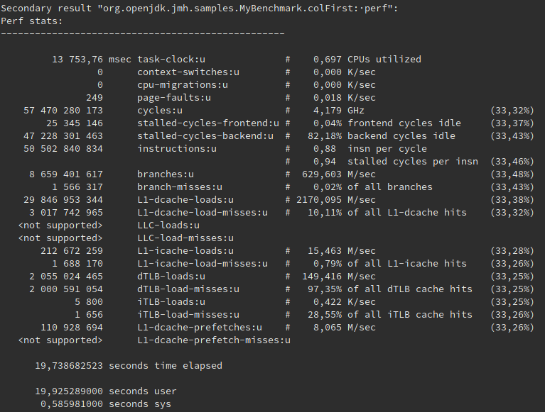
And the output? (matrix multipl., oblig 2)
Column first:
L1-dcache-load-misses:u # 10,11% of all L1-dcache hits
0,88 insn per cycle
0,94 stalled cycles per insn
Row first:
L1-dcache-load-misses:u # 0,34% of all L1-dcache hits
2,04 insn per cycl
0,37 stalled cycles per insn

Slide 8
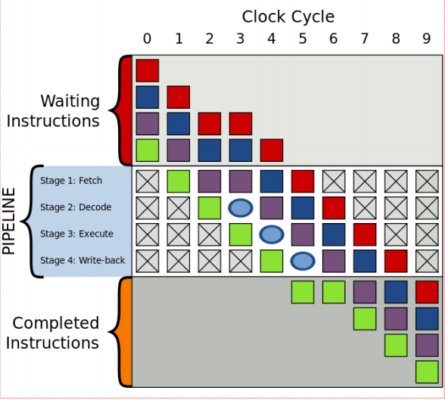
What is stalling?
Front-end is stage 1 and 2 of of the pipeline
Back-end is stage 3 and 4 of the pipeline
In simple terms:
Stalling in the back-end means the CPU cannot execute the instruction. Why? Mostly because it has to wait for the data to arrive from memory.
(The slow speed of light….)

Slide 9
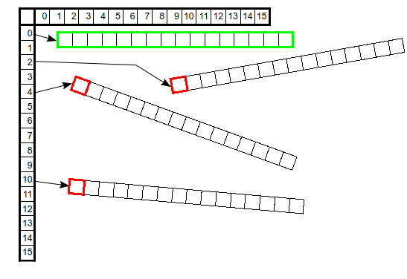
I don’t get it...
When doing matrix multiplication by the column first, the CPU can only buy one beer at a time (red squares).
When doing it row first, it can get a six-pack (actually a sixteen-pack, a cache line) each time it goes to the store (or RAM) via to the pre-fetch / readahead mechanism (green rectangle).
(Java’s multi-dim arrays are stored with references to the rows, not as one long memory segment.)

Slide 10
Summary
JMH (and perf) helps you understand the fine details of how your code behaves in the CPU. Very useful for tuning critical parts of your applications.
Experiment with it and use it in your reports, if you want. If you’re already struggling to get the obligs done, don’t worry about it.

Slide 11
Questions?

