Slide 1
Welcome to
AST3220 – Cosmology I

Slide 2
Who is teaching?
Øystein Elgarøy, oystein.elgaroy@astro.uio.no
Jakob Borg, jakob.borg@astro.uio.no
Lectures (ØE): Monday 14:15-16:00
Wednesday 12:15-14:00
Problem sessions (JB): Wednesday 14:15-16:00, starting on January 24 in room 304 in Svein Rosselands hus (ITA)

Slide 3
Where to find information
I will use the course webpage:
https://www.uio.no/studier/emner/matnat/astro/AST3220/v24/index.html
Topics for the week’s lectures and problems for the problem sessions can be found under “Timeplan”
Check this page several times every week!

Slide 4
What will you learn in this course?
The equations governing homogeneous and isotropic universe models, and some of their solutions.
Important phases in the history of the Universe (synthesis of light elements, origin of the CMB,…)
Inflation: Why and what, and its importance as the origin of cosmic structures

Slide 5
What you should know
I will assume that you have a knowledge of physics and mathematics corresponding to what you should have after five terms on the FA bachelor programme.
More specifically, I will assume that you have taken introductory courses on mechanics, electromagnetism, quantum mechanics and statistical physics.
Some knowledge of numerical methods and programming, sine the projects will be partly numerical. You can use any programming language you want. Matlab, Mathematica etc. are also OK.

Slide 6
A presumption of interest
I will also assume that you are on this course because you are interested in cosmology
Among other things, this means that I expect you to work on the weekly assigned problems, even though you don’t have to in order to pass
Some of the weekly problems pursue interesting topics not covered in the lectures

Slide 7
Syllabus
My lecture notes, can be found on the course webpage
Exercises
In practice: Anything you need to know/know how to do in order to solve the problems in the projects
If you want a supplementary book:
B. Ryden: “Introduction to cosmology” (2nd edition, in some places more elementary than this course)
S. Weinberg: “Cosmology” (above the level of this course, but a useful reference to have in your library)

Slide 8
Chatbots and AI
It is strictly forbidden to use AI in any way on the projects
You can, however, work together.
Also, Jakob and I are fairly liberal with hints and suggestions

Slide 9
How is your grade determined?
Three projects (dates TBA, will coordinate with AST3310 and take your wishes into account). The first is available on the course web page
The projects are a mix of analytical and numerical (mainly) problems
The first two contribute 25% each, the final one 50% towards your final grade
You can write your projects in Norwegian, Danish, Swedish or English

Slide 10
Web forum
Please go to
https://astro-forum.utenforuio.no/index.php
and register
You can ask questions, discuss, etc.
I will also use this forum to communicate with you.

Slide 11
What is cosmology?

Slide 12
Cosmology is the study of the whole Universe as a physical system
But what is the Universe?

Slide 13
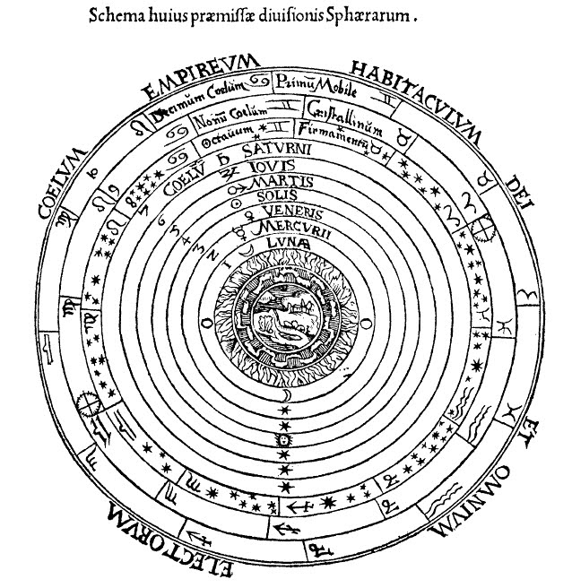

Slide 14
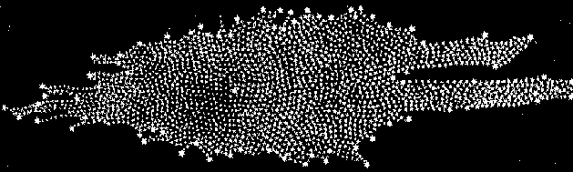

Slide 15
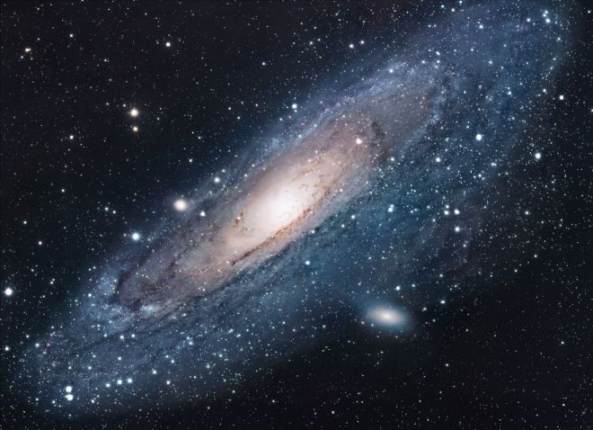
AST1010 - Galakser

Slide 16

1917: The Einstein Universe

Slide 17
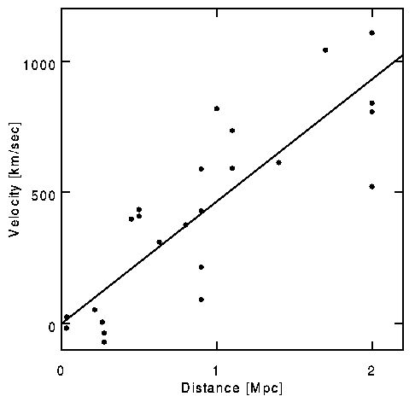
Hubble’s first data

Slide 18
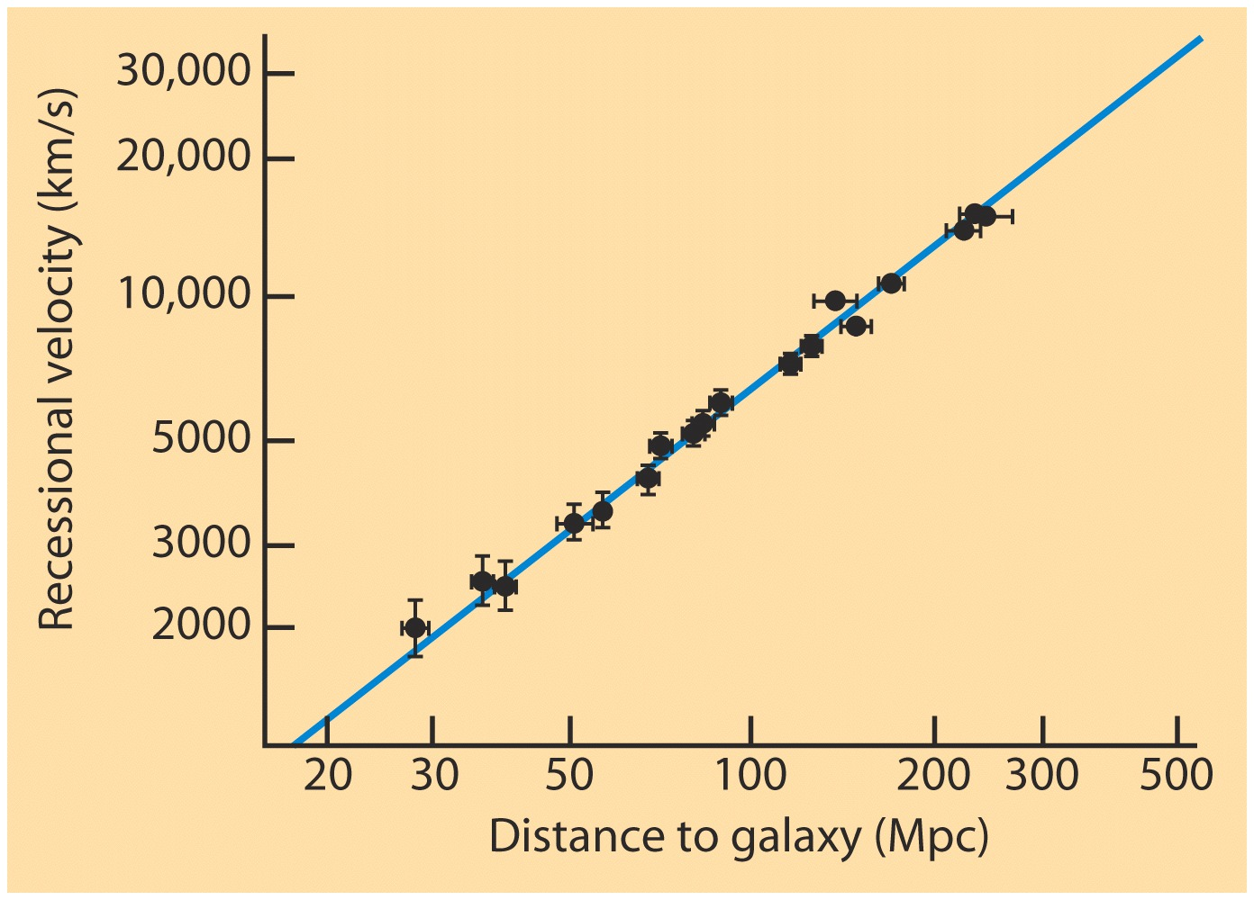

Slide 19
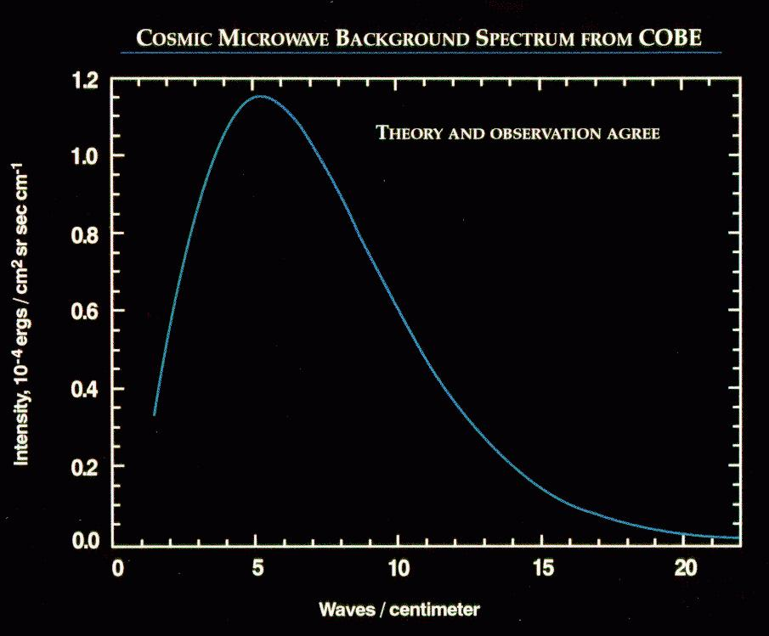
The Cosmic Microwave Background

Slide 20
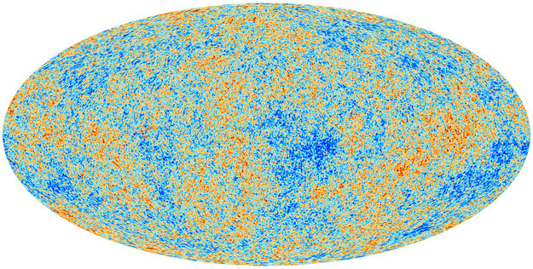
Notes:
Den 21. mars 2013 presentere teamet bak ESA-satellitten Planck sine første målinger av temperaturvariasjonene i bakgrunnsstrålingen. Planck har høyere oppløsning og bedre presisjon enn WMAP, og dette kartet viser variasjonene i uovertruffen detaljrikdom. Ved å analysere de statistiske egenskapene til kartet kan man lære en hel masse om de viktigste parametrene som bestemmer universets struktur og utvikling. En gruppe av kosmologer ved Institutt for teoretisk astrofysikk her i Oslo har gitt viktige bidrag til dette arbeidet.

Slide 21
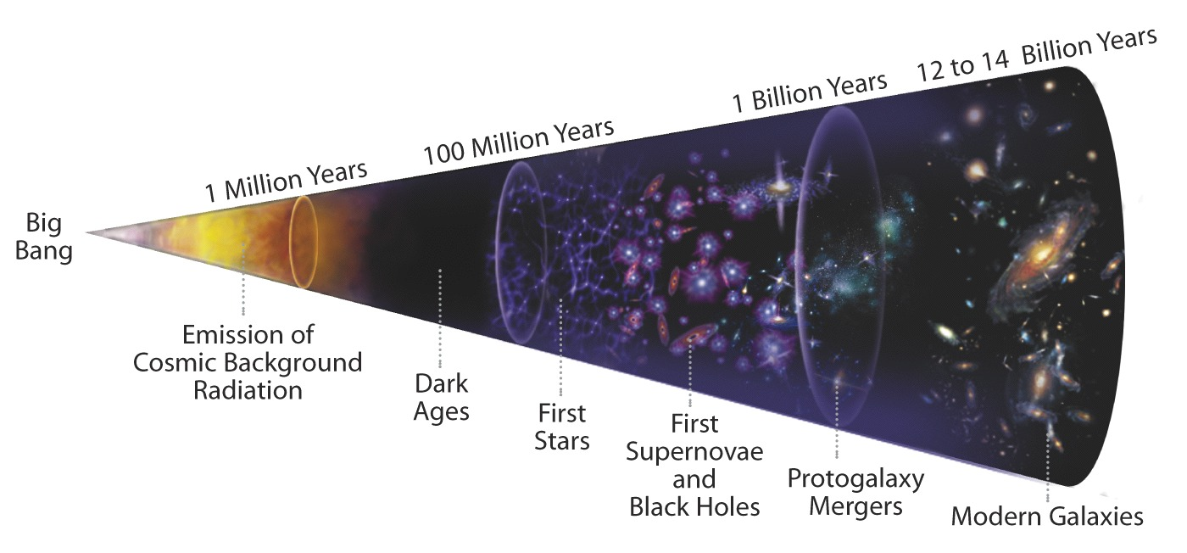
Notes:
Her ser vi en oppsummering av universets historie, i grove trekk, slik vi kan sette den sammen fra ulike observasjoner i kombinasjon med teoretiske modeller.

Slide 22
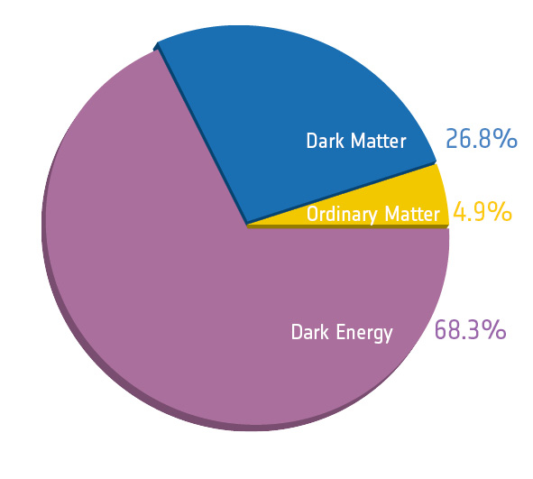

Slide 23
How can we build cosmological models?
Lower our ambitions (e.g., don’t care about anything smaller than galaxies)
Make simplifying assumptions, add complexities later, if necessary

Slide 24
The Cosmological Principle
Viewed on sufficiently large scales, the Universe is homogeneous and isotropic.

