Slide 1

Creating social stories with Generative AI: A pedagogical design for Special Needs Education
Catriona Windsor, PhD candidate, ISP.
catriow@uio.no
Generative AI course inspiration. 15/09/2025
Notes:
Hi, I’m Catriona, doing my PhD at ISP and I focused my lesson plan coursework on how AI could be used to support the teaching and development of social stories.
These are tools used to support people with communication and neurodiverse needs to understand various interactions, situations and events… And just so you have some point of reference for what I’m talking about…

Slide 2
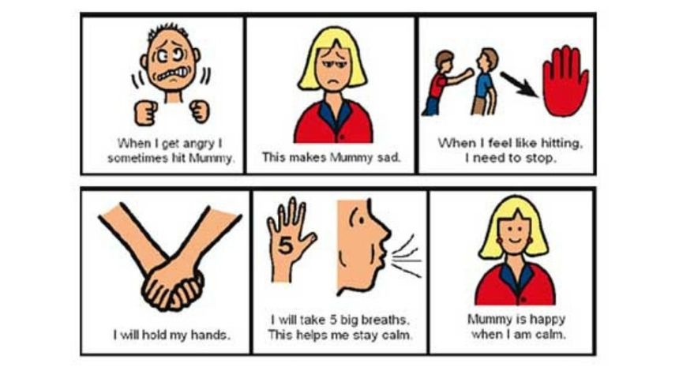
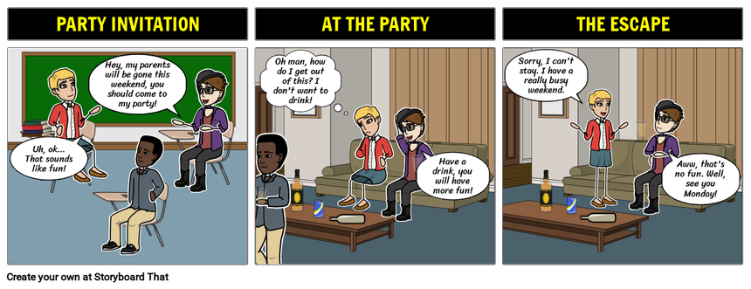
https://mycarespace.com.au/sites/default/files/resources/Social-Stories-for-Autism-ADHD-and-PDD-NOS.jpeg
https://cdn.storyboardthat.com/storyboard-srcsets/natashalupiani/adolescent-peer-pressure.png
Notes:
– these are a couple of examples – from more basic social settings with minimal text,
to more complex, detailed social situations.
They can be made for a range of scenarios and tailored to a range of individual needs.

Slide 3


Engaging students creatively with case-based learning
Notes:
If you have ever asked students to create a case study or scenario to work with, you may have experienced something I have, which is being met with blank stares or, best case scenario, some generic answers or examples.
To try to address this, I designed a theoretical learning activity for 3rd-year Bachelor students in Special Needs Education that uses generative AI to help them create both a case study, and social stories.
The idea with using AI in this way was not to replace creativity, but to unlock it.
I used Microsoft CoPilot both to support me in designing the activity and to embed use of AI into the plan for students.

Slide 4
FIRE! (Focus, Intended audience, Request, Example)
FOCUS: “I want you to act as a university learning assistant”
INTENDED AUDIENCE: “3rd year bachelor students studying special needs education in Norway”
REQUESTS:
  “I want them to create an appropriate pupil profile for the child, with a scenario that would be appropriate to develop a social story“
  “I then want them to use generative AI to develop a social story”
EXAMPLE: “Provide two to three learning objectives and outcomes for these students based on the information above”.
Notes:
When using GenAI to develop the plan, I used the FIRE prompt structure, detailing the “Focus”, “Intended audience” “request” and “example” of what I wanted.
With focus, I informed AI what role I wanted it to fulfill.
I provided information about the intended audience. I could have been more detailed here, and stated, for example, how many placements they had been on.
These are two examples of the requests I made, although I did provide more context and specific detail.
Finally, I asked it to provide me with some example so I could select what I found most appropriate.

Slide 5
Context & rationale
Target group: 3rd year Bachelor students in Special Needs Education
Challenge: creating realistic pupil profiles and social stories
Use GenAI to support: profile creation and story development
Optional activity: compare outcomes to using vs not using AI
Teacher role: support prompt engineering and critical reflection
GenAI use benefit: scaffold creativity and reduce cognitive load
Goal: encourage responsive, reflective and ethical AI use in education.
Notes:
This led to my activity plan…
(CLICK - CLICK - CLICK)
Students would use tools like Microsoft Copilot, or another UiO-approved GenAI tool, to create a fictional pupil with communication needs, and then generate a social story tailored to that child’s age and situation.
They could also use AI to support the development of the social story, including structure, content and image production.
(CLICK)
An optional extra, could be to have half of the group use GenAI and half rely on their experience and imagination, then exchange thoughts, comparing their experiences of the activity with each other at the end.
(CLICK)
The teacher role would be in supporting students with prompt engineering, and in critically reflecting on the benefits and challenges of such tasks.
(CLICK-CLICK)
This aims to reduce the cognitive load of ‘starting from scratch’ with a case study, and allows students to focus on applying theory to practice, while also reflecting on the usefulness and limitations of AI in educational contexts.

Slide 6
Lesson plan
Learning goal | Specific Task | GenAI Tool integration | How GenAI supports task | Ensuring content mastery
Seminar 1: Consider where social stories can be useful | Student role: Provide a pupil profile & scenario. Teacher role: Provide feedback to the applicability of the selected pupil and scenario. | Teacher role: support in prompt engineering and analysis of appropriate pupils/scenarios. Student role: practice creating pupil profiles/ support scenarios with GenAI. | Reduces mental load of creating a scenario and story, providing more “space” to consider appropriate use of the tool. | Critically consider the suggested pupil profile and scenario GenAI presents – how realistic is it? Is it appropriate? Is it detailed enough. Practice with prompt engineering. Discuss and debate the appropriateness of social stories to GenAI generated scenarios.
Seminar 2: Design and evaluate a social story | Student role: create a draft story for the pupil profile and scenario created. Teacher role: provide feedback on the social story; prompt discussion on what could be improved/ altered. | Teacher role: ongoing support in prompt engineering, and analysis of social stories. Student role: use GenAI as a tool to develop the structure of a social story; assess how useful GenAI is in supporting the task. | Support in organising and structuring a social story appropriate to the pupil and scenario. Aiming to remove the “fear” some students have in relation to more creative activities, allowing more critical analysis of the social story as a tool, and in using GenAI to create it. | Teacher input in the design of the social story. Students need to justify choices. Encourage analysis and constructive feedback between groups of each other’s stories – also practice in presenting/public speaking in an informal/relaxed environment – another area of anxiety for many students. Consider utility of, theories, and research about social stories.
Seminar 3: Reflect on, and evaluate GenAI tools | Teacher role: prompt discussions around reflective theories. Student role: write a short reflective piece & participate in group discussions. | N/A – GenAI not used here – reflection on the process of using the tools. |  | Students need to apply reflective theory to the process of using GenAI to create social stories.
Notes:
The activity was structured across three 2-hour seminars.
Don’t worry about the detail of this, I’ll summarise each seminar, and if anyone wants the slides let me know.
During Seminar 1: Students will be directed to create the pupil profile and a scenario that could be supported using a social story.
Here, the teacher’s role is mainly to support prompt writing.
During Seminar 2: Students draft a social story using GenAI. They’re encouraged to include image prompts or descriptions and reflect on how the story supports the communication challenge they identified. Here the teacher’s role is to support the critical analysis of the quality of the social stories produced.
In the final Seminar: Students reflect on the process, considering what worked, what didn’t, and how useful GenAI was for the task. Here, the teacher’s role is to support, guide and structure reflections.
The overall activity was designed to be flexible: students can determine the extent to which they engage with the GenAI, and the seminar leader’s role is to guide, not dictate.

Slide 7
Pedagogical value
Constructivist learning: prior knowledge and placement experience
Student-centered: autonomy within clear boundaries
Critical evaluation: supported and encouraged
Encourage engagement: through debate and reflection.
Notes:
CLICK-CLICK
I grounded this activity in constructivist learning, where students build on prior knowledge and placement experience to create something meaningful.
CLICK
It was also student-centred: they choose how to engage with the task, and have autonomy in how they use AI within the boundaries provided.
CLICK
Critically, it encourages ethical and reflective AI use. Students must evaluate the quality of AI-generated content and consider its limitations.
CLICK
For some, AI may help reduce anxiety around creative tasks. For others, it might encourage debate about whether AI can truly generate ‘human’ examples, especially for students who by their 3rd year have at least had experience on placement. Exploring these tensions within an academic setting has the potential to be pedagogically rich.

Slide 8

How could GenAI reduce barriers or encourage debates in your own teaching?
Notes:
Although this activity wasn’t implemented, it helped me think deeply about how GenAI can support, not replace, pedagogical creativity.
I now feel more confident in using AI tools myself, and in guiding students to use them responsibly.
I’ll leave you with a question (CLICK): How could GenAI reduce barriers or encourage debates in your own teaching?

