Slide 1

Welcome to Department of…
Faculty of Humanities

Slide 2
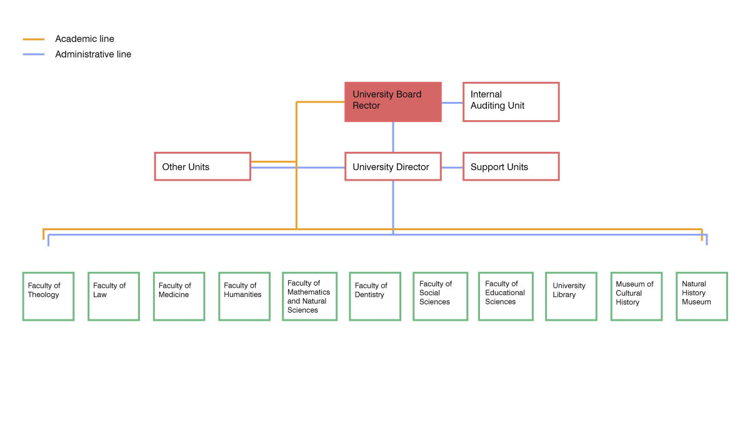
University of Oslo
Educational Services
Research administration
IT-services
Communications & External Relations
Finance & Business
Personnel Support
Estate
Healt, Safety & Environment
Ioccupational Healt Service
Notes:
UNIVERSITETET I OSLO – ORGANISASJON pr. 21.10.2018

Slide 3
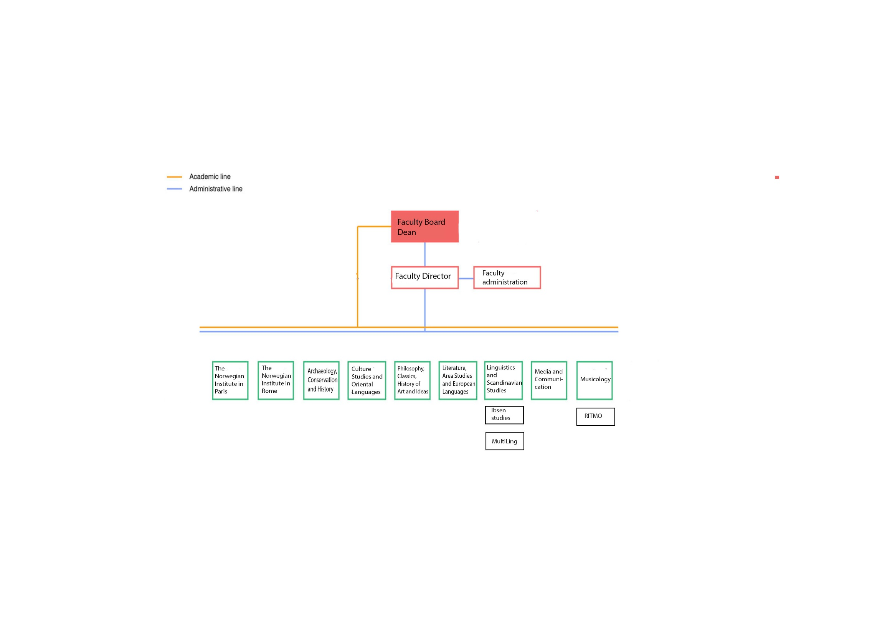
Faculty of Humanities
Studies
Research
Communications
Finance
HR
(IT and AV services)

Slide 4
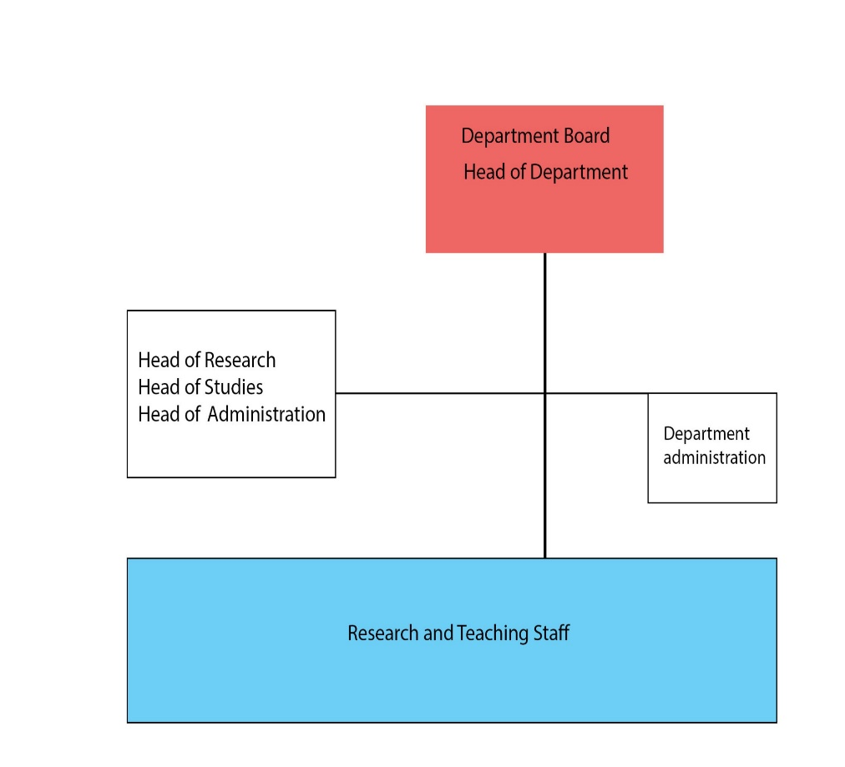
Department of X
Management:
Head of Department:
Head of Research
Head of Education
…others?
Head of Administration:
Student councelling
Academic administration
Student exchange
Internationalisation
PhD administration
Research administration

Slide 5
Who does what in the administration?
Legg inn informasjon og lenke til personside for de mest relevante kontaktpersonene (adm. leder, eventuelt forskningsrådgivere, studieadminitrasjon etc)

Slide 6

Who can I ask, and who is my manager?
Questions relating to practical things (office, equipment, access card, etc): adviser/head of administration/ etc xxx, email: xxx
HR related questions (leave of absence, salary, contract etc):
HR adviser xxx, e-mail xxx
Studies related questions: xxx
Research related questions: xxx
Other?
Who will have the one-to-one work dialogue with you?
Permanent academic staff:
Postdoctoral fellows:
Doctoral fellows:
Technical/administrative staff:
Notes:
Fyll inn relevante kontaktpersoner
Om medarbeidersamtalen: https://www.uio.no/for-ansatte/arbeidsstotte/personal/personaloppfolging/medarbeidersamtale/index.html (skjema for samtalen er i høyre marg)
https://www.uio.no/for-ansatte/arbeidsstotte/personal/personaloppfolging/mottaknyansatt/index.html

Slide 7
Other relevant contact persons and websites
Floor Contact: The Floor Contact shall serve as support for the manager and contribute to the undertaking’s fire-prevention and fire-fighting tasks.
  Floor x: Name, phone number
  Floor x: Name, phone number
Safety representatives:
  Name, phone number
UiO Security Operation Center. Open around the clock, all days. Phone number: 22 85 66 66
Estate Services. Cleaning, outdoor space, waste, internal relocation, courier services or other daily maintenance work: Estate Services - For employees - University of Oslo (uio.no)
Occupational Health Service Unit supports employers, staff, working environment committees, and safety representatives in creating safe and sound working conditions. Occupational Health Service Unit - University of Oslo (uio.no)
Speak up!-system – Speak up! - University of Oslo (uio.no)
On the Safe Side – a mobile-optimized website that provides you with user-friendly training and advice on what to do in emergency situations: https://www.sikresiden.no

Slide 8
Opening hours
General opening hours are every day from 05:00-00:00 with access card/code.
Without an access card, the general opening hours are 07:00-18:00 Monday-Friday.
For detailed information on all opening hours, see: Opening hours - University of Oslo (uio.no)
Remember to lock your office when you are not there!

Slide 9
Miscellaneous information
Mail: Mail shelves can be found …
Office supplies can be found …, and (name and e-mail) will order in more when empty.
Parking: Remember to download the app and register. Parking at the University of Oslo - University of Oslo (uio.no)
Employee ID card: The card is normally issued within two days after starting work at UiO and must be renewed every five years. Employee ID card - For employees - University of Oslo (uio.no)

Slide 10
Social activities
Sett inn faste aktiviteter på instituttet, som lunsjer, seminarer, jule- og sommerfest og lignende
Information on introductory events, such as welcome breakfast for international researchers: Introduction - For employees - University of Oslo (uio.no)
Upcoming events: Arrangementer - For ansatte - Universitetet i Oslo (uio.no)
UiO’s drug and alcohol policy (Norwegian only): uios-retningslinjer-om-rusmiddelbruk.pdf

Slide 11
Procurements
All procurement, with the exception of books and travel, must be undertaken by your purchasing officer through the UiO procurement system.
  How do you order? - For employees - University of Oslo (uio.no)
Travels:
  Travel - For employees - University of Oslo (uio.no)

Slide 12
Holiday
Employees have the right and obligation to take holidays. Everyone is entitled to take 5 weeks of holiday per year.
Everyone has the obligation to take at least the number of holiday days that are compensated with accrued holiday pay, a maximum of 25 days (30 days for employees over 60).
If you join UiO after 30 September, you are entitled to take one week of holiday in that year.
The holiday quota in the self-service portal shows the number of days you have available for holiday in the current year.

Slide 13
Sick leave
If you cannot attend work due to own or your child's illness, you must notify your immediate superior.
You report self-certified sick leave through the self-service portal.
You can use self-certification when you have worked at UiO for at least two months, for up to 8 days within a 16 day period, and a total of 24 calendar days during a 12 month period.

Slide 14
REPORTING CENSURABLE CONDITIONS FOR EMPLOYEES AT UiO (whistleblowing)
UiO should be a safe and open workplace for everyone. If you see or experience any censurable conditions or behaviour at UiO, we would like you to tell us about it.
Your employer has a duty to prevent harassment and inappropriate behaviour in the workplace.
The UiO has a zero tolerance policy when it comes to harassment, bullying and inappropriate behavior.
Reporting censurable conditions for employees at UiO (whistleblowing) - University of Oslo
Harassment - University of Oslo (uio.no)

Slide 15
Guidelines against harassment
Together against harassment!
We shall meet each other with respect and stop all forms of bullying, abuse of power, racism, harassment, discrimination and sexual harassment.
Be open to feedback regarding your own use of language and behaviour.
As a leader, supervisor, teacher, employee, student leader, student pub/association leader, and buddy it is expected that you have a special awareness of your own behaviour so that power imbalance is not exploited, for example to achieve sexual relations.
Physical contact, behaviour and intimate language that may be perceived as sexually offensive must not occur.
It is not allowed to send or pass on sexually charged texts or images without explicit consent.
Sexual assaults must be reported to and investigated by the police.
Avoid situations that may be perceived as unsafe or unwanted for others.
Pay attention during travel, field work, practice, deployment, and at events so that no one experiences the situation as unsafe.
Alcohol may increase the risk of harassment and sexual harassment. This implies a heightened responsibility for both organisers and participants.
Guidelines against harassment - University of Oslo (uio.no)

Slide 16
IT services
Help with anything from user name, password, computer, software, WiFi, networks and working from home. For a comprehensive list, go to: IT services at the UiO - University of Oslo
Single point of contact for all IT user support: IT Help – your single point of contact for all IT user support at UiO - University of Oslo

Slide 17
Communication and visual profile
Norwegian is to be nurtured as the primary language at the University, at the same time as linguistic diversity is encouraged, with English as the main foreign language.
How to write for the web: How to write for the web – checklist - For employees - University of Oslo (uio.no)
Templates and visual profile: Communication, web publishing and profile - For employees - University of Oslo (uio.no)
Contact communications at the Faculty of Humanities: kommunikasjon@hf.uio.no

Slide 18
UiO in social media
Communication is a key part of the university´s mission, and UiO uses social media as a channel for knowledge communication.
Knowledge communication is an eligible interest that is viewed as more important than the potential risks to the users´ privacy. There are, however, some precautions, predispositions, and procedures that must be in place to ensure compliance with privacy laws, including the following recommendations for social media. This was discussed by the UiO´s management and adopted in the autumn of 2022.
You can read the general recommendation for all pages/accounts here: UiO in social media - For employees - University of Oslo

Slide 19
New at UiO
Website with useful information:
New at UiO - For employees - University of Oslo

