Slide 1
UiO EU-office 2020
Introduction to your EU-project at UiO - Marie Sklodowska-Curie Actions ITN

Slide 2
Agenda
Funding & tender opportunities
Grant Agreement
Employment
Financial Issues
Reporting
Budget
Payments
Audit
EU research support at UiO

Slide 3
EU-project (Project No. ACRONYM)
(Here you can insert information from the Participant Portal)
Call: H2020-MSCA-ITN-….
Type of Action: MSCA-ITN-…
Acronym: …….
Current Phase: Grant Management
Number: ……
Duration: .. months
GA Signed On: …………..
Start Date: ……………
Estimated Project Cost: €……………..
Requested EU Contribution: €……………..
Contact: (Project Officer)
UOslo - Legal Entity Appointed Representative (LEAR): Lars Øen, EU-office
UOslo - Authorised Representative to sign the Grant Agreement (LSIGN): Malena Bakkevold, Section manager FIADM

Slide 4
Marie Curie –
Initial Training Networks (ITN)
ITN supports competitively selected joint research training and/or doctoral programmes, implemented by partnerships of universities, research institutions, research infrastructures, businesses, SMEs, and other socio-economic actors from different countries across Europe and beyond.
Partnerships take the form of collaborative European Training Networks (ETN), European Industrial Doctorates (EID) or European Joint Doctorates (EJD).

Slide 5
Funding & tender opportunities ‘My Projects’
H2020 management and implementation will be carried out from start to finish through the Funding & tender opportunities (Participant Portal)
All ongoing projects are available to individuals through their ‘EU Log-in’ (previously European Commission Authentication Service (ECAS)) profile under ‘My Projects’ > ‘My Area’ which becomes visible after logging in.
Comprehensive guidance concerning the management of projects is available in the Online Manual.

Slide 6
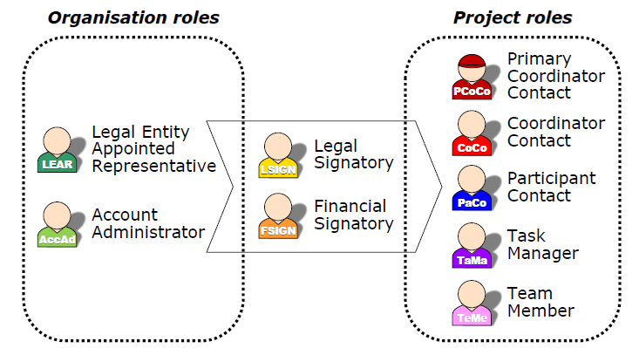
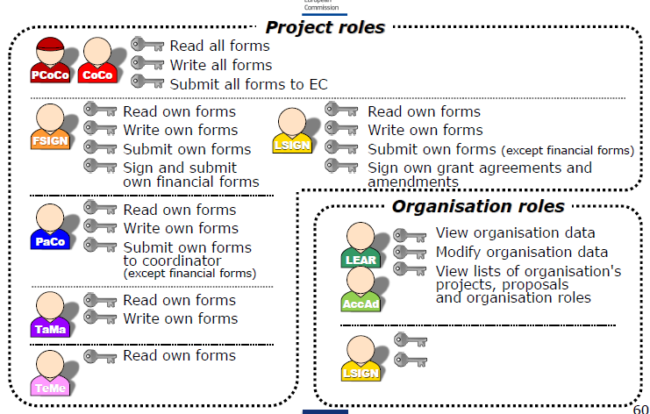
Funding and Tender Portal: Access and Roles
Access through ECAS-System (European Commission Authentication System):
  email-address is used as identification

Slide 7
(acronym) – EU’s Funding & Tender Portal
(oversiktsbilde over alle som har roller i prosjektet, hentet fra portalen)

Slide 8
Grant Agreement (GA)
GA is a contract concluded between the European Union and the beneficiary (or beneficiaries) that have been successfully evaluated in the proposal stage of Horizon 2020. Under this agreement, the beneficiary is awarded a grant and commits to a set of rights and obligations:
List of beneficiaries
Duration
Reporting periods
Maximum EU financial contribution
Pre-financing and Guarantee Fund
Bank Account
All provisions necessary for GA implementation (review, terminations,
communication, ownership, etc.)
It is always UiO as an institution who is part of the agreement. Therefore is the Grant Agreement signed on a central level. For contract draft and amendments the EU-office (FIADM) needs to be contacted.

Slide 9
Grant Agreement (GA)
Core Grant Agreement
Data sheet – summary of core information – duration, beneficiaries, budget, start date, etc.
Annexes:
Annex I – Description of the action
- Part A – structured data – Beneficiaries list, Deliverables, Milestones, Workpackages, Ethics list
- Part B – narrative part from the proposal
Annex II – Estimated budget of the action
Annex III – Accession forms
Annex IV– Model for the financial statement
Annex V and VI – not applicable for MSCA

Slide 10
Consortium Agreement (CA)
  UiO as an institution is part of the Consortium Agreement – to be signed on central level
  For negotiations, drafts or amendments, the EU-office (FIADM) needs to be contacted (eu-office@admin.uio.no).
  CA determines the relationship among the project partners
  Describes the governance of the project
  Managing of intellectual property rights and patents (IPR)
  Provides structures and solutions in case of conflicts
  Obligatory for most projects (always highly recommended)
Has to be in agreement with the Description of Action and the rest of the GA
There are different models for the Consortium Agreement. UiO prefers the DESCA model

Slide 11
Eligibility Conditions
The MSCAs identify two career stages relevant to certain schemes – depending on the individual’s career stage/status and their international mobility:
Early Stage Researcher (ESR) - Shall, at the time of recruitment by the host organisation, be in the first four years (full-time equivalent research experience) of their research careers and have not been awarded a doctoral degree.
Experienced Researcher (ER) - Must, at the date of the call deadline, be in possession of a doctoral degree or have at least four years of full-time equivalent research experience. Any parental leave periods do not count towards the time of research experience.

Slide 12
Mobility rule
In terms of the mobility rule applied, the standard condition stipulates:
“…the researcher must not have resided or carried out his/her main activity (work, studies, etc.) in the country of the beneficiary for more than 12 months in the 3 years immediately before the call deadline/reference date…”
In order for costs on a project to be eligible, researchers and other individuals on MSCA projects must meet the eligibility conditions. Eligibility conditions will also be outlined clearly in the Grant Agreement and should be noted by every project partner for all projects.

Slide 13
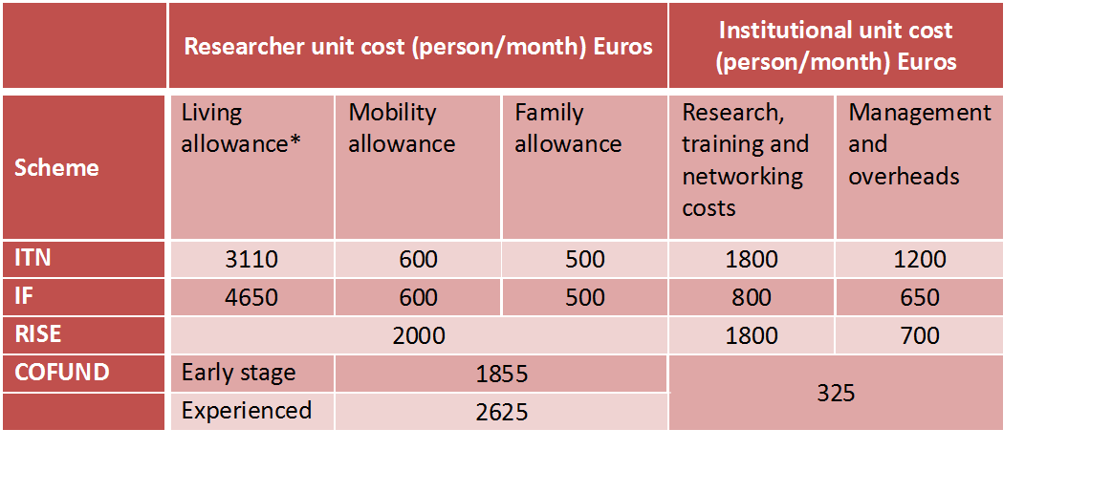
Structure of the EU contribution (MSCA 2014-2017)
* A correction co-efficient will apply to these costs (MSCA Work Programme Table 4)
For Norway applies a rate of 131.9% (2014-2017). NB. Change in MSCA WP 2018-2020!
For COFUND: Unit costs are subject to a co-funding rate of 50 % as established in the grant agreement.

Slide 14
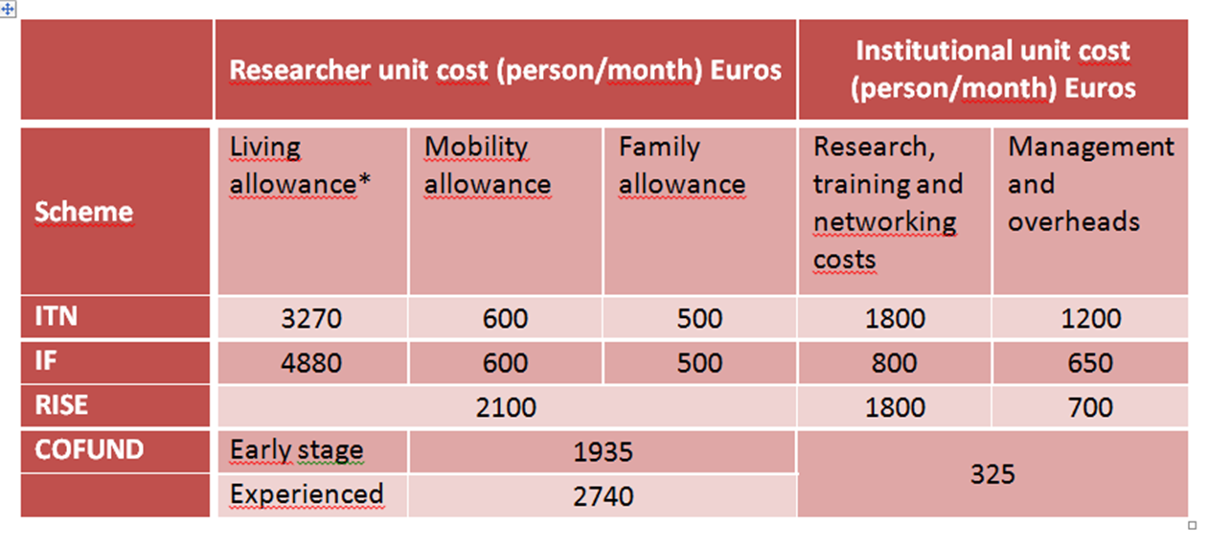
Structure of the EU contribution (MSCA 2018-2020)
* A correction co-efficient will apply to these costs (MSCA Work Programme Table 4)
For Norway applies a rate of 130,6% (2018-2020). NB. Change in MSCA WP 2018-2020!
For COFUND: Unit costs are subject to a co-funding rate of 50 % as established in the grant agreement.

Slide 15
Researcher and institutional unit costs
The EU contribution under the Marie Sklodowska-Curie Actions is based on unit costs expressed in person/months.
Unit costs are budgeted on the basis of lump sums and are reported accordingly. No real costs are reported to the REA/EU.
The cost driver is one person/month and therefore the beneficiary has to document the number of person/month worked on the project by the MSCA-researcher. Timesheets are not an obligation for Marie Curie Fellows but can be used if in line with local practices.

Slide 16
Researcher unit costs
In all cases, it is very important that the Researcher unit costs are used to the benefit of the Fellow in full.
Where these costs make up the salary of the researcher, they provide a gross figure from which statutory deductions for both the employer and employee can be made.
Standard practice is to apply a conservative exchange rate during the implementation of the project to account for currency fluctuations.
This is then followed by a corrective balancing payment to the researcher part-way through, or at the end of, the project to ensure they receive the full amount.

Slide 17
Employment at UO
All MSCA-candidates are employed under Norwegian and UiO’s normal regulations (Norwegian tariff salary and regular position categories).
All MSCA-candidates employed at UiO will receive
- Regular Employment Contract,
- Career Development Plan
- UiO MSCA Researcher Agreement
- Secondment Agreement (if applicable)
UiO wages for PHD and Post doc fellows/researchers exceeds the sum of Living and Mobility Allowance (Family allowance additional) that will be received through the fixed rates offered by the MSCA program.
The difference between the amount received from the EU and the total cost of the project will be covered by the respective department/faculty.

Slide 18
Payment
All MSCA researchers and fellows will be employed at UiO with a regular contract of employment, based on the principle that the position code and salary level should be at least equivalent to UiO colleagues at the same level.
“Living Allowance” and “Mobility Allowance” are included in the salary.
“Family Allowance” is paid as a separate monthly, taxable addition to the candidates who are entitled to this according to MSCA rules, and must be added to the contract of employment.
The obligation to contribute to social insurance and to pay taxes (health, nursing, un- employment and pension insurance) is based on relevant regulations.
If the funding from the MSCA programme related to personal benefits to researcher / fellow exceeds the contractual salary of the candidate, which is clarified in connection with final reporting, then the additional income will be transferred to the candidate as a separate payment.

Slide 19
MSCA Budget template and Salary chart
Link to UiO’s budget templates for MSCA in H2020
https://www.uio.no/for-ansatte/arbeidsstotte/okonomi/efp/soknad-og-kontrakt/budsjettering/index.html

Slide 20
Institutional Unit Cost
Research, Training and Networking Costs ITN:
Euro 1.800 per person/month for an ITN. Costs related to the training and research expenses of researchers as well as to the costs related to the transfer of knowledge and networking.
Management and Indirect Costs ITN:
Euro 1.200 per person/month for an ITN. Costs related to managing a project and, for ITN and IF, indirect costs.
Paid as a unit cost, which means that the unit cost is reported in financial statement. EU/REA does not require any specific documentation of individual costs.
Notes:
the execution of the training/partnership project (for example , etc),
the coordination between beneficiaries (for example partnership meetings, secondment of staff, etc),
the organisation of international conferences, workshops and events open to beneficiaries outside the network, including: organisational expenses (invitation of keynote speakers, publications, rental of premises, web casting) and participation fees of eligible researchers from outside the partnership.For ITN and IAPP

Slide 21
Institutional unit costs
The Institutional unit costs are directly linked to the Researcher unit costs. They can only be claimed if the host institution successfully recruits researchers in accordance with the months specified in the Grant Agreement.
The project has the flexibility to use the Institutional unit costs as they see fit to ensure the successful implementation of the project. For example, the coordinator may retain a higher proportion of the Management and Overheads budget or one organisation may have lower research costs and, therefore, receive a reduced Research, Training and Networking contribution.
All redistribution of the Institutional unit costs should be formalised in writing in the Consortium Agreement.

Slide 22
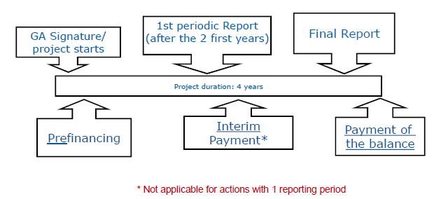
Project life cyclus: Example

Slide 23
Pre-Financing
Pre-financing of MSCA projects is limited to a maximum of 65% of the total EU contribution, 5% of which will be retained for the Guarantee Fund.
Pre-financing will normally be transferred to the Coordinator within 30 days from entry into force of the Grant Agreement or 10 days before the start date of the project.
The Coordinator can only transfer funds to beneficiaries that have already acceded to the Grant Agreement and only when the minimum number of beneficiaries has been met (normally three beneficiaries in three different EU Member States/Associate Countries).

Slide 24
Financing and reporting (1)
Through the Participant Portal ‘My Projects’ management system, MSCAs work on the basis of Continuous Reporting, i.e. information concerning the project can be added at any time throughout the duration of the project and will be consolidated at the reporting stage to help alleviate the administrative burden of bringing reports together.
Researcher Declaration needs to be uploaded within 20 days of the recruitment of the researcher.
The Researcher Declaration includes personal data of the individual (name, date of birth, nationality, gender, family status, etc.) and information related to the project allowances (start and end date of recruitment, hosting institution, etc.).

Slide 25
Periodic report
Depending on the overall lifespan of the project, beneficiaries will also be obliged to complete Periodic Reports. The schedule of reporting for each MSCA project will be detailed under Article 20 of the Grant Agreement.
Generally speaking, though not exclusively, reporting periods last 18 months.
Periodic reports are to be delivered within 60 days following the end of each reporting period
Periodic report (predefined templates in the system) includes:
  Technical report (attachment) + Continuous reporting*, including questionnaire (H2020 key indicators)
  Financial report – Individual financial statement from each Beneficiary + Periodic summary financial statement
*Continuous reporting (during whole project life cycle, whenever needed): Researcher declaration, Deliverables, Publications, Questionnaires, etc.)

Slide 26
Final report
WHEN
Within 60 days following the end of the last reporting period
WHAT
- Report covers whole project period
- Final technical report
- Final financial report (final summary financial statement created automatically by the electronic exchange system, consolidating the individual financial statements for all
reporting periods)
- To be submitted together with Periodic report for last RP
The beneficiaries are responsible for submitting a Evaluation questionnaire - at the end of a secondment/recruitment, and
a Follow-up questionnaire - two years after a secondment/recruitment.

Slide 27
Financing and reporting
Under MSCA are all costs defined as «unit cost», therefore the unit cost stated in the budget are reported in the financial statement.
Records that needs to be kept for EU audit purposes:
- Evidence of the eligibility of the fellow.
- Employment contract/agreement with the fellow.
- Proof of payment of the salary to the fellow and of the deductions for social security etc.
- Evidence that the fellow worked on the project on the beneficiary's premises: this can include lab books, conference abstracts, library records, etc.
- Timesheets are not an obligation for Marie Curie Fellows but can be used if in line with local practices.

Slide 28
Reporting - Exchange rate
Exchange rate: Average of the daily exchange rates published in the Official Journal of the EU calculated over the reporting period. Calculation shortcut: you may use the editable charts on the website of the European Central Bank at:
http://www.ecb.europa.eu/stats/exchange/eurofxref/html/index.en.html

Slide 29
Recruitment and employment
For projects with recruitment of fellows during the project duration (ITN, COFUND) beneficiaries must advertise and publish vacancies internationally and, as a minimum, they should be posted on the EURAXESS Jobs portal.
MSCA fellows must be hired on a full employment contract by the host institution (including Early Stage Researchers)
The employment contract must comply with Article 32 of the MSCA Grant Agreement, which specifies recruitment and working conditions for researchers, as well as researcher obligations, such as working exclusively on the MSCA project and submitting evaluation questionnaires.

Slide 30
Open Access
  Obligation to make sure any peer reviewed journal article which is published is openly accessible, free of charge. The open access policy can be found in the H2020 online manual
For self-archiving (‘Green’ open access), researchers can deposit the final peer-reviewed manuscript in a repository of their choice. In this case, they must ensure open access to the publication within the embargo period of six months of publication - 12 months in case of the social sciences and humanities.
Costs for publishing Open Access are eligible for reimbursement during the duration of the action as part of the Horizon 2020 grant.
UiO about Open access

Slide 31
Information on EU-funding
The Model Grant Agreement states the following:
"29.4 Information on EU-funding - Obligation and right to use the EU-emblem
Unless the Agency requests or agrees otherwise or unless it is impossible, any dissemination of results (in any form, including electronic) must:
(a) display the EU emblem and (b) include the following text:
"This project has received funding from the European Union’s Horizon 2020 research and innovation programme under the Marie Skłodowska-Curie grant agreement No [number]".
When displayed together with another logo, the EU emblem must have appropriate prominence. […]”
"29.5 Disclaimer excluding [Commission][Agency] responsibility
Any dissemination of results must indicate that it reflects only the author's view and that the Agency is not responsible for any use that may be made of the information it contains.”
Notes:
Part taken out […]: «For the purposes under this Article, the beneficiaries may use the EU emblem without first obtaining approval from the [Commission][ Agency].
This does not however give them the right to exclusive use.
Moreover, they may not appropriate the EU emblem or any similar trademark or logo, either by registration or by any other means.»

Slide 32
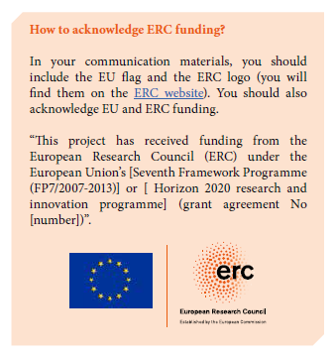
Acknowledgement of EU-funding
How to aknowledge ERC-funding
FP7 model grant agreement - communication provisions (Annex 2, section II.12 )
H2020 Communication Manual

Slide 33
Record Keeping and Audits
The European Commission may order an audit of any Horizon 2020 grant during the lifetime of the project, or at any time up to two years after the final payment. It can be a direct audit, with the Commission's own staff from the Common Audit Service (CAS), or an indirect audit, with external auditors appointed by the Commission.
The Horizon 2020 Indicative Audit Programme provides information on how audits of Horizon 2020 projects will be performed, for Marie Skłodowska-Curie Action (MSCA) projects, please see page 108.
Projects are selected at random by the CAS.

Slide 34
MSCA Audits – It’s all about Researcher Unit Costs
Audits for MSCA projects are different from other Horizon 2020 projects. When monitoring and/or auditing MSCA projects, the main concern is whether the Researcher unit costs were correctly implemented. In practice, this means auditors don’t look at actual costs.
As per art. 18 of the MSCA Annotated Model Grant Agreement, ''the beneficiary must keep adequate records and other supporting documentation to prove the number of units declared and that the costs for the recruited researchers (living allowance, mobility allowance, family allowance) have been fully incurred for the benefit of the researchers."
As previously explained, assuming the Researcher unit costs are accepted, the Institutional unit costs will be accepted without any detailed checks from the European Commission/REA.

Slide 35
MSCA audits – what do they want to know?
Since MSCA budgets are fully based on unit costs, checks focus on events and conditions triggering the reimbursement of these unit costs.
Checks concern researcher unit costs, including eligibility of the fellows involved in projects and Grant Agreement obligations (e.g. recruitment process, working conditions, access to facilities and dissemination activities).
Some auditors may want to speak to both the researchers and supervisors, either in person or via remotely. They also check promotional activities, including acknowledgment of EU funding and the EU emblem being displayed in publications and presentations.
Again, because of the unit cost model, the institutional costs are not checked.

Slide 36
Supporting documentation requested from auditors (1)
MSCA allowances payments:
  Payslips;
  CV's (Experienced Researcher or Early Stage Researcher);
  Employment contracts (signed and original);
  Bank statements
Evidence of work done on the project to demonstrate units:
  Lab book, attendance lists, conference abstract, library records, travel expenses, diplomas, publications, timesheets (not mandatory, but appreciated);
  Reports to supervisors, minutes of meetings, emails;
  For stays in another entity or secondments: copy of travel / accommodation documents and reports to supervisor

Slide 37
Supporting documentation requested from auditors (2)
Eligibility of Fellows:
  CV and copy of 1st degree certificate, doctoral degree certificate;
  Proof of dates of entry to Norway (visa, tickets, etc.);
  Proof of their residence for the 3 years before the recruitment date (e.g. residence/ID cards and/or registrations/de-registrations in previous countries; former employment contracts or course enrolment documentation);
  Specifically for the family allowance, marriage/formal relationship certificate and/or birth certificate/other evidence of having dependent children.
Recruitment under MSCA ITN:
  Copies of published adverts for the vacancy were recruited;
  A print from the EURAXESS jobs portal registration for this post – and any other international advertising;
  Copies of other CVs received;
  Explanation of the recruitment procedure to demonstrate why the specific candidate was selected.

Slide 38
Ephorte - UiOs Archive
Filed at the central level:
  Only the documents which are signed on paper:
    Consortium Agreement
Filed at the local level:
  All documents which are signed electronically through the Funding and Tender portal and others:
    Contracts – Declaration of Honour and Grant Agreement and Contract Amendments
    Scientific reports
    Financial reports
    Important emails
    Etc.

Slide 39
Innovative Training Networks (ITN) Info Day 2019
The European Commission and Research Executive Agency recently held a Coordinators' Day event for ITN submissions successful in the 2019 call providing them with useful information on the implementation of their projects.
The presentation slides from the day cover:
  Recruitment;
  Reporting;
  Finance;
  Ethics and Research Integrity;
  IP Management in Horizon 2020 (focus on MSCA);
  Open Access to Publications and Research Data;
  Communication/Outreach and Dissemination;
  ITN Best Practices;
  European Industrial Doctorates (EID); and
  European Joint Doctorate (EJD)

Slide 40
EU Research Support at UiO
EU Research Support at UiO is provided by UiO's EU-Office and advisers at the faculties and departments, who work in close collaboration to offer professional research support on Horizon 2020.
Contact UiO's EU-office and/or you local support unit if:
  You have questions related to all aspects of EU-funded activities at UiO.
  you would like to discuss opportunities for H2020-funded support to one or more fields/research groups
  you need help and advice on how to find or understand H2020 documents and/or calls
  you wish to develop/participate in a project under H2020 as a coordinator or a partner
  you need advice or guidance on other EU funded initiatives
Contact EU Research Support at UiO

Slide 41
More information
H2020 Online Manual http://ec.europa.eu/research/participants/docs/h2020-funding-guide/index_en.htm
MSCA Page http://ec.europa.eu/programmes/horizon2020/en/h2020-section/marie-sklodowska-curie-actions
How to manage your MSCA project https://ec.europa.eu/research/mariecurieactions/how-to/manage-your-project_en
European IPR Helpdesk Fact Sheet on IP management in Horizon 2020 MSCA
http://iprhelpdesk.eu/Fact-Sheet-IP-Management-in-H2020-MSCAs
EURAXESS https://www.euraxess.no/
UiOs nettsider om MSCA https://www.uio.no/english/for-employees/support/research/funding/eu-funding/how-to/MSCA%20how%20to/

