Slide 1
UiO EU-office 2021
Introduction to your EU-project at UiO - ERC

Slide 2
(Acronym) – Grant Data
(data hentes fra portalen)
Call:
Type of Action: ERC grants
Acronym:
Current Phase: Number:
Duration:
GA based on the:
Start Date:
Estimated Project Cost:
Requested EU Contribution:
Contact: (project officer)

Slide 3
Agenda
Funding & tender opportunities
Grant Agreement
Employment
Financial Issues
Reporting
Budget
Payments
Audit
EU research support at UiO

Slide 4
Funding & tender opportunities ‘My Projects’
H2020 management and implementation will be carried out from start to finish through the Funding & tender opportunities (Participant Portal)
All ongoing projects are available to individuals through their ‘EU Log-in’ (previously European Commission Authentication Service (ECAS)) profile under ‘My Projects’ > ‘My Area’ which becomes visible after logging in.
Comprehensive guidance concerning the management of projects is available in the Online Manual.

Slide 5
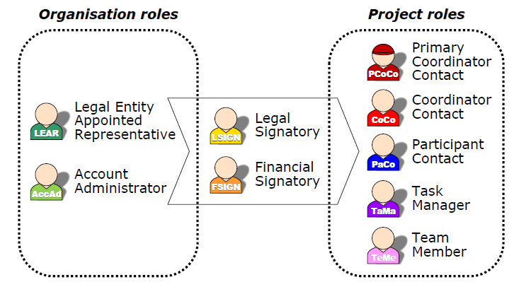
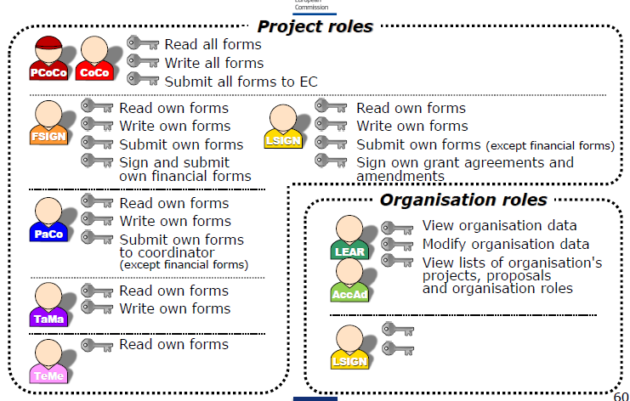
Funding & tender opportunities: Access and Roles
Access through ECAS-System (European Commission Authentication System):
  email-address is used as identification

Slide 6
(acronym) – EU’s Funding & Tender Portal
(oversiktsbilde over alle som har roller i prosjektet, hentet fra portalen)

Slide 7
Contract – Grant Agreement
The Grant Agreement is always signed by UiO represented by the appointed Legal Signatory (LSIGN). Also contract amendments must be signed by LSIGN, please contact the UiO EU-office (FIADM).
Function of the contract
  The contract specifies all rights and obligations of the partners.
  The contract presents predictability and solutions in case of conflicts.
  The contract is a steering tool for the partners
    Is to be used actively during the whole project period
    Defines deliverables
    States project number, project type, budget, reporting periods, regulations etc.
  The annotated version of the Model Grant Agreement explains and illustrates the legal text

Slide 8
Contract – Grant Agreement
The Agreement is composed of:
  Terms and Conditions
    General and specific data and regulations with regard to the project
  Annex 1 Description of the action (DoA)
    Based on the project proposal
  Annex 2 Estimated budget for the action
  Annex 3 Accession Form
    Signed by the partners to participate in the project
  Annex 4 Model for the financial statements
    Example for Form C – the financial reporting
  Annex 5 Model for the certificate on the financial statements
    Basis for the Audit Report
  Annex 6 Model for the certificate on the methodology
    Not applicable for UiO

Slide 9
Chapter 1: General
Chapter 2: Action
Chapter 3: Grant
Single article: subject of the agreement
Chapter 4: Rights and obligations
Action, duration and budget
Amount, reimbursement rates, eligible costs
Chapter 5: Division of roles
To implement the action: resources, in-kind contributions, subcontracts
Grant administration: reporting, payments, audits
Background and results: access rights, protection of results, exploitation, dissemination
Others: gender equality, ethics, confidentiality
Roles and responsibilities, internal arrangements
Chapter 6: Rejection, reduction, penalties, termination, etc.
Chapter 7: Final provisions
Rejection, reduction, recovery and penalties
Suspension and termination of the action
Accession, entry into force, amendments, applicable law
H2020 Grant Agreement
Disclaimer: Information not legally binding

Slide 10
ERC Specific:
Supplementary Agreement
Supplementary Agreement between Host Institution/Beneficiary (HI) UiO and the Principal Investigator (PI)
Model Supplementary Agreement H2020
UiO has established a Supplementary Agreement with specific additions to be used at UiO
The Supplementary Agreement is signed by UiO represented by the appointed Legal Signatory (LSIGN) and the PI
Notes:
The Supplementary Agreeement needs to be signed on paper in three copies – one for the Commission’s Project Officer, one for grant holder and one for the Beneficiary institution (UiO). The supplementary Agreement can not be submitted though the Participant Portal, but must be sent separately to Project Officer

Slide 11
Financial Issues –
Direct Costs and Indirect Costs
The funding rate for ERC-projects is 100 % of the eligible direct costs
Direct costs are specific costs directly linked to the work done in the project – such as personnel costs, travel costs, equipment bought for the project, subcontracting
Indirect costs (overhead) will be covered by a uniform 25% flat-rate of your eligible direct costs
Typical indirect costs are telephone charges & photocopies, rent, heating, electricity, PCs, laptops, office software etc

Slide 12
Financial Issues –
Eligible Direct Costs
Eligible direct costs must be generated by the implementation of the action
In order to be eligible the project costs must be:
  incurred by the beneficiary (actual)
  incurred directly in connection with the action
  incurred during the project duration
  identifiable & verifiable in the beneficiary’s accounts
  compliant with national law and the beneficiary's usual accounting principles
  reasonable, justified, in accordance with sound financial management (economy & efficiency)
  indicated in the budget
In Horizon 2020 value added tax is an eligible cost for beneficiaries who cannot claim refund for VAT from other sources. This accounts for UiO.

Slide 13
Financial Issues – Non-Eligible Costs
Non-eligible Costs
  Costs not related to the action or costs paid by another source
  Interests and related costs, including exchange losses and debt or service charges
  National charges like customs duty, indirect taxes
  Unnecessary and excessive expenses

Slide 14
Financial Issues – Cost Categories
Personell costs
Other direct costs
  Equipment
  Travel
  Other direct costs
Subcontracting

Slide 15
Employment and Time recording
The usual rules for employment at UiO are applied
No time records necessary for researchers working exclusively on the project, instead they need to sign a “Declaration on person”. However, this is just valid for individuals who work on the action for a full reporting period. Persons who start working exclusively on an action after the beginning of the reporting period are required to provide time records.
Individuals who do not work exclusively on the project need to keep time records for the time worked on the project
Note that for ERC, PI needs to present recording of all hours granted to the ERC-project as stated in GA, even if parts of these working hours are paid from other sources

Slide 16
Time sheets
Time sheets need to contain the following information:
  Title and number of the action, as specified in the GA
  Beneficiary's full name, as specified in the GA
  Full name, date and signature of the person working on the action
  Number of hours per day declared for the action
  Supervisor’s full name and signature
  Reference to the action tasks and work package described in annex 1, to easily verify that the work carried out matches the work assigned
  Description of the activities performed to show what work was carried out
It is highly advised to prepare time sheets on regular basis
Link to UiO’s approved templates for timesheets

Slide 17
UiOs retningslinjer for rapportering av lønnskostnader til EU
Alle personalkostnadene som rapporteres i Financial Statement skal være basert på beregnet timepris – også for fulltidsansatte som ikke fører timelister
Beregning av timepris skal ta utgangspunkt i siste avsluttede regnskapsår
Deler av lønnen som betales en gang i året (for eksempel feriepenger) tas med i beregningen i det året hvor de er regnskapsført.
Rapporteres lønn for deler av regnskapsåret må timeprisen beregnes med utgangspunkt i fjorårets lønnskostnader for den ansatte. Har vedkommende ikke vært ansatt foregående år brukes inneværende år for beregning av timepris.
UiOs mal for Lønnsavregning i H2020

Slide 18
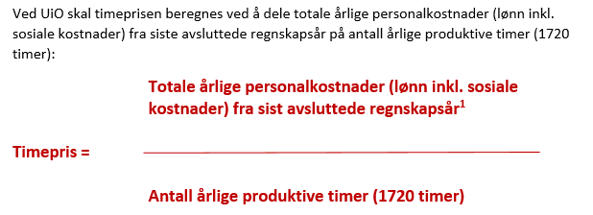
Beregning av timepris

Slide 19
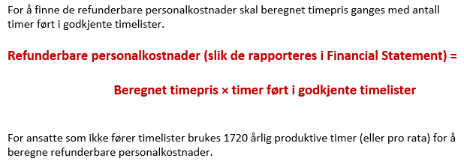
Beregning av refusjon av personalkostnader fra EU

Slide 20
Costs for equipment
UiO’s guidelines and system for procurement have to be followed
Costs are depreciated with regard to UiO’s usual practice
Only costs depreciated during the project period can be reported to the European Commission

Slide 21
Other direct costs
Other direct costs – such as costs for publications, travel, consumables
  Travel costs:
  Travel costs have to be directly linked to the objectives of the project. For example, to be able to travel to a conference, the participant must give a presentation or present a poster and document linked to the project.
  Documentation: travel expense invoice (reiseregningen) with all documentation, objective of the travel, proof of the relationship with the project (program, invitation, participant list, etc.)
  Meals:
  Costs for dinner/ meals is in general not covered. The only exception is meals served as an integrated part of an event/ conference.
  Documentation: the program and participant list of the event.

Slide 22
Subcontracting
  Only allowed for special tasks defined in Annex 1 (DoA) and needs to be presented in the budget for the action
  Subcontractors have to be chosen based on ”Best value for money” and need to follow the standard tendering procedures (UiO’s usual practice on procurement)
  Examples: Translations, websites, analysis
  The amount spent on ”subcontracting” is excluded from the calculation of indirect costs

Slide 23
Reporting
Scientific and financial reporting follow different schedules:
  Two scientific reports during the lifetime of the project – after 2,5 years and at the end of project. The reports should cover:
    Publishable summary
    Project objectives for the period
    Work progress and achievements during the period
    Deliverables and milestones tables
  Four administrative / financial reports – every 18 months. The reports should cover:
    Project Management
    Explanation of the use of the resources
    Financial statements
    Certificates

Slide 24
Payments
 |  |  |  |  |  |  | Time-to-Pay | From
One Pre-financing |  |  |  |  |  |  | 30 days | The latest between starting date and entry into force
 | → Retention 5 % of maximum grant for the Guarantee Fund
Interim Payments |  |  |  |  |  |  | 90 days | From reception of periodic report
 | → Based on financial statements (EU contribution= eligible costs approved * reimbursement rate)
 | → Limit = 90 % of the maximum grant (Retention 10%)
Payment of the Balance |  |  |  |  |  |  | 90 days | From reception of final reports

Slide 25
Financial Statement
The layout of the Financial Statement corresponds to the layout of the budget
Average of the daily exchange rates published in the Official Journal of the EU calculated over the reporting period. Use the editable charts on the website of the European Central Bank
The reported figures in Financial Statement have to correspond to the figures in UiO’s project accounts
In addition to the Financial Statement the beneficiary shall provide an overview of personnel with regard to work packages, a list of all travels, a list of all publications etc

Slide 26
Audit – Certificate on financial statements
At UiO the Internal Audit Unit (Intern revisjon) carries out the Certificate on financial statements
Only for final reports when total EU contribution claimed by the beneficiary on the basis of actual costs + unit costs for average personnel ≥ EUR 325.000 (excluding e.g. flat rates / indirect costs !)
The Department should contact the Internal Audit Unit for an appointment at least 3 weeks before reporting deadline
The documentation for the audit includes the contract, work contracts, invoices, depreciation plans, timesheets, etc.
The project is responsible for providing the needed documentation and that the project is in compliance with the rules
In addition the European Commission can conduct Audits at any time up to two years after final payment

Slide 27
Open Access
  ERC Management - Open Access Since its creation, the ERC has been supporting the principle of open access to the published output of research as a fundamental part of its mission. It also promotes the basic principle of open access to research data.
  Obligation to make sure any peer reviewed journal article which is published is openly accessible, free of charge.
For self-archiving (‘Green’ open access), researchers can deposit the final peer-reviewed manuscript in a repository of their choice. In this case, they must ensure open access to the publication within the embargo period of six months of publication - 12 months in case of the social sciences and humanities.
Costs for publishing Open Access are eligible for reimbursement during the duration of the action as part of the Horizon 2020 grant.
UiO’s Open Access policy

Slide 28
ERC on Open Access
requests that an electronic copy of any research article, monograph or other research publication that is supported in whole by ERC funding be deposited in a suitable repository immediately upon publication.
Open access should be provided as soon as possible and in any case no later than six months after the official publication date. For publications in the Social Sciences and Humanities domain a delay of up to twelve months is acceptable.
strongly encourages ERC funded researchers to use discipline-specific repositories for their publications. If there is no appropriate discipline specific repository, researchers should make their publications available in institutional repositories or in centralized ones, such as Zenodo1 or at UiO DUO.
reminds ERC funded researchers that open access fees are eligible costs that can be charged against ERC grants, provided they are incurred during the duration of the project.
asks Host Institutions to cover open access fees of any research publications supported in whole, or in part, by ERC funding, arising after the end of the project.

Slide 29

ERC on Research data management and sharing
recommends to all its funded researchers that they follow best practice by retaining files of all the research data they have produced and used during the course of their work, and that they be prepared to share these data with other researchers whenever they are not bound by copyright restrictions, confidentiality requirements, or contractual clauses.
The European Research Council considers that, given the fast evolving practices in this area and the extreme diversity of situations, as well as the different approaches in different disciplines, it would be premature at this time to ask ERC funded researchers to make a binding commitment to open research data right at the start of their project.
Nevertheless, the ERC continues to strongly encourage all ERC funded researchers to seek to establish and practice good research data management in accordance with the current best practices in their respective fields and to share their data with other researchers in a responsible way.
Source
Contact at UiO: research-data@uio.no
UiO’s Policies and guidelines for research data management

Slide 30
Communicating your research
Communicate on your research and results
Report back to the Agency on your outreach activities
Give visibility to ERC /EU funding by using its visual identity
Acknowledge the ERC funding in all your communication supports and activities
Contact the Agency if you are planning communication activities that could have a major media impact (compulsory for Horizon 2020 beneficiaries)
ERC on communication and outreach activities

Slide 31
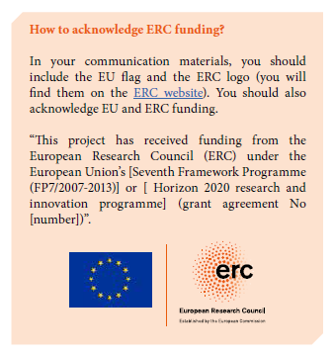
Acknowledgement of EU-funding
How to aknowledge ERC-funding
FP7 model grant agreement - communication provisions (Annex 2, section II.12 )
H2020 Communication Manual

Slide 32
Aknowledgement of EU-funding
The Model Grant Agreement states the following:
"29.4 Information on EU-funding. Obligation and right to use the EU-emblem
Unless the [Commission][Agency]requests or agrees otherwise or unless it is unpossible, any dissemination of results (in any form, including electronic) must:
(a) display the EU emblem and (b) include the following text:
"This project has received funding from the [European Union's Horizon 2020 research and innovation programme][Euratom research and trainingprogramme 2014-2018] under grant agreement No [Number]".
When displayed together with another logo, the EU emblem must have appropriate prominence. […]"
"29.5 Disclaimer excluding [Commission][Agency] responsibility
Any dissemination of results must indicate that it reflects only the author's view and that the [Commission ][Agency] is not responsible for any use that may be made of the information it contains."

Slide 33
Key messages
Comply with H2020 rules/own HI rules/procedures
Consider periodic CFS for assurance (one final invoice)
Only indicate the reality in timesheets
Avoid excessive and uneconomic costs
Avoid unnecessary purchases in the last few months/weeks of the project just to consume budget
Ensure visibility of H2020 financing
Avoid situations of conflict of interest
Prepare thoroughly for an audit + don't sit on a problem and wait for an audit to detect – seek our help/advice!

Slide 34
There is further information on the ERC website in their
Frequently Asked Questions section

Slide 35
Archiving routines at UiO
Filed at the central level:
Only legal documents signed on paper:
    Supplementary Agreement
Filed at the local level:
All documents signed electronically through the Particpant Portal, as well as project related communication:
    Declaration of Honour
    Grant Agreement
    Contract Amendments
    Scientific reports
    Financial reports – Financial statements
    Certificate of the financial statements
    Important e-mails, etc

Slide 36
EU Research Support at UiO
EU Research Support at UiO is provided by UiO's EU-Office and advisers at the faculties and departments, who work in close collaboration to offer professional research support on Horizon 2020.
Contact UiO's EU-office and/or you local support unit if:
  You have questions related to all aspects of EU-funded activities at UiO.
  you would like to discuss opportunities for H2020-funded support to one or more fields/research groups
  you need help and advice on how to find or understand H2020 documents and/or calls
  you wish to develop/participate in a project under H2020 as a coordinator or a partner
  you need advice or guidance on other EU funded initiatives
Contact EU Research Support at UiO

Slide 37
EU Research Support at UiO
HORIZON 2020: EU Research Funding: This page provides information about EU funding possibilities. Check funding schemes and find your call. Realize your research ideas step by step through the process from application to closing of the project. Find facts and success stories about EU funding at UiO, and get inspired. Learn who you can contact for help.
How to apply for, negotiate and manage Horizon 2020 projects: Here you will find information about all stages of a Horizon 2020 projects's life cycle; from how to get started through application process, contractional phase and managing and finalizing the project.

